Slide 2
Brian Sheehan, City of Rushville Director of Special Projects

Slide 3
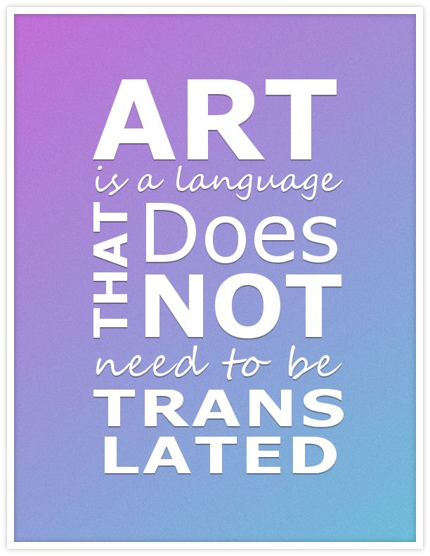

Slide 5
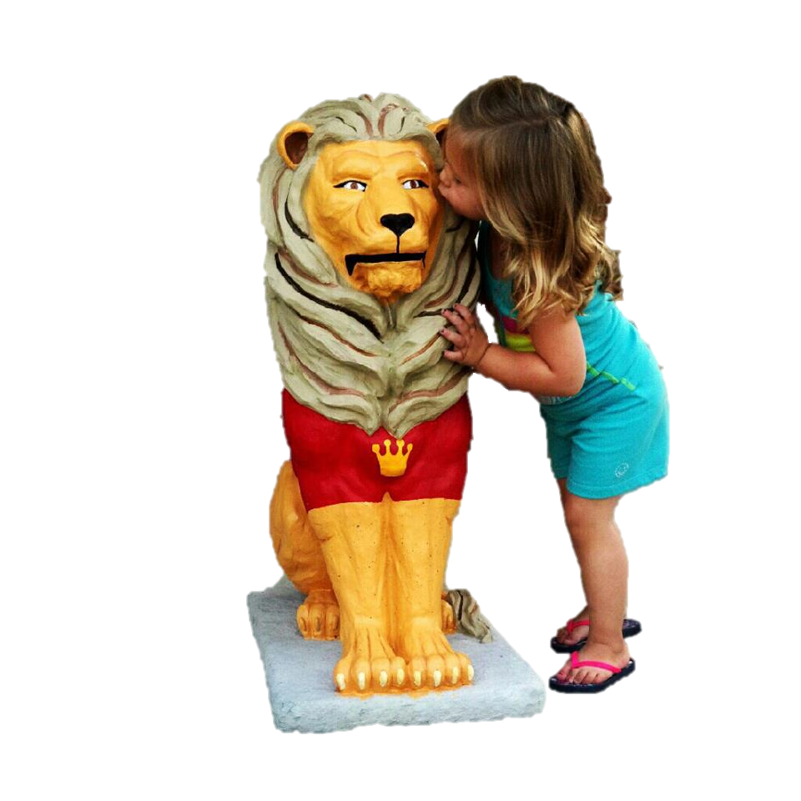

Slide 6
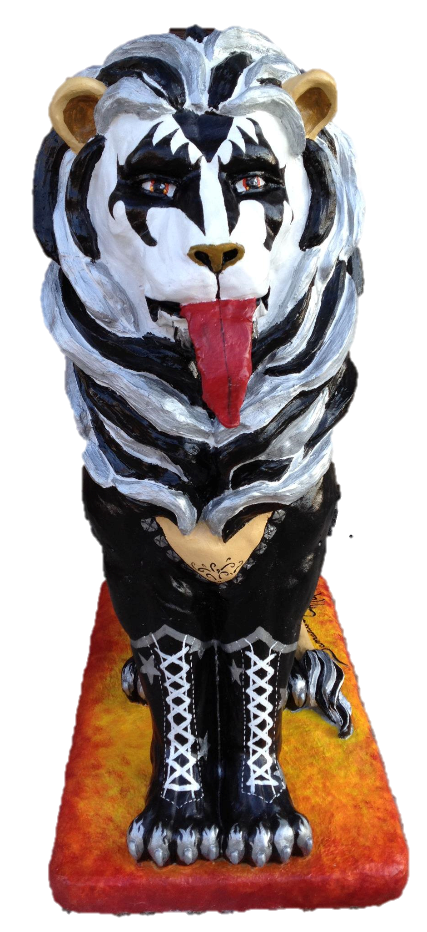
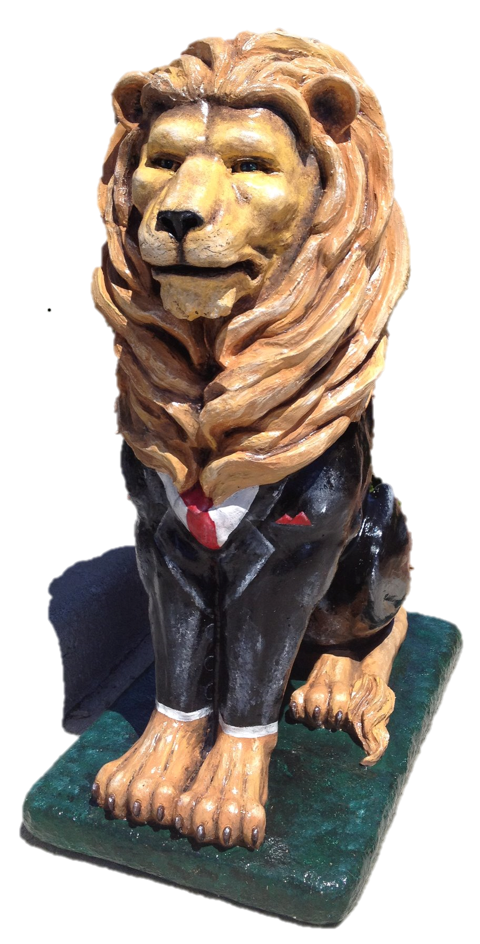

Slide 7
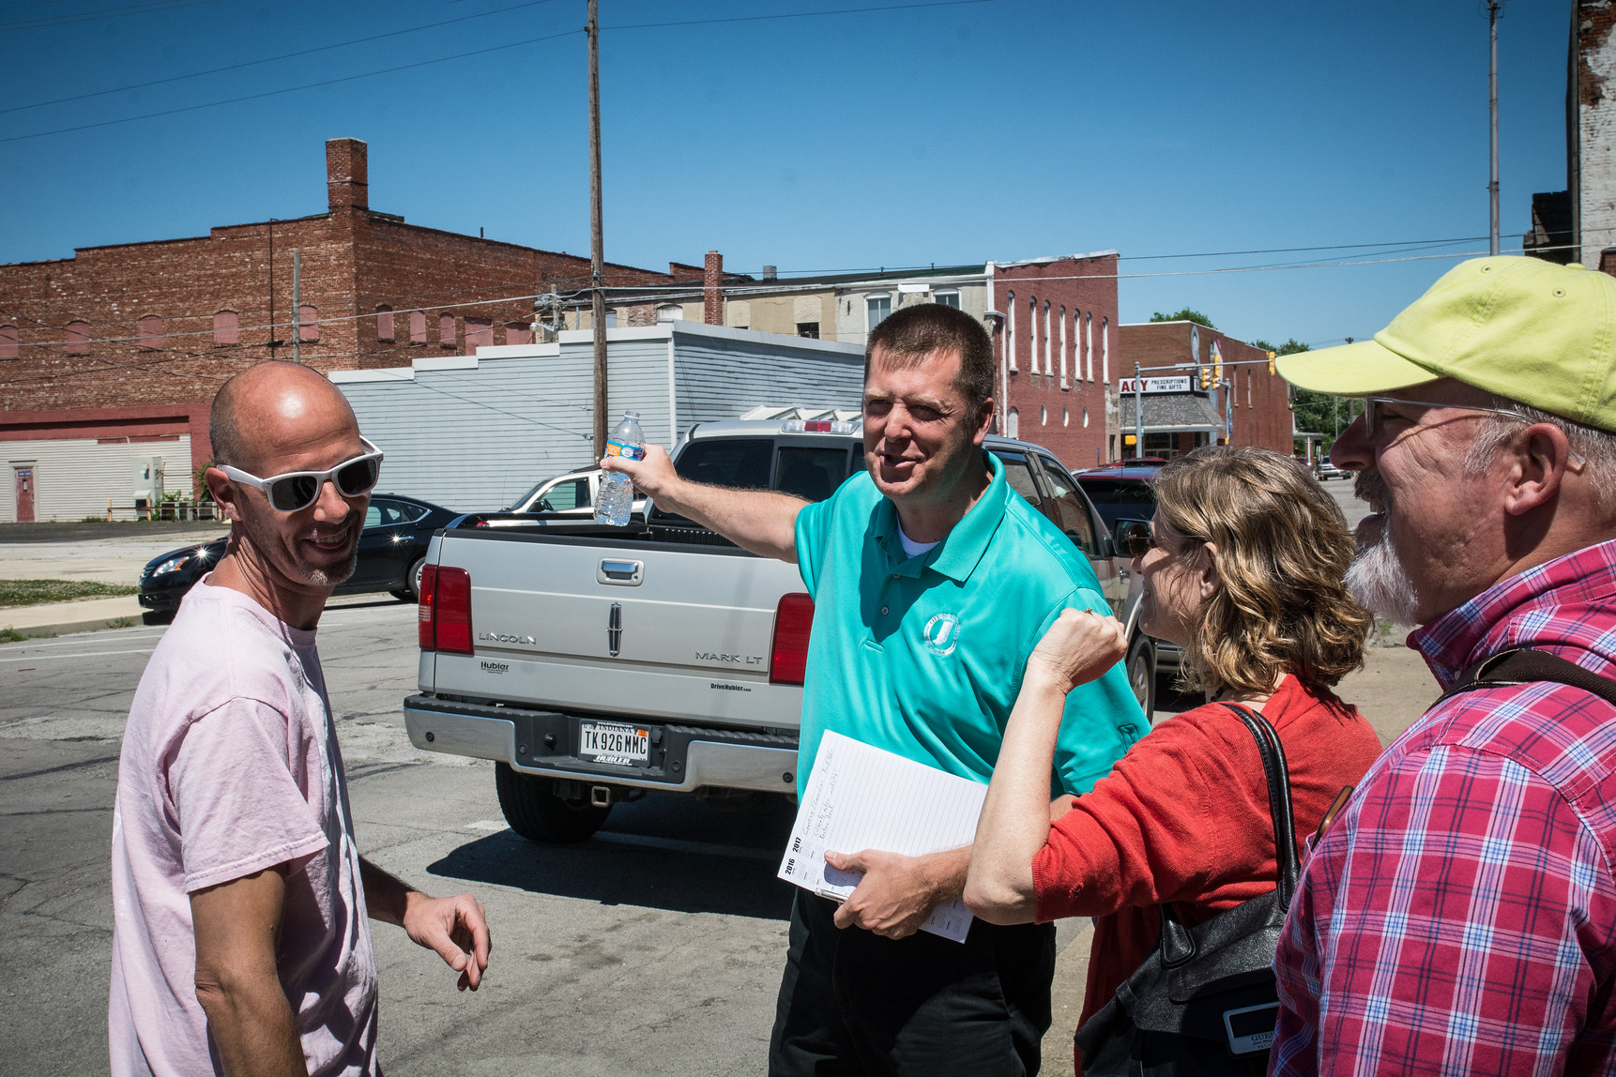

Slide 8
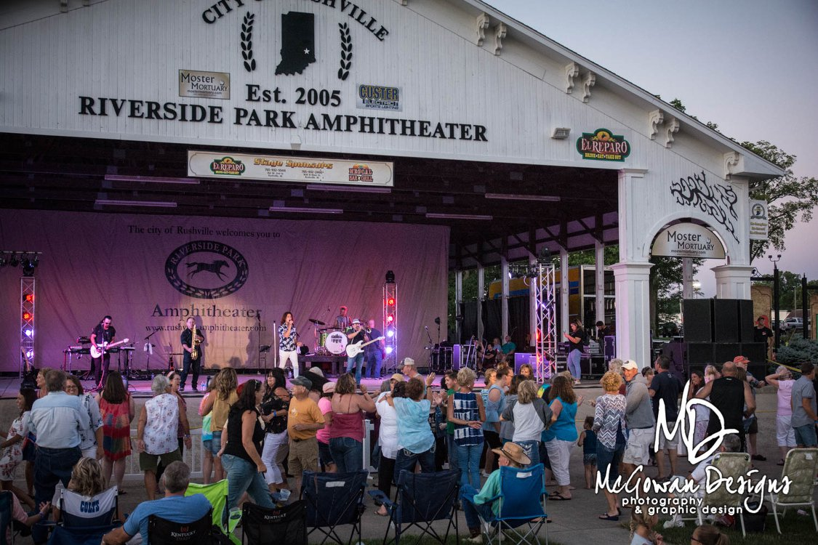
!

Slide 9
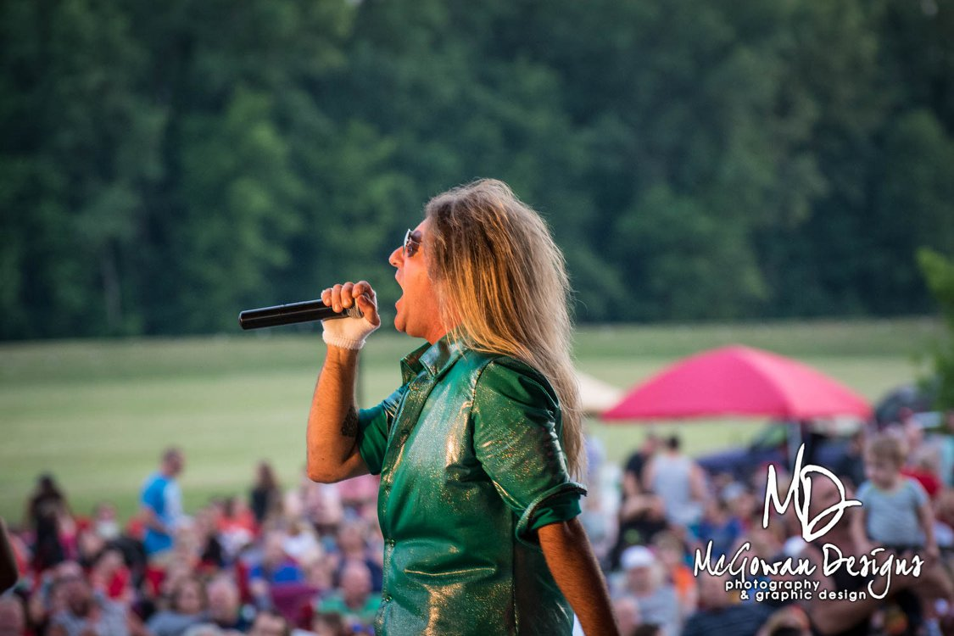
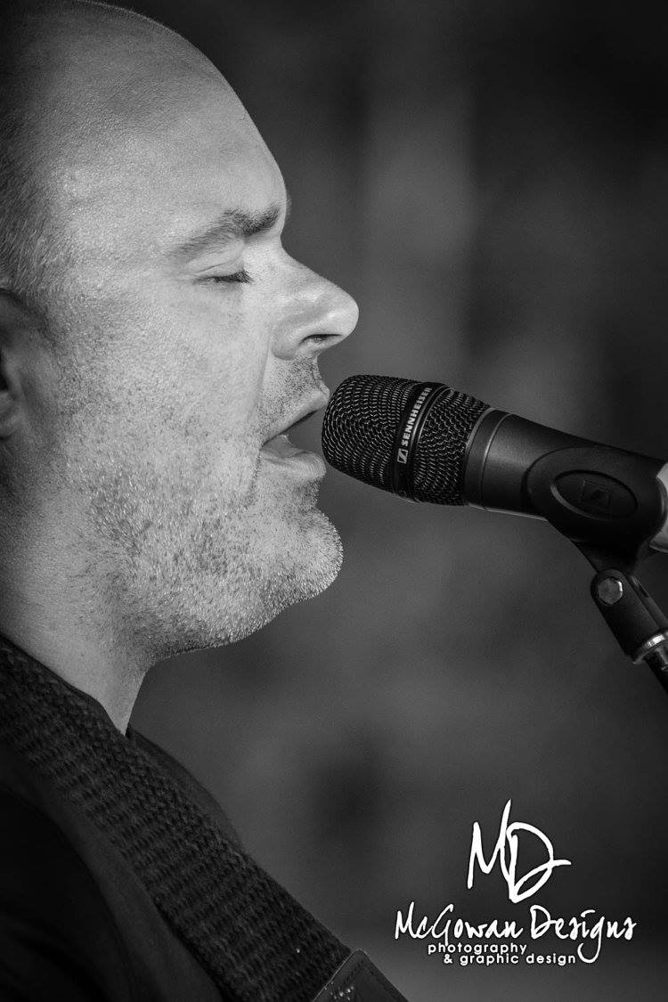
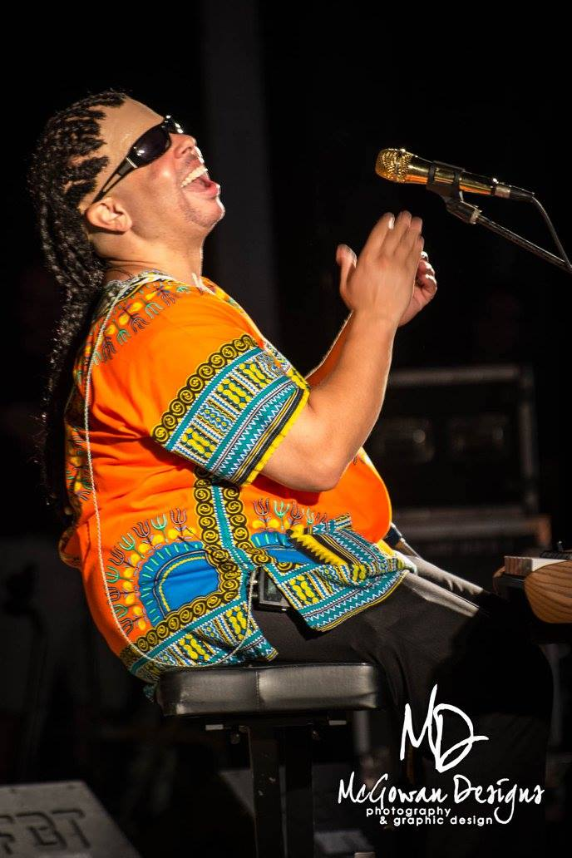
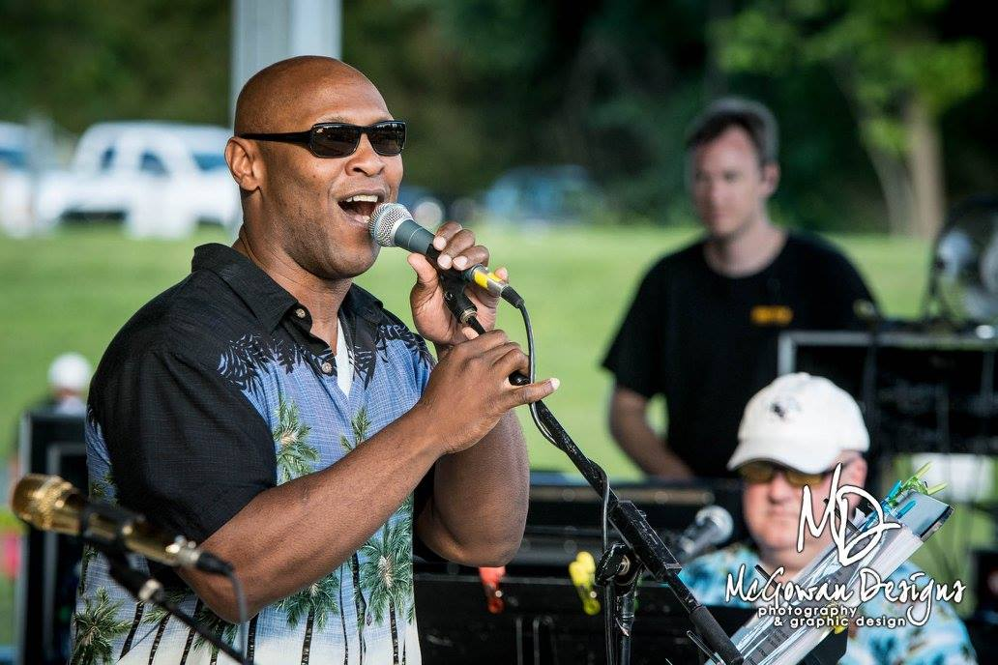

Slide 10
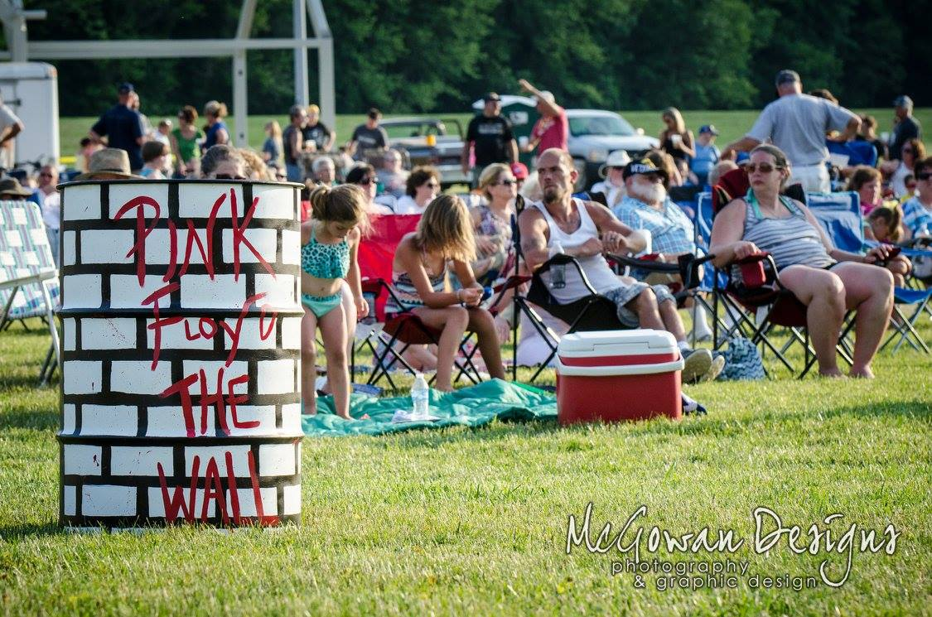
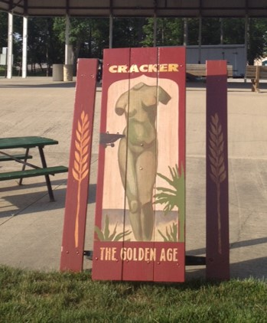
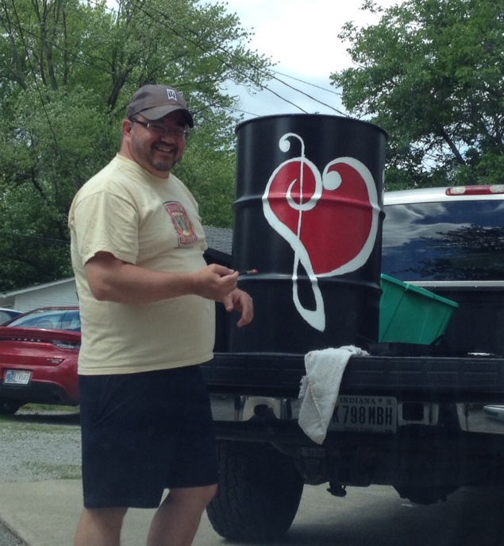
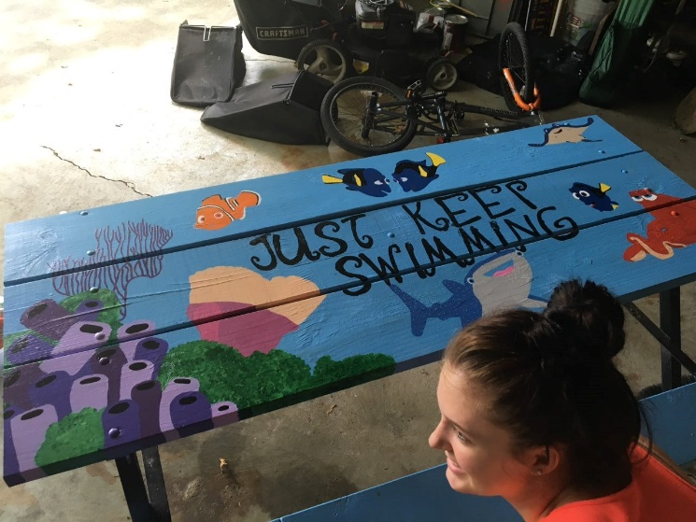

Slide 11
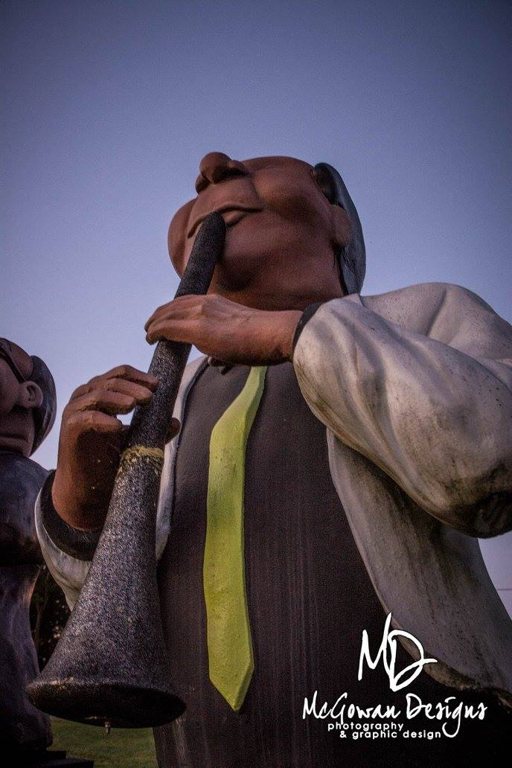
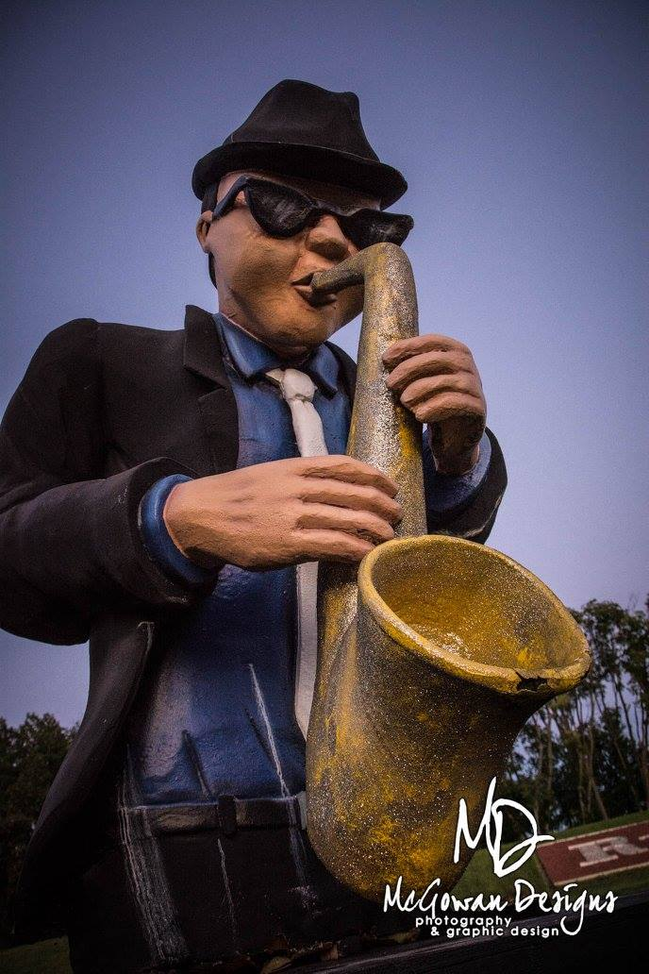
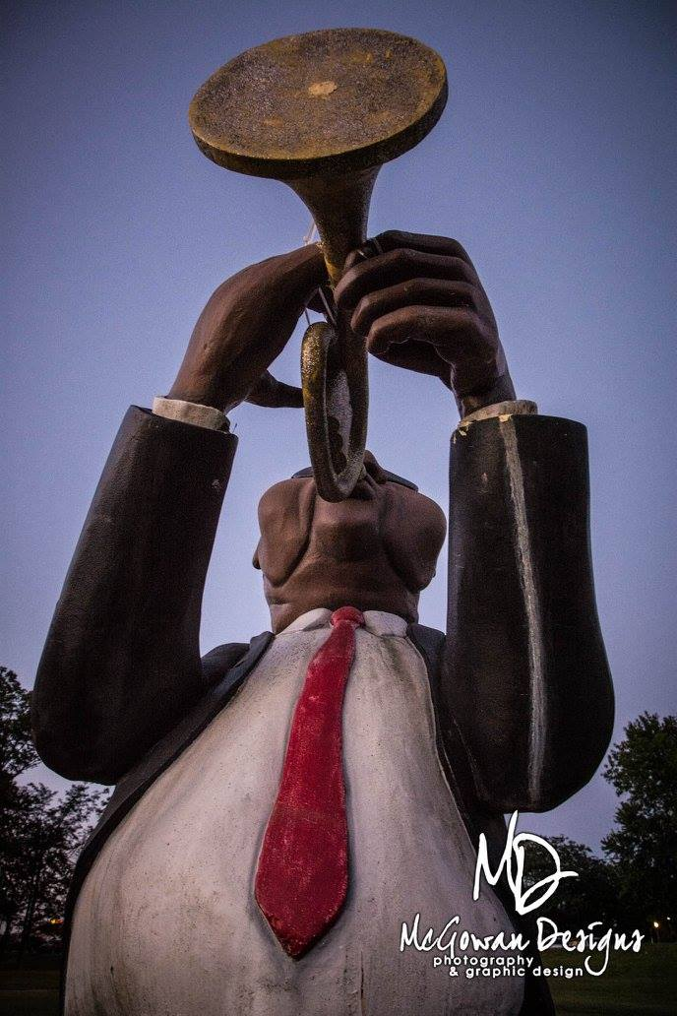

Slide 12
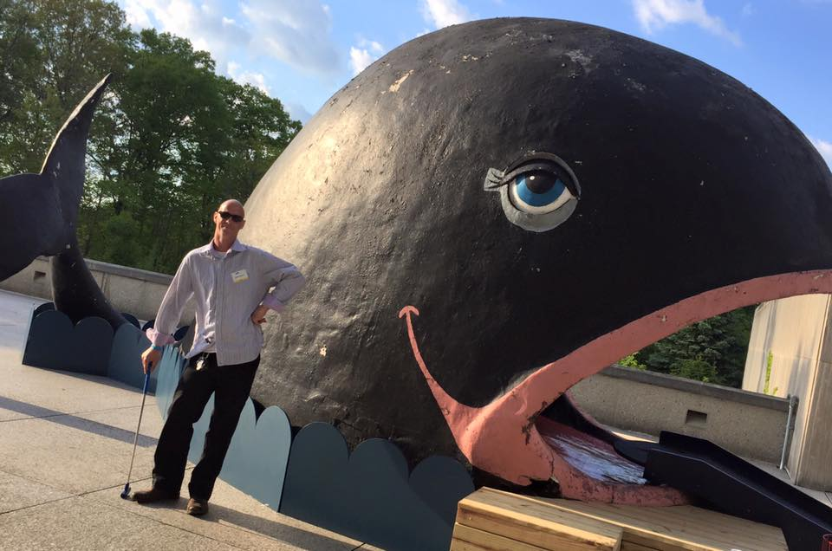

Slide 13
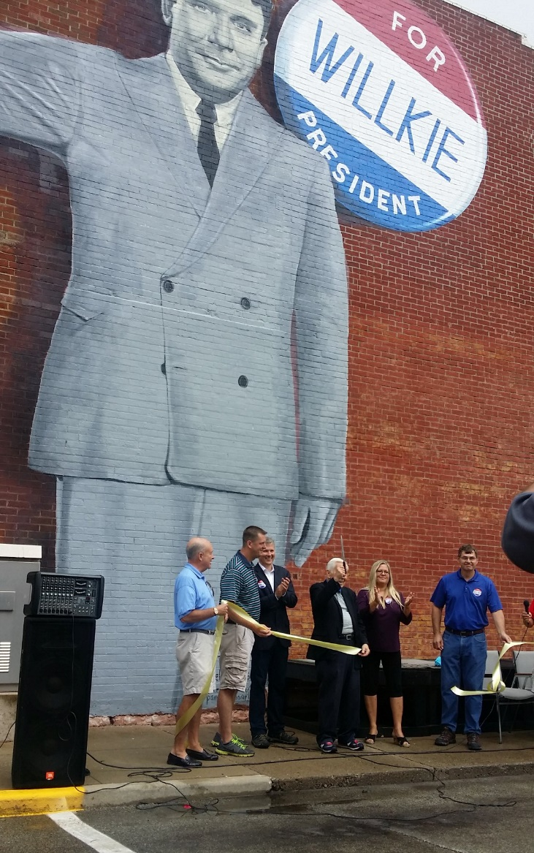
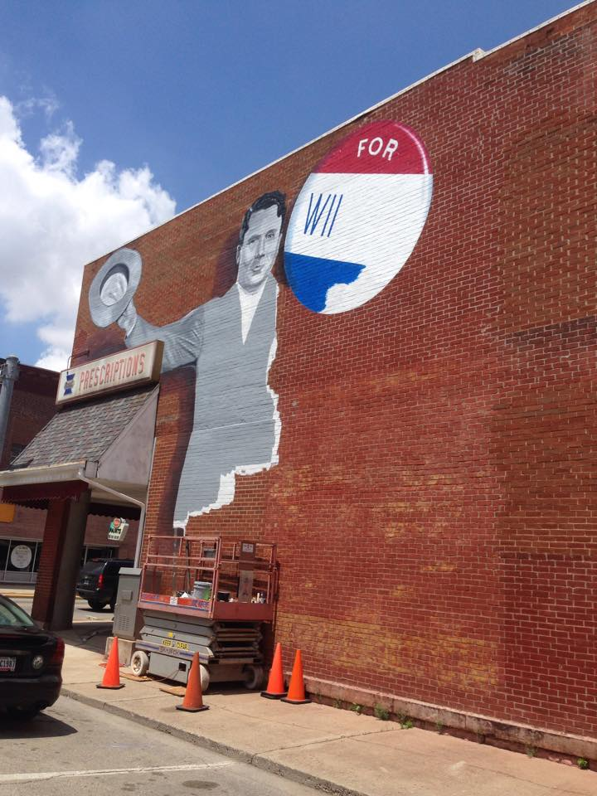

Slide 14
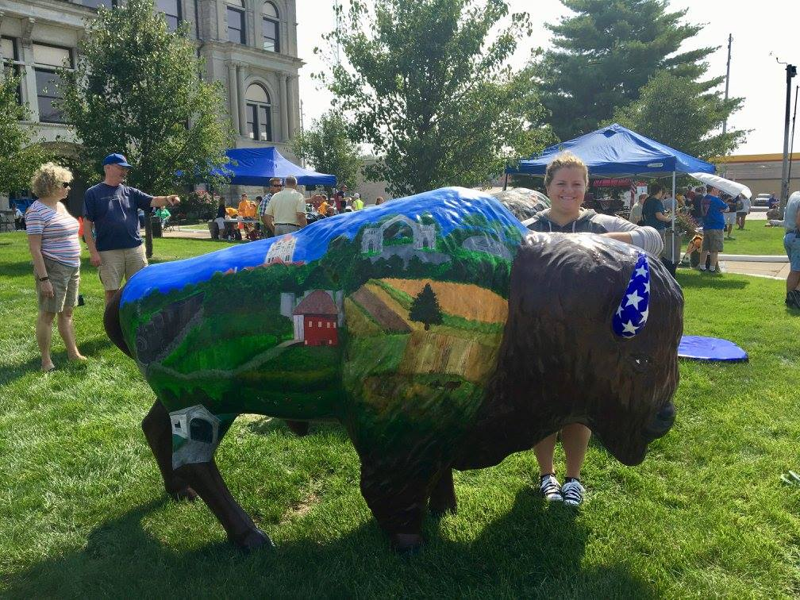
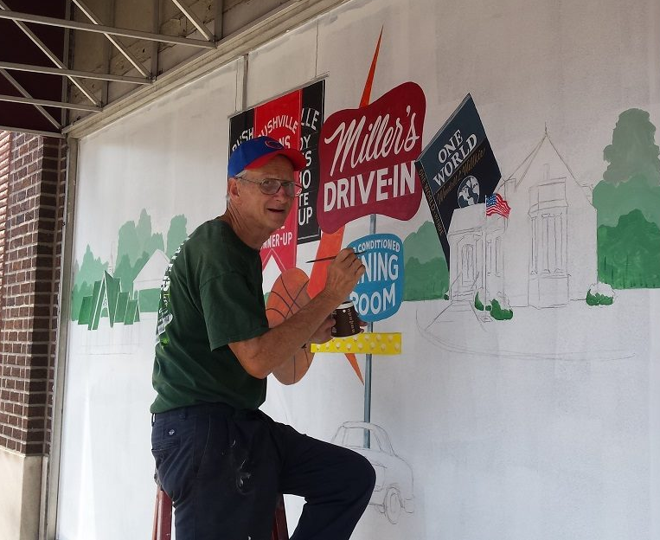
+

Slide 15
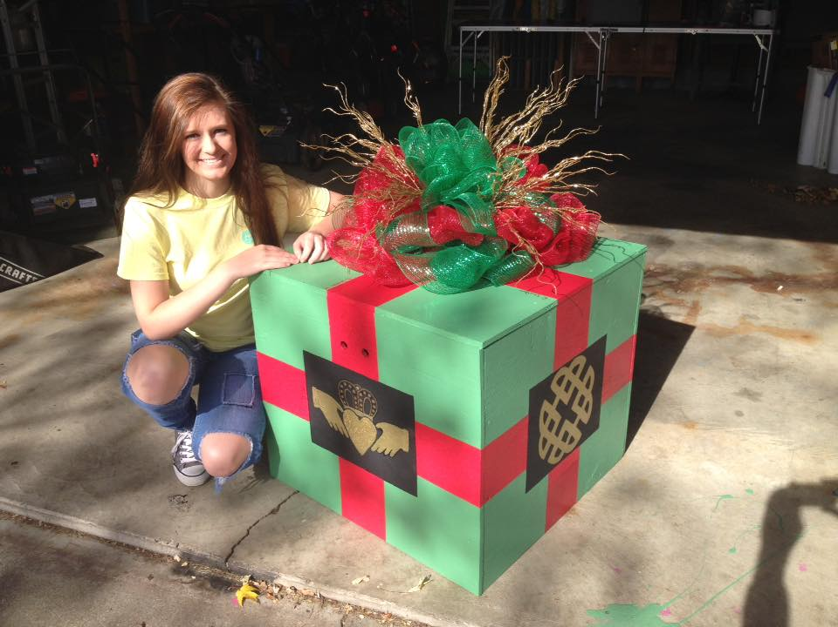
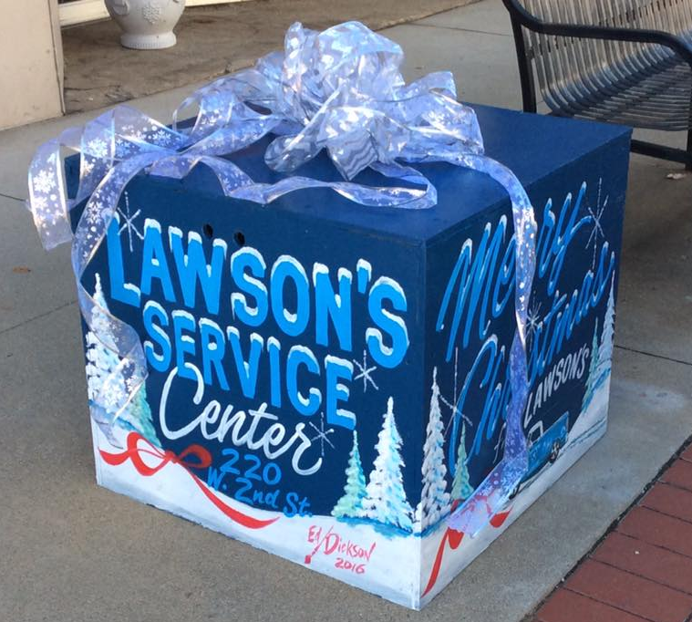

Slide 16
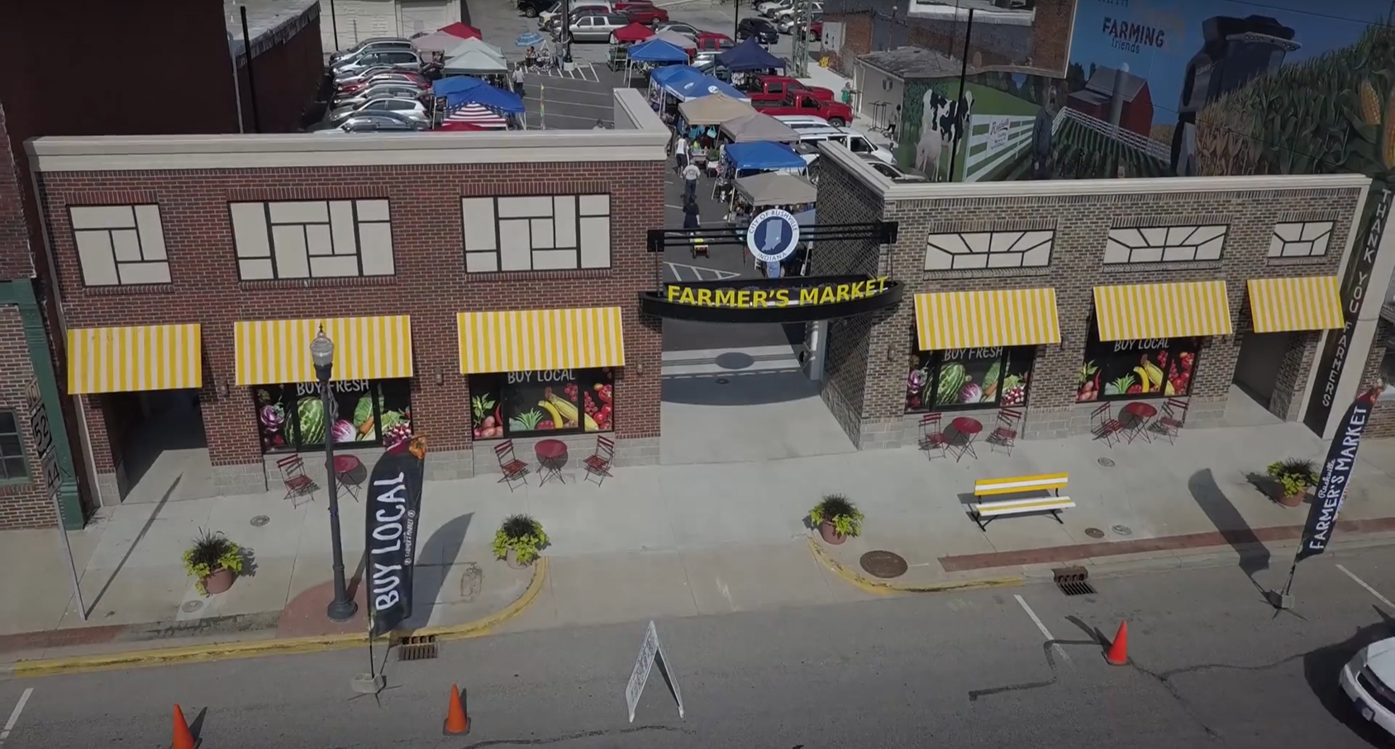
‘
&

Slide 17
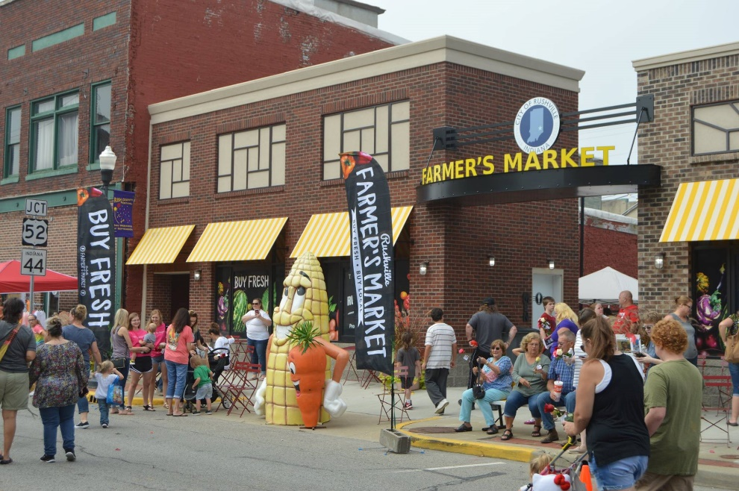
‘
&

Slide 18
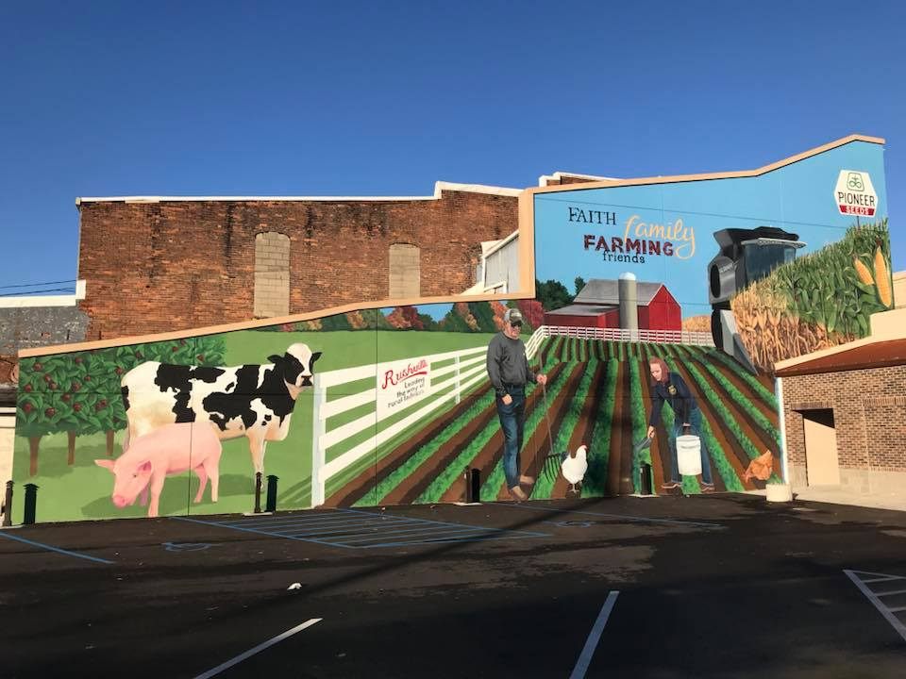
‘
&

Slide 19
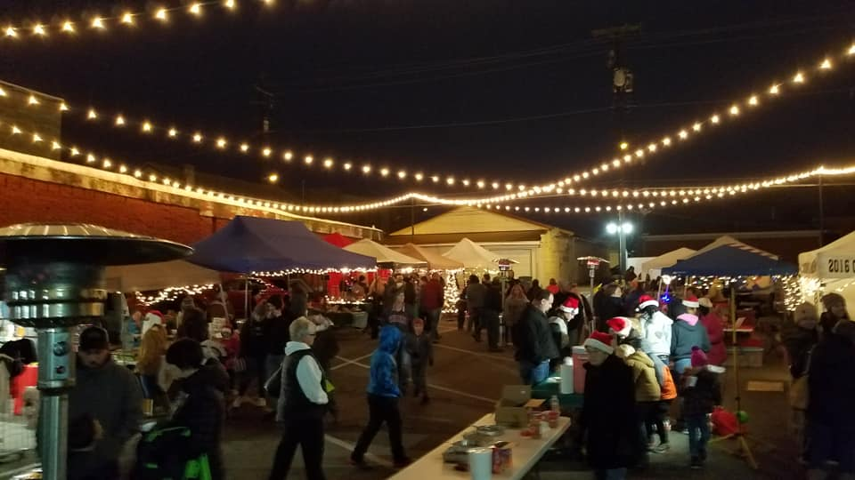
‘
&

Slide 20
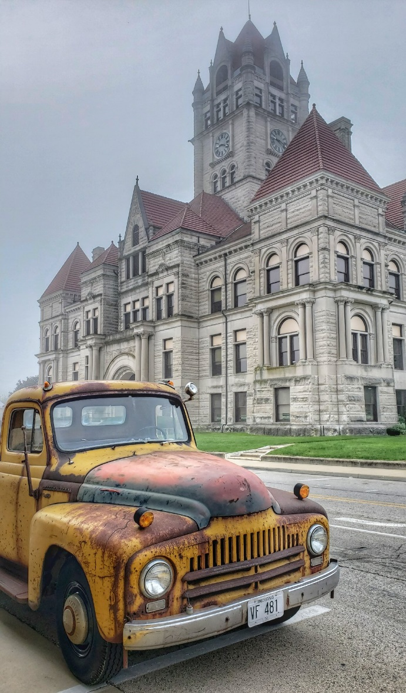

Slide 21
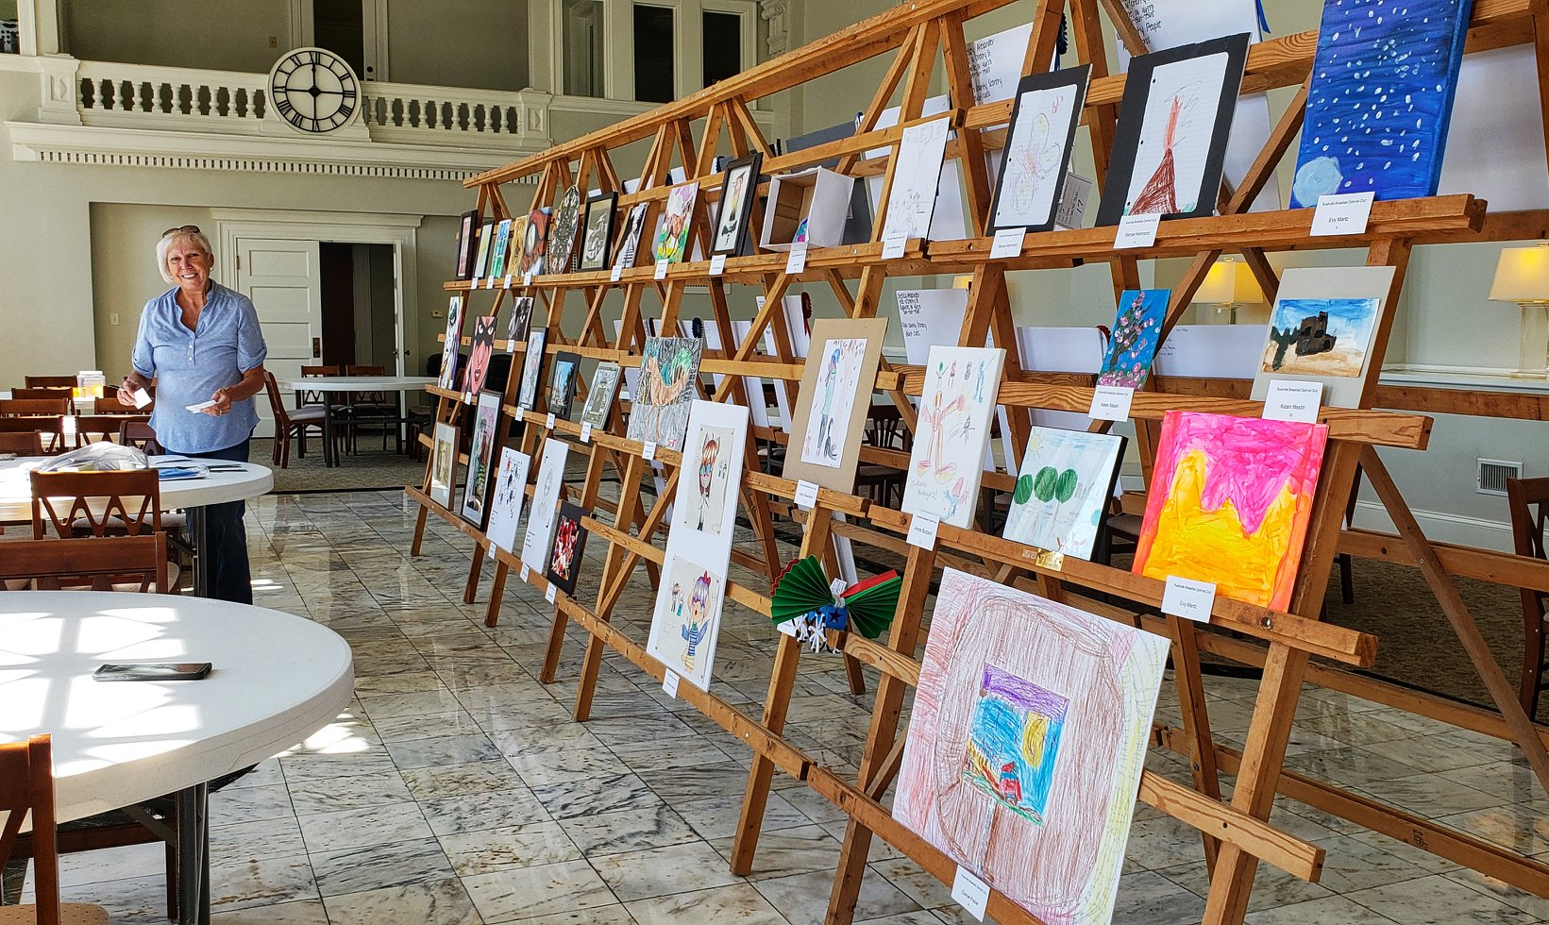

Slide 22
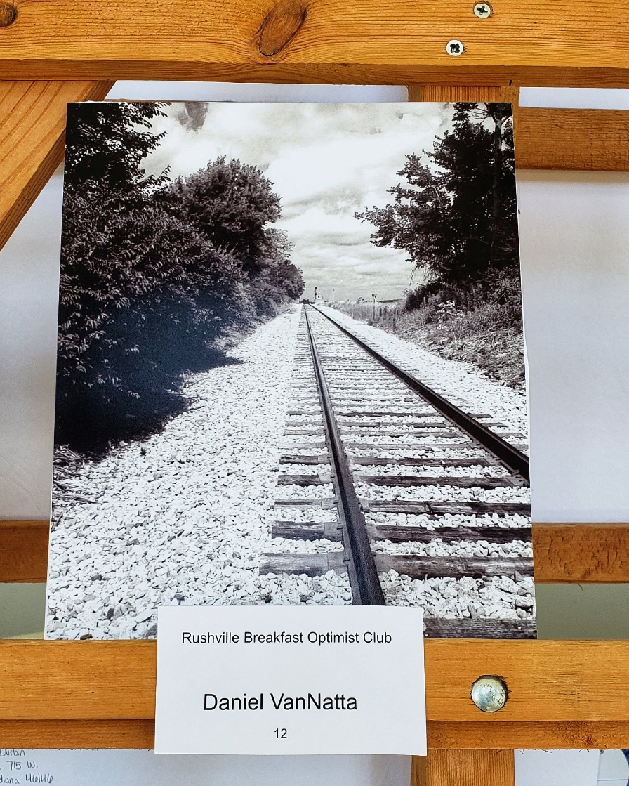
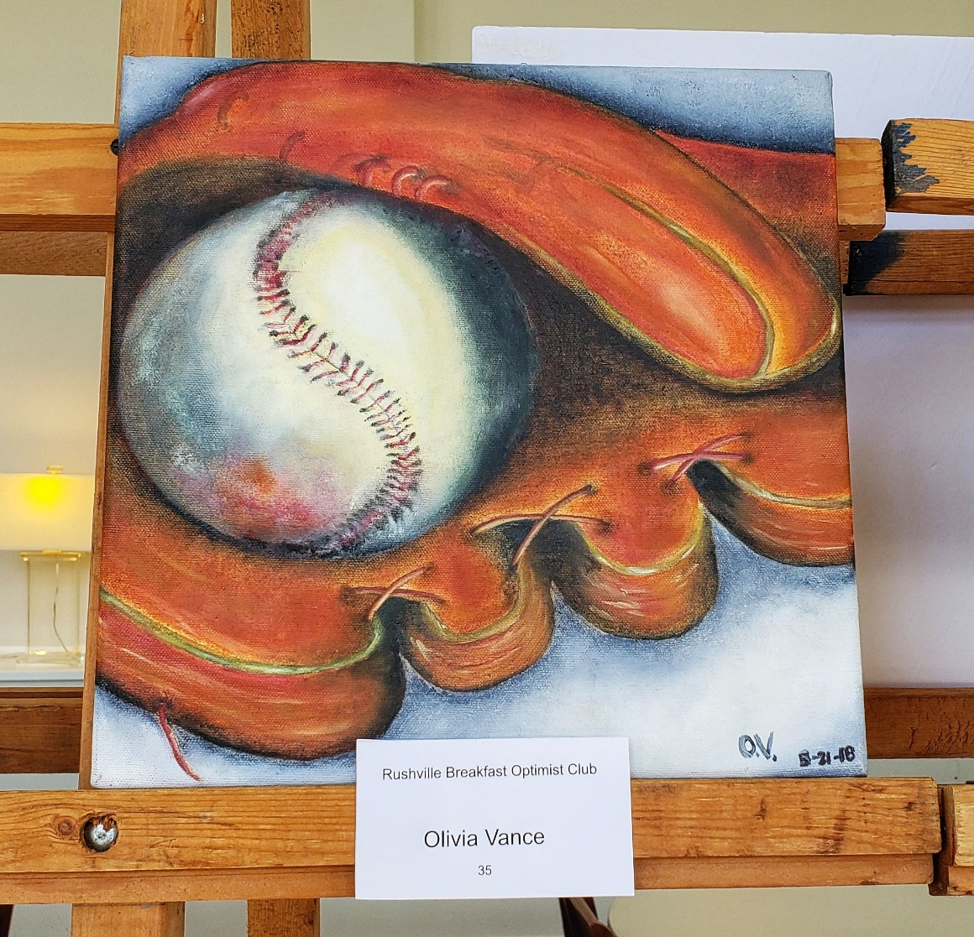
!

Slide 23
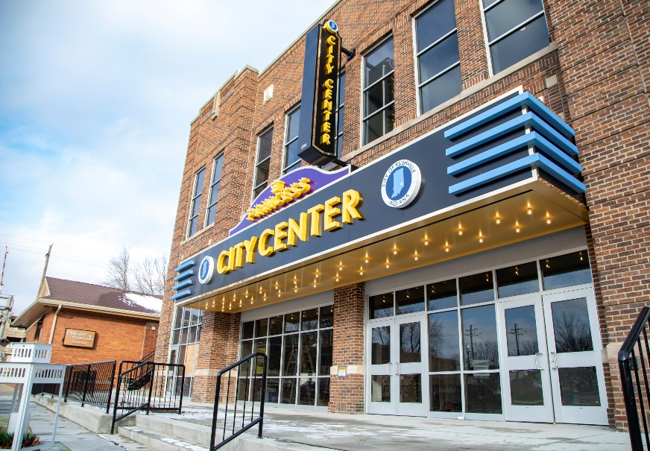

Slide 24
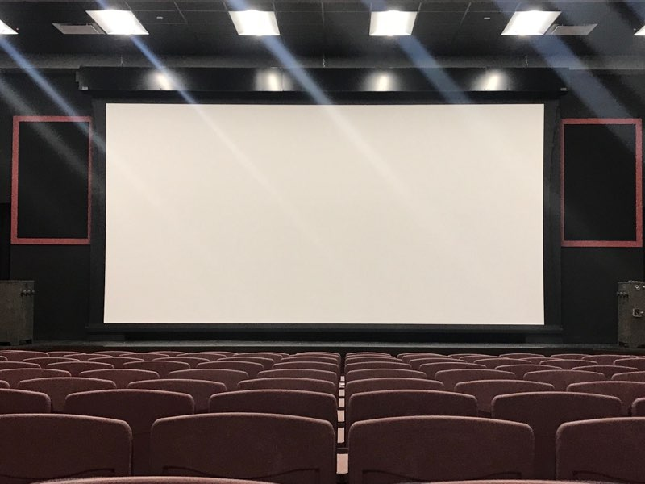
Movies
Live Music
Comedy
Lectures
Theater
Special Events

Slide 25
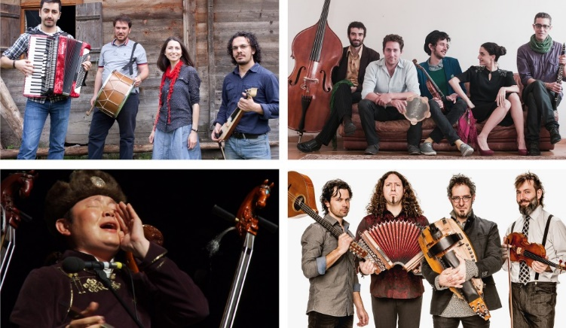

Slide 27
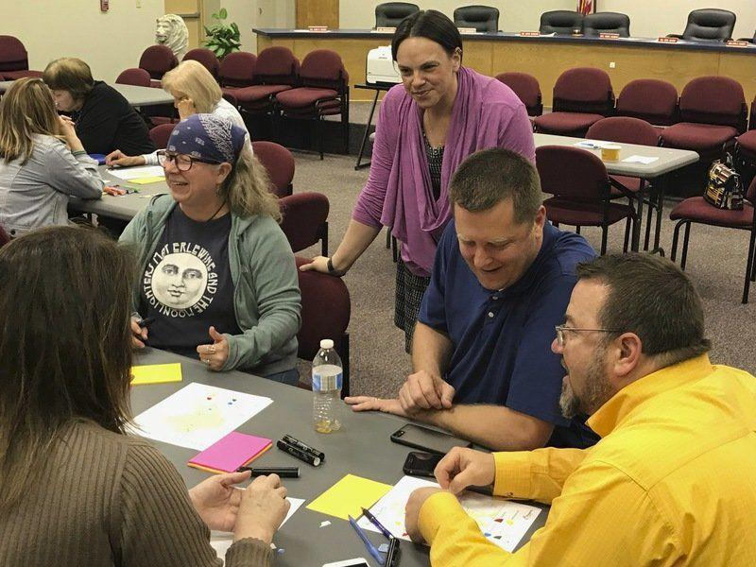
Art Consultancy Grant
Art Master Plan

Slide 28
…
Develop a maker space/gallery
Engage youth and seniors in performing arts classes
Implement unexpected temporary art in public spaces
Offer at least three live performances and three artists-in-residence days at the Farmer’s Market per season.
Integrate at least one art-focused event into each festival/parade.
Highlight local architecture and landscapes with at least one tour event per year.
Support existing and new live performances in downtown venues, offering at least four per year.

Slide 29
Look for Easy Wins Out of the Gate
Display in Highly Visible Areas
Lighter Quicker Cheaper
Engage Local Artists
Seek Outside Artist for New Perspective
Dare to Be Different
Find Art Ambassadors / Find Funding
Don’t Be Afraid to Fail
Stalk Artist / Community Social Media
Art Moves People & Creates Energy

