Slide 1
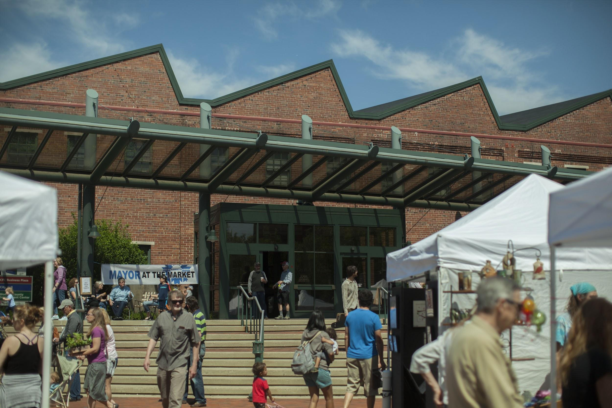

Slide 2
...to foster a livable and economically resilient community…
...through partnerships, collaboration and outreach, and
through strategic initiatives…
...which expand economic opportunities, preserve the health of our environment, provide for social equity to the citizenry, and advance the principles of sustainable development.

Slide 3
Business Relations and Development – Assistance and advocacy, incentives for job creation, private capital investment, and sustainable growth; serve as the primary liaison between the City and the business community.
Sustainable Development - Building networks, expertise and efficiency in the community as well as internally to City operations.
Arts & Cultural Development – BEAD, public art and placemaking, promotion of our uniquely Bloomington attractions and events.

Slide 4
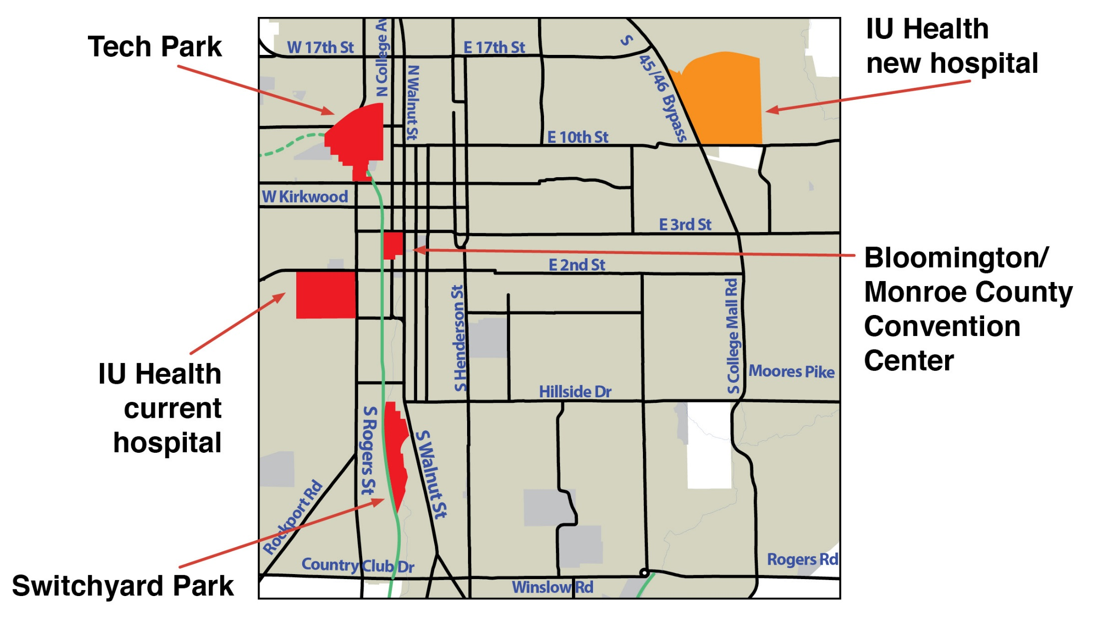
Cook/GE
I-69

Slide 5
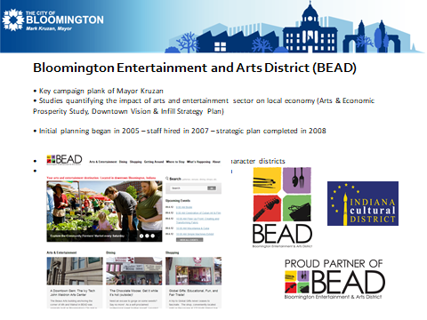
In 2005, Mayor Kruzan announced plans to create the Bloomington Entertainment and Arts District (BEAD) to strengthen the already successful natural arts district through nurturing and marketing existing arts organizations and businesses and aiding in the development of new creative enterprises.
In 2006, BEAD locally designated as a cultural district.
In 2008, BEAD presented its own thorough strategic plan that emphasized maintaining the already unique aspects of the downtown community, getting people to and keeping people in Bloomington.
In 2009, BEAD was officially designated by the Indiana Arts Commission as a State Designated Cultural District.
Notes:
Mayor Kruzan, Miah Michaelson thanks to - the formation of arts and economic impact/development

Slide 6
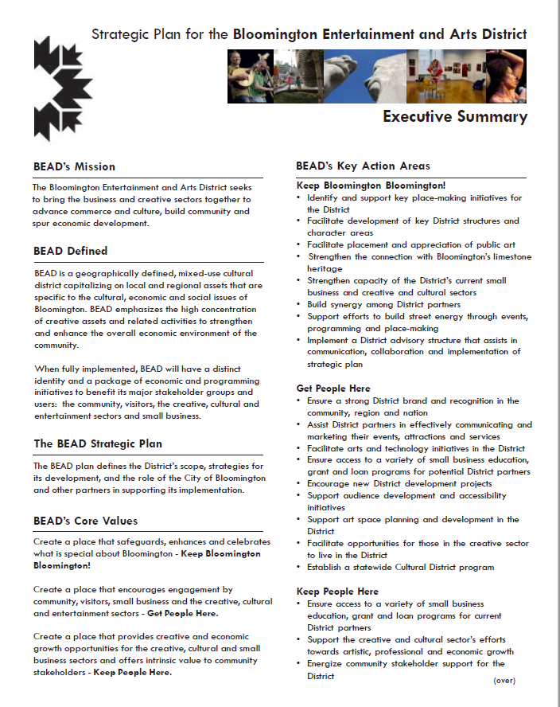
Mission: The Bloomington Entertainment and Arts District seeks to bring the business and creative sectors together to advance commerce and culture, build community and spur economic development.
Create a place that safeguards, enhances and celebrates what is special about Bloomington - Keep Bloomington Bloomington!
Create a place that encourages engagement by
community, visitors, small business and the creative, cultural and entertainment sectors - Get People Here!
Create a place that provides creative and economic growth opportunities for the creative, cultural and small business sectors and offers intrinsic value to community stakeholders - Keep People Here!
Notes:
Bloomington Entertainment and Arts District encompasses a 60-block area in the downtown “BEAD Seeks to bring the business and creative sectors together to advance commerce and culture, build community and spur economic development. In 2008, the district what subdivided into ten character districts.
Drawing new artists or creating new arts and cultural opportunities was not a primary objective driving BEAD’s decision to attain state designation. Rather, BEAD’s primary reasons to seek state designation was to demonstrate how these cultural and arts assets increase and spur economic activity within the district.

Slide 7
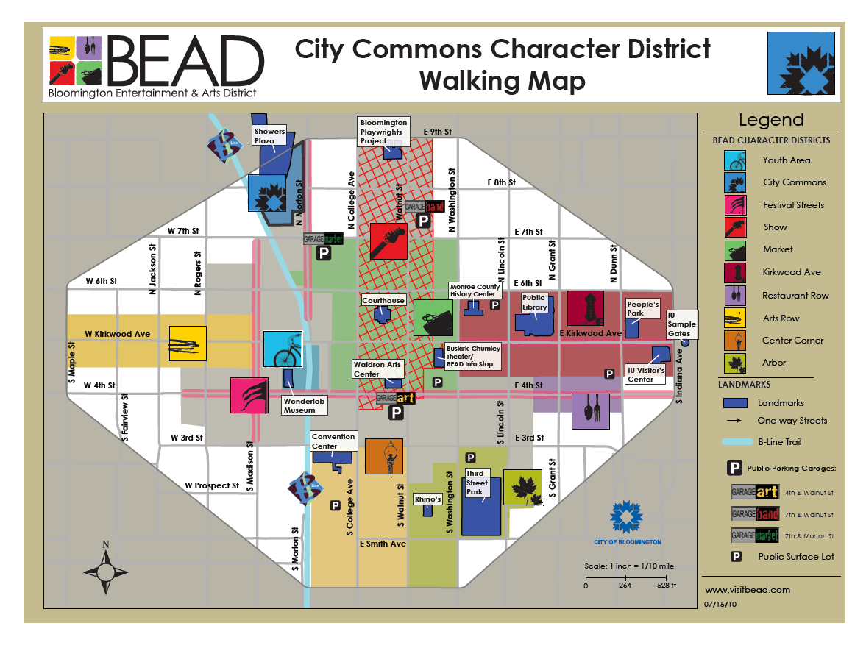

Notes:
The IAC - oversees the designation of and evaluation of Indiana’s Cultural Districts. The program was implemented to facilitate community and economic and cultural development within communities containing hgih concentrations of arts assets. There are currently 7 cultural districts across the state. The primary goal of the IAC program is to increase community exploration and participation in arts and culture. IAC believes that increased participation in arts and culture revilitizes and stabilizes communities in Indiana.

Slide 8
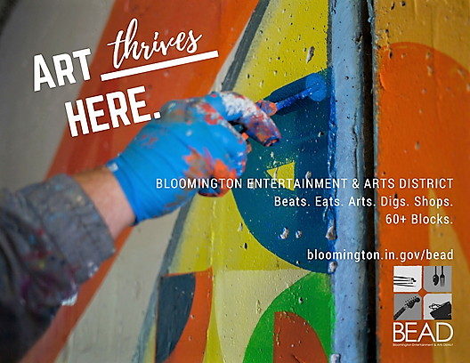
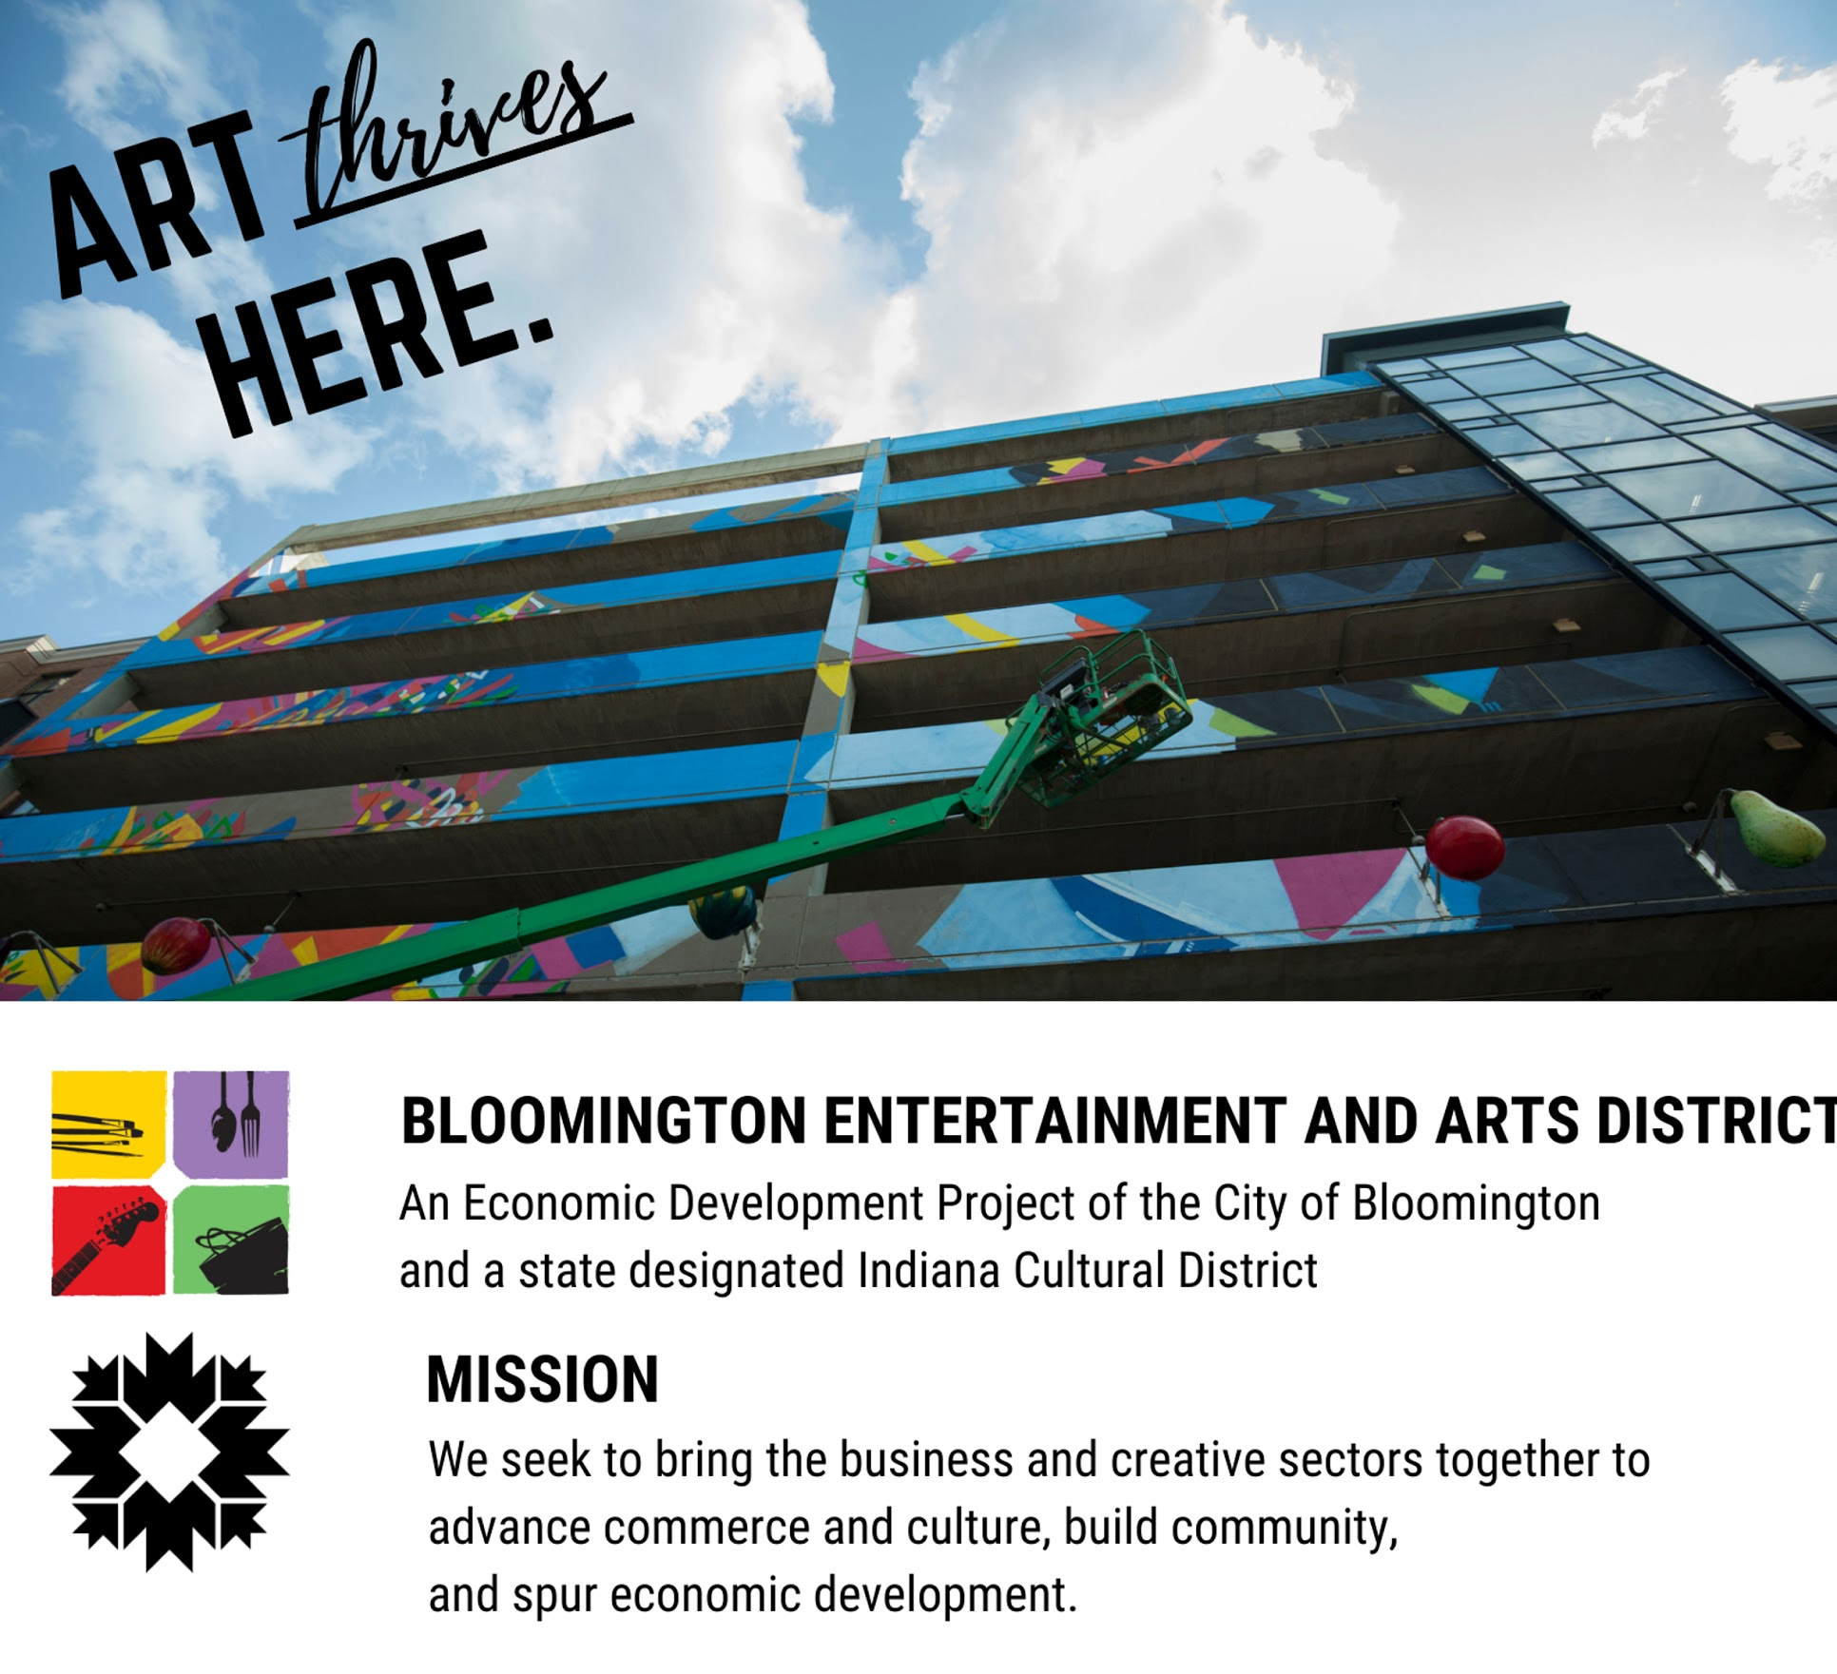

Slide 9
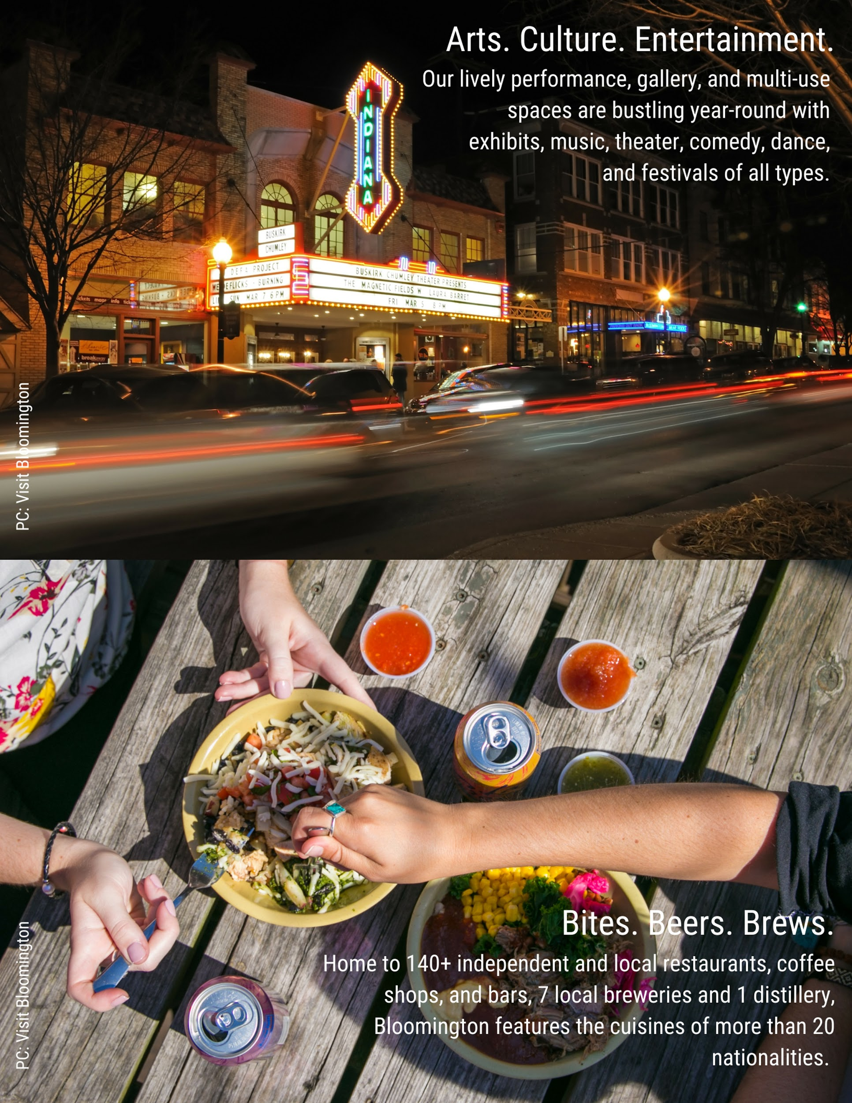
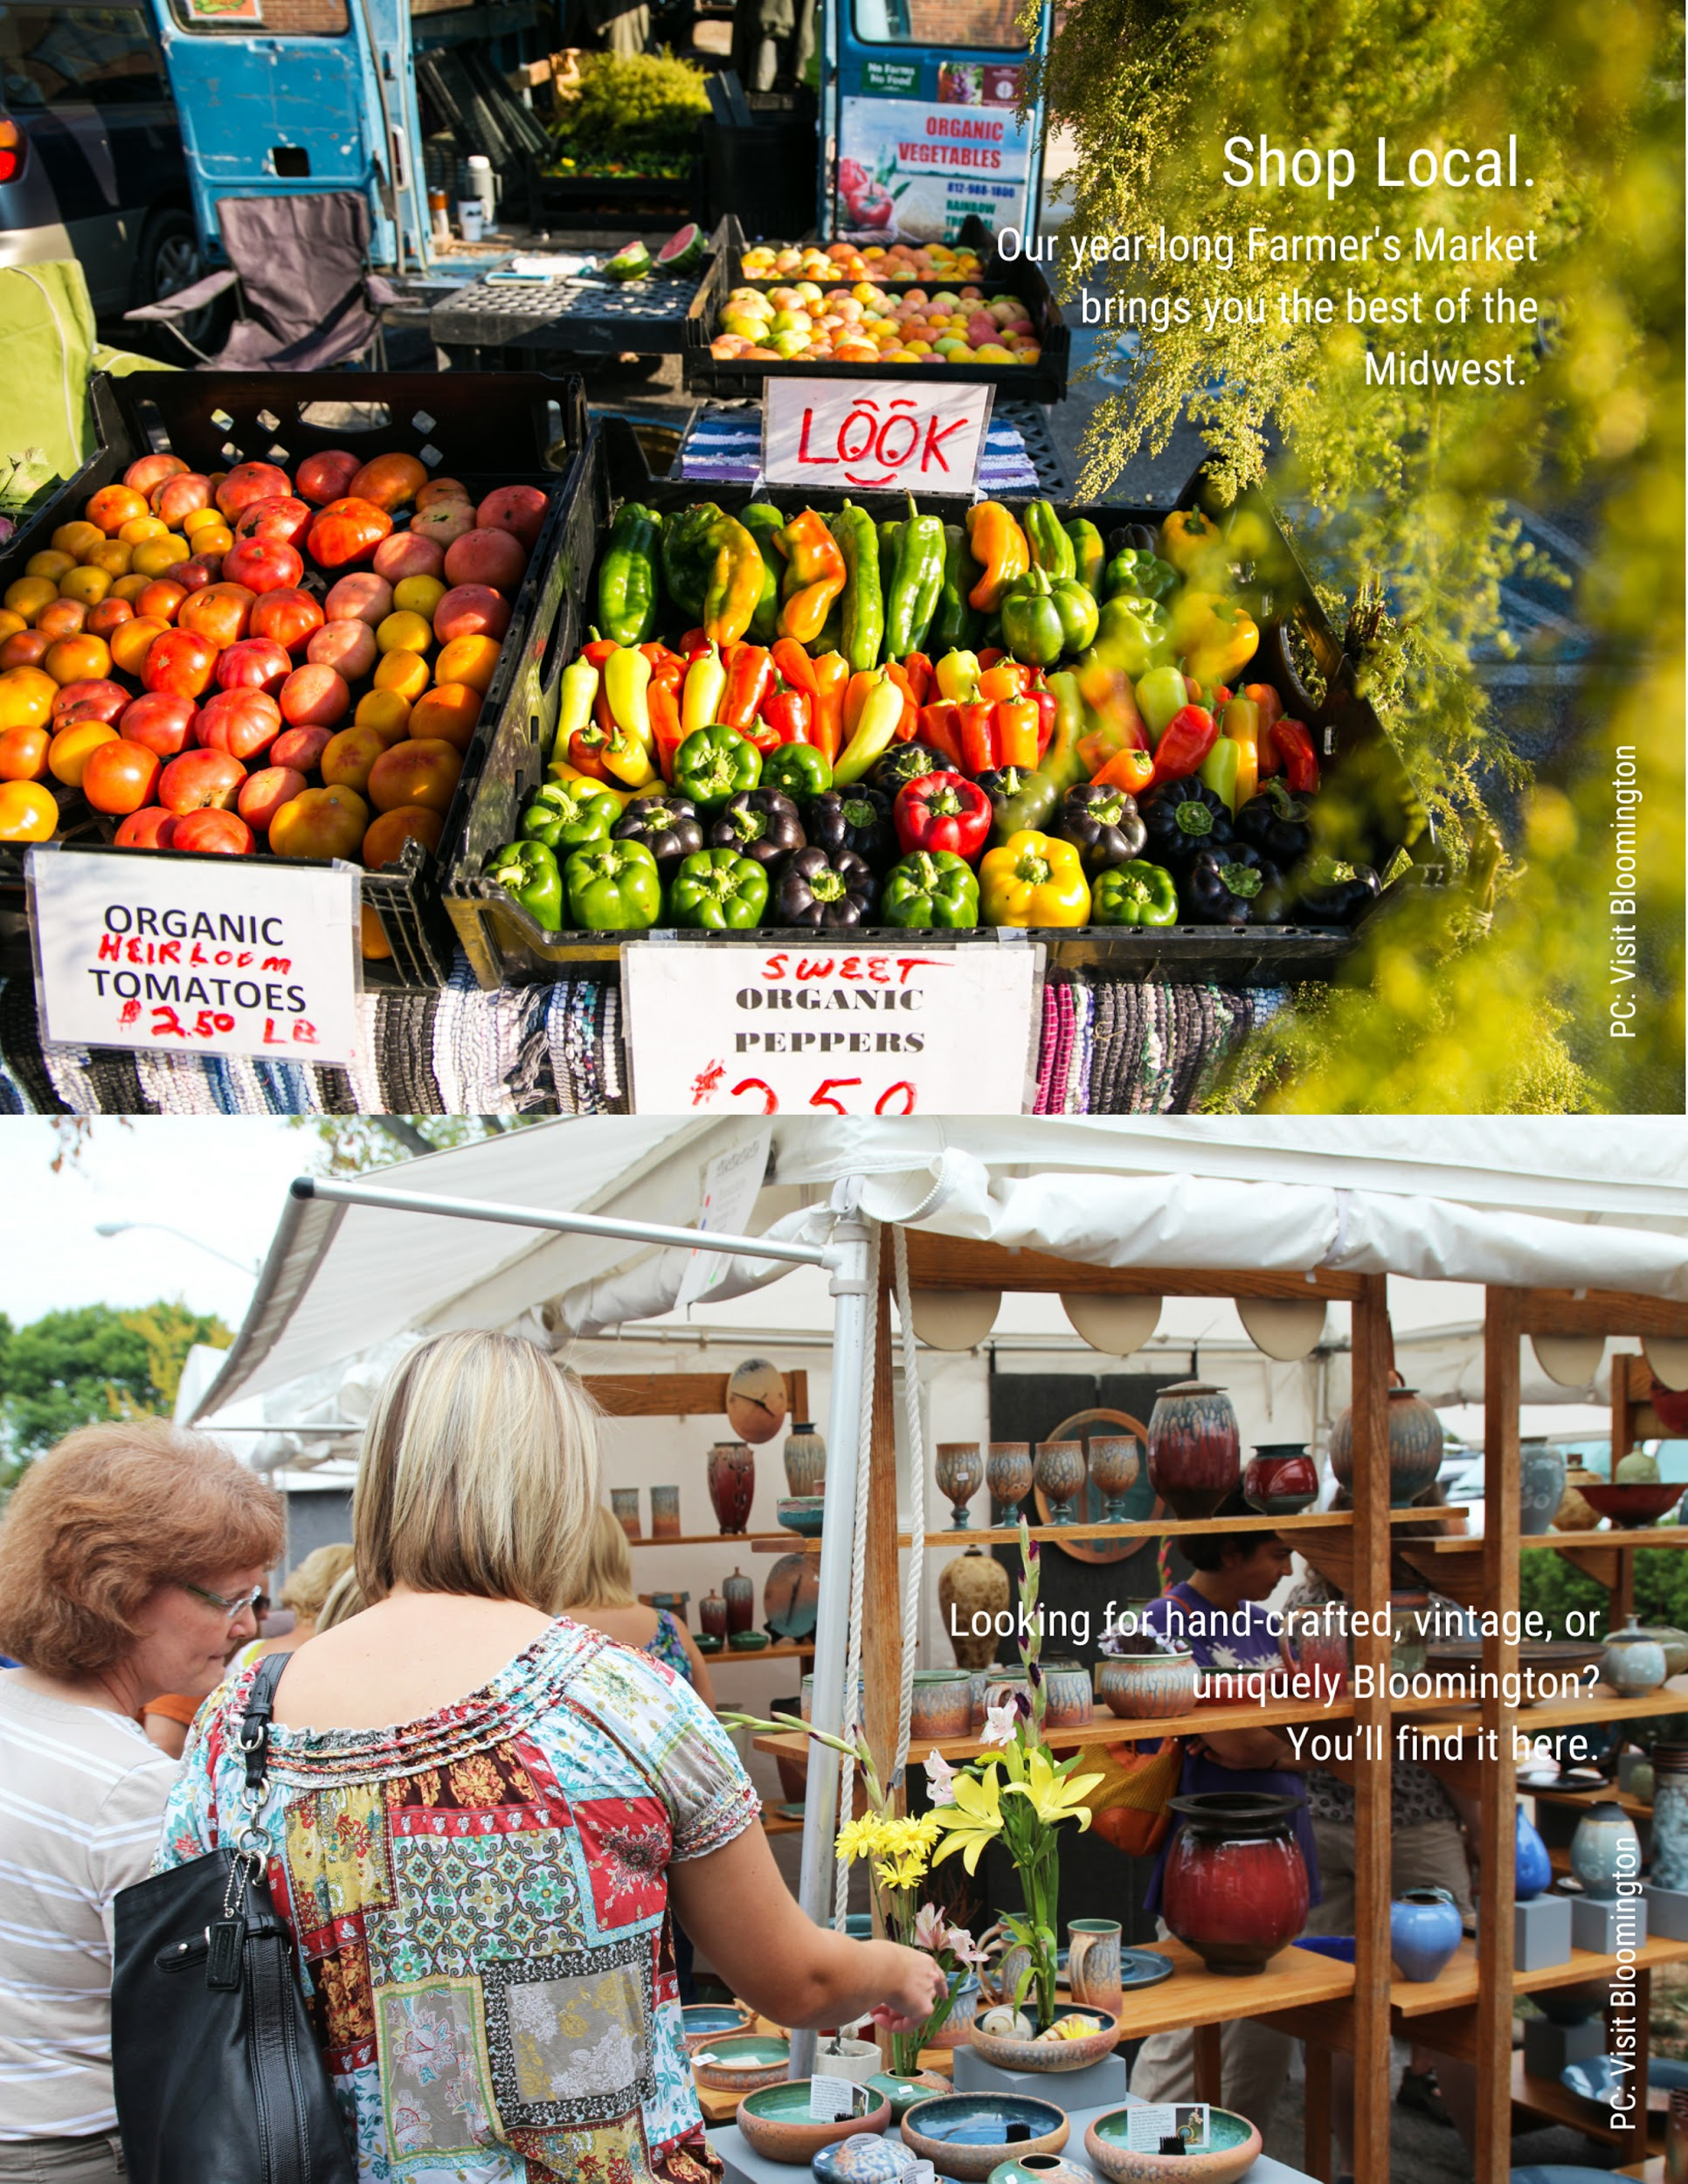

Slide 10
Industry | Bloomington MSA* | Monroe County
Government | 23,462 | 22,605
Health Care and Social Assistance | 9,835* | 9,835
Retail Trade | 9,052 | 8,290
Accommodation and Food Services | 8,461 | 8,122
Manufacturing | 8,954 | 7,033
Other Services | 17,979* | 17,368
Professional, Scientific, Technical Services | 4,267 | 4,042
Construction | 3,889 | 3,377
Wholesale Trade | 1,551* | 1,809
Information | 1,401* | 1,401
Arts, Entertainment, and Recreation | 2,011 | 1,927
Transportation and Warehousing | 1,551 | 1,290
Income & Wages
2015 Bloomington MSA Average Yearly Salary = $42,833
2015 Bloomington MSA Per Capita Personal Income = $36,926
2015 Monroe County Median Family Income = $43,389
Race/Ethnicity | Percent
White | 88.00%
Asian | 6.10%
Black | 3.20%
Hispanic or Latino (any race) | 3.10%
Two or more races | 2.30%
American Indian/Alaskan Native | 0.30%
Notes:
Arts makes up 2.6 of the labor force.

Slide 11
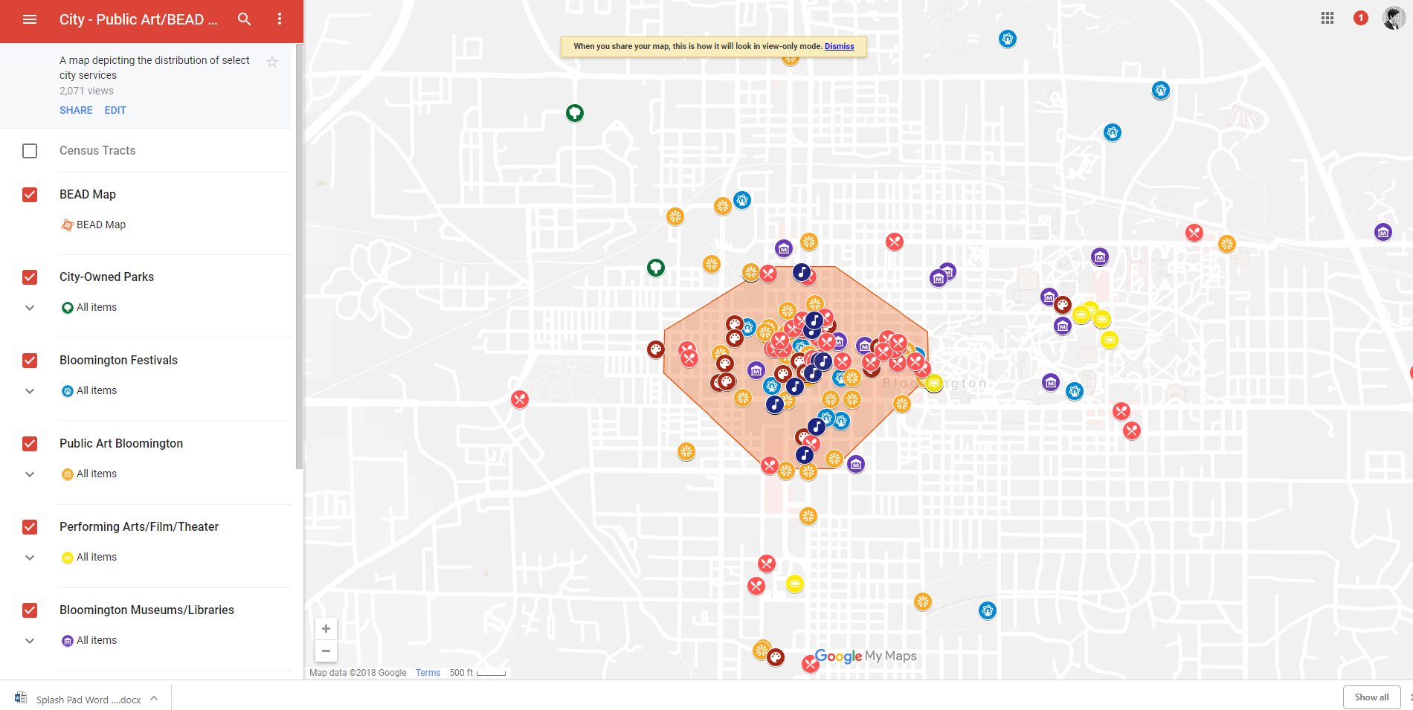
Notes:
Over 190 cultural assets in the 60 block area. Increase of service/restaurants/bars

Slide 12
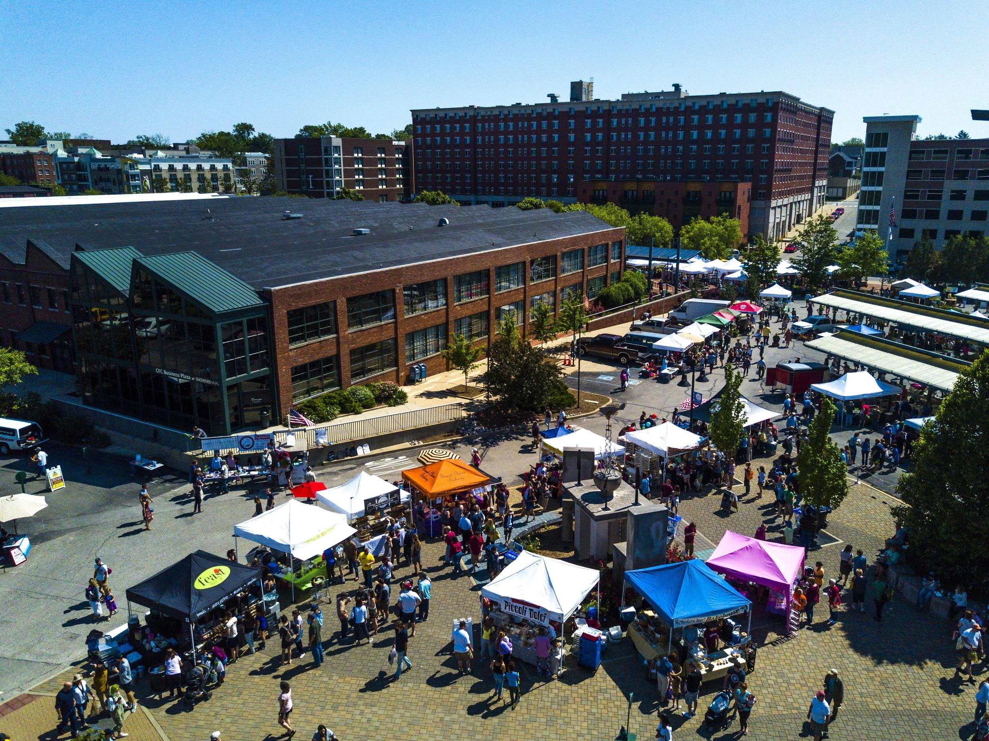
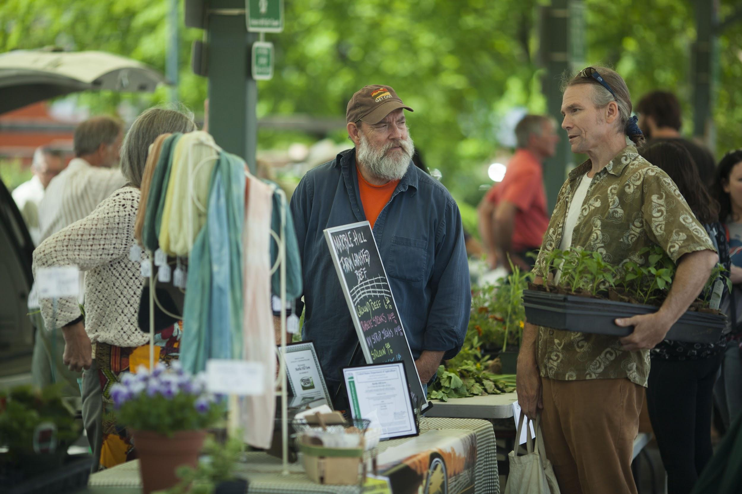
Notes:
Parks - Around 18,000 plus staff time, donations and certain artist fees

Slide 13
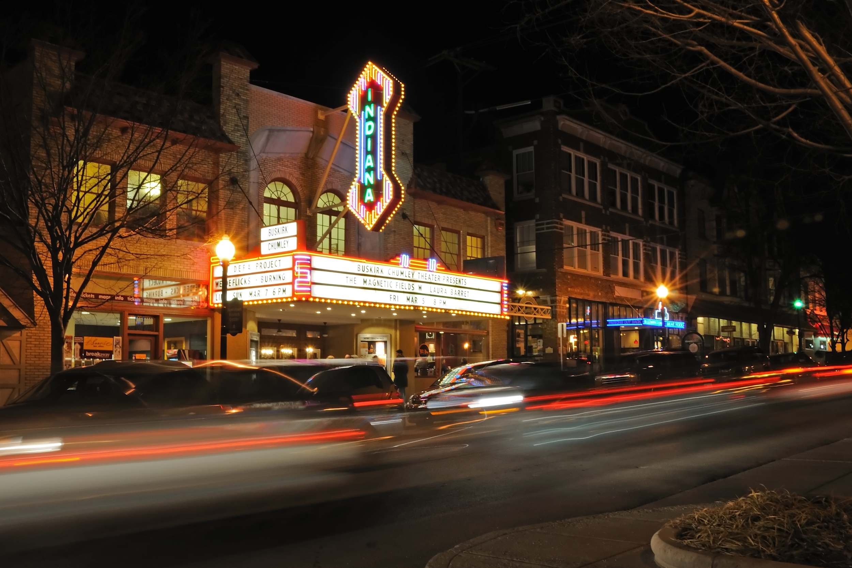
Notes:
50,000 dollars goes to the BCT every year from the City Council budget - BCT Box Office, help subsidize use for local acts.

Slide 14
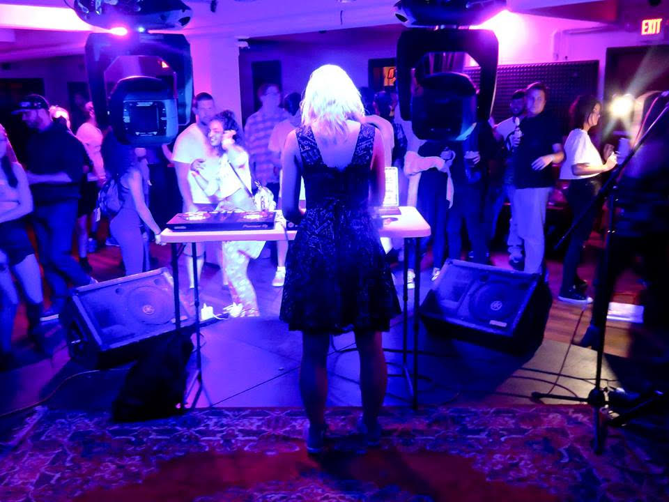
BAC Arts Project Grants Program
In 2018, $20,000 distributed to 17 local arts and cultural organizations
The Bloomington Arts Commission supports the work of more than 632 artists annually.
Annually, more than 15,700 Bloomington audience members attend Bloomington Arts Commission grant-supported arts projects.
2019 City Budget has increased the BAC Grant program to $40,000.

Slide 15

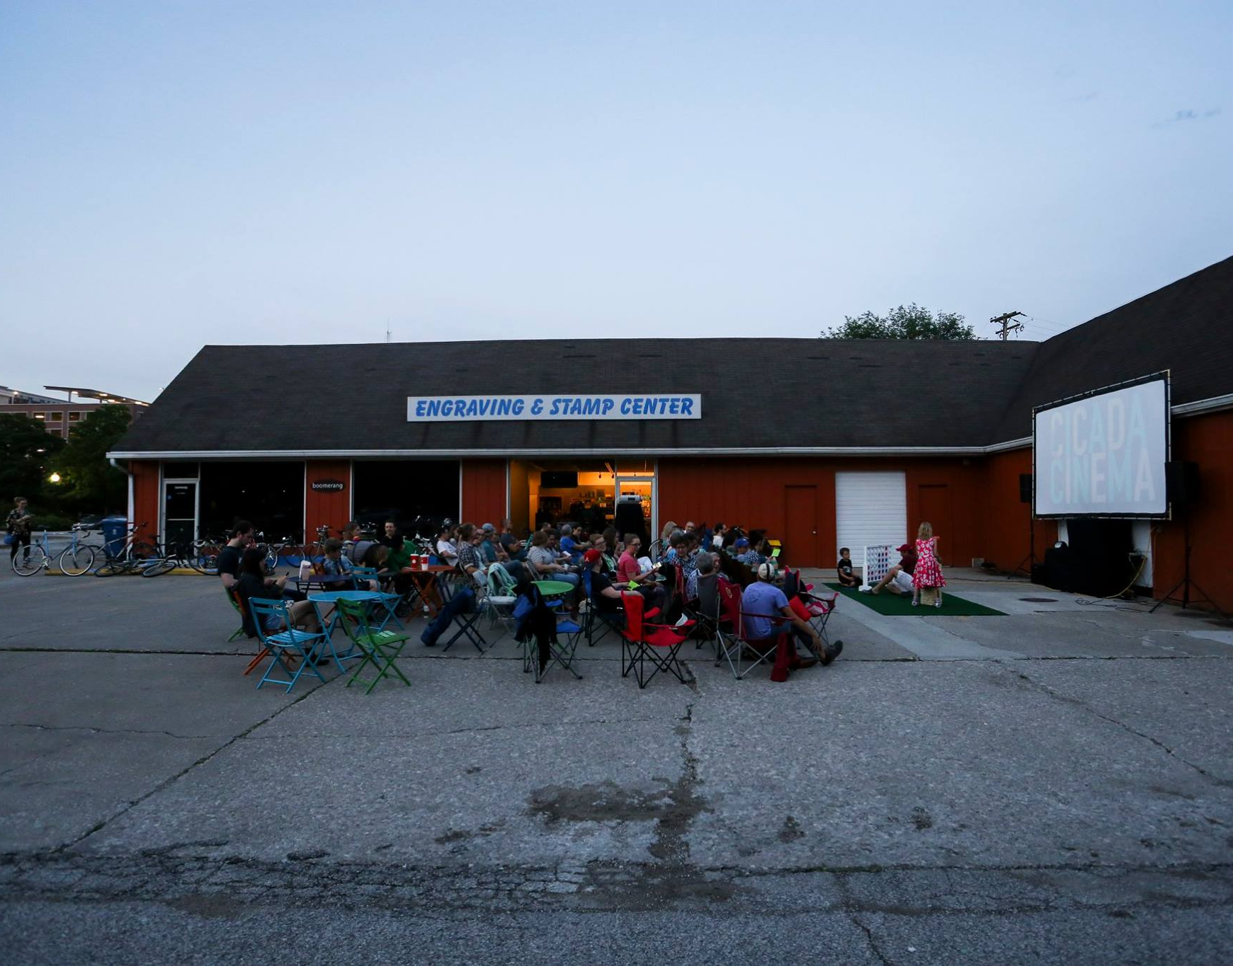
Amount of Money Awarded: $40,000
Number of Applicants: 21
Number of Applicants Awarded: 13
Average amount awarded: $3,076

Slide 16
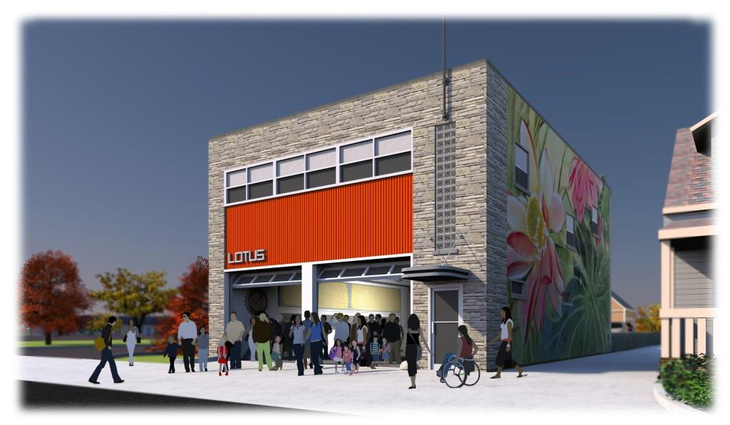
Notes:
Lotus Education and Arts Foundation recently rennovated the former fire station which was sold to Lotus for 1. Will open it’s doors with a kickoff benefit on Saturday, November 3.

Slide 17
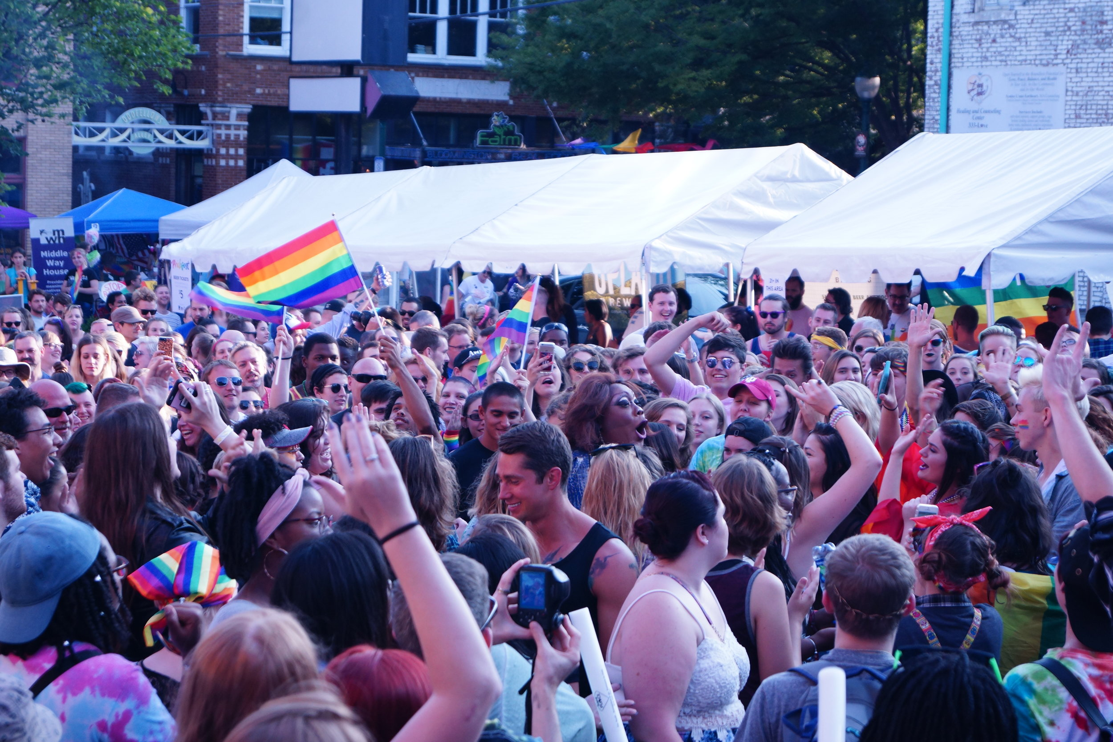

Slide 18
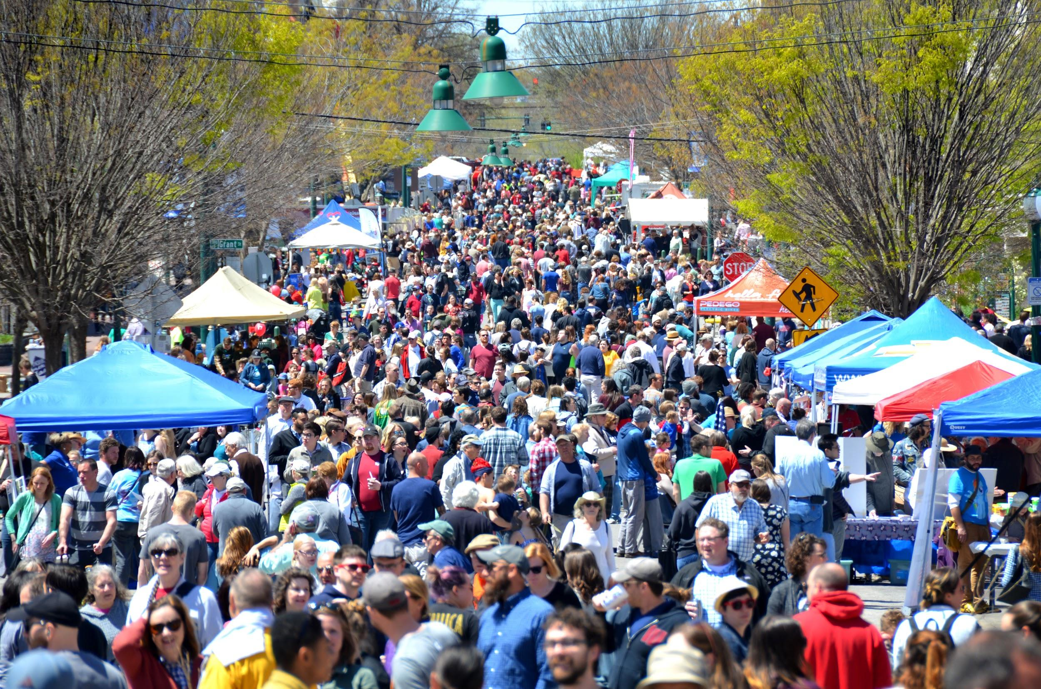
Notes:
With or without festival is happening when need to make sure we have beautiful space in our community from the neighborhood to the downtown.

Slide 19
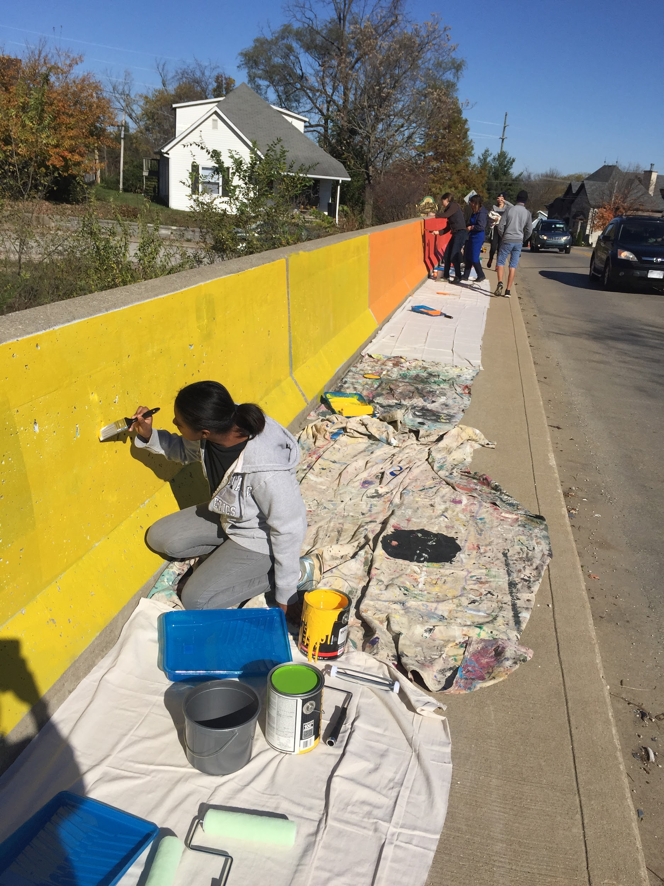
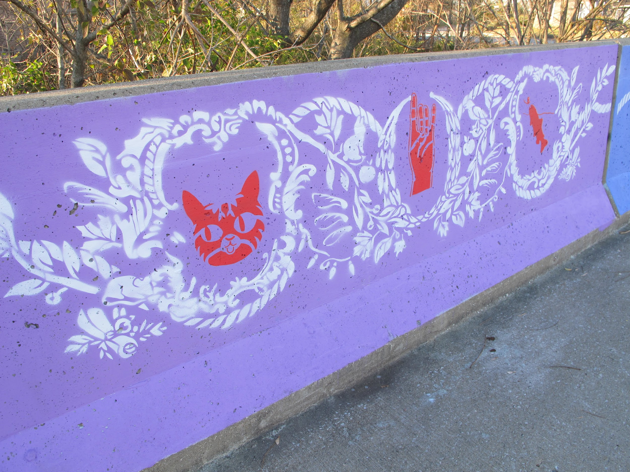
Notes:
We’re encouraging and supporting public projects in every neighborhood and identifying City-owned properties, parcels and overlooked infrastructure that could support artistic and cultural expression. Street medians, underpasses, traffic calming devices and, more recently, the street itself, can become platforms for our community to express and celebrate themselves.

Slide 20
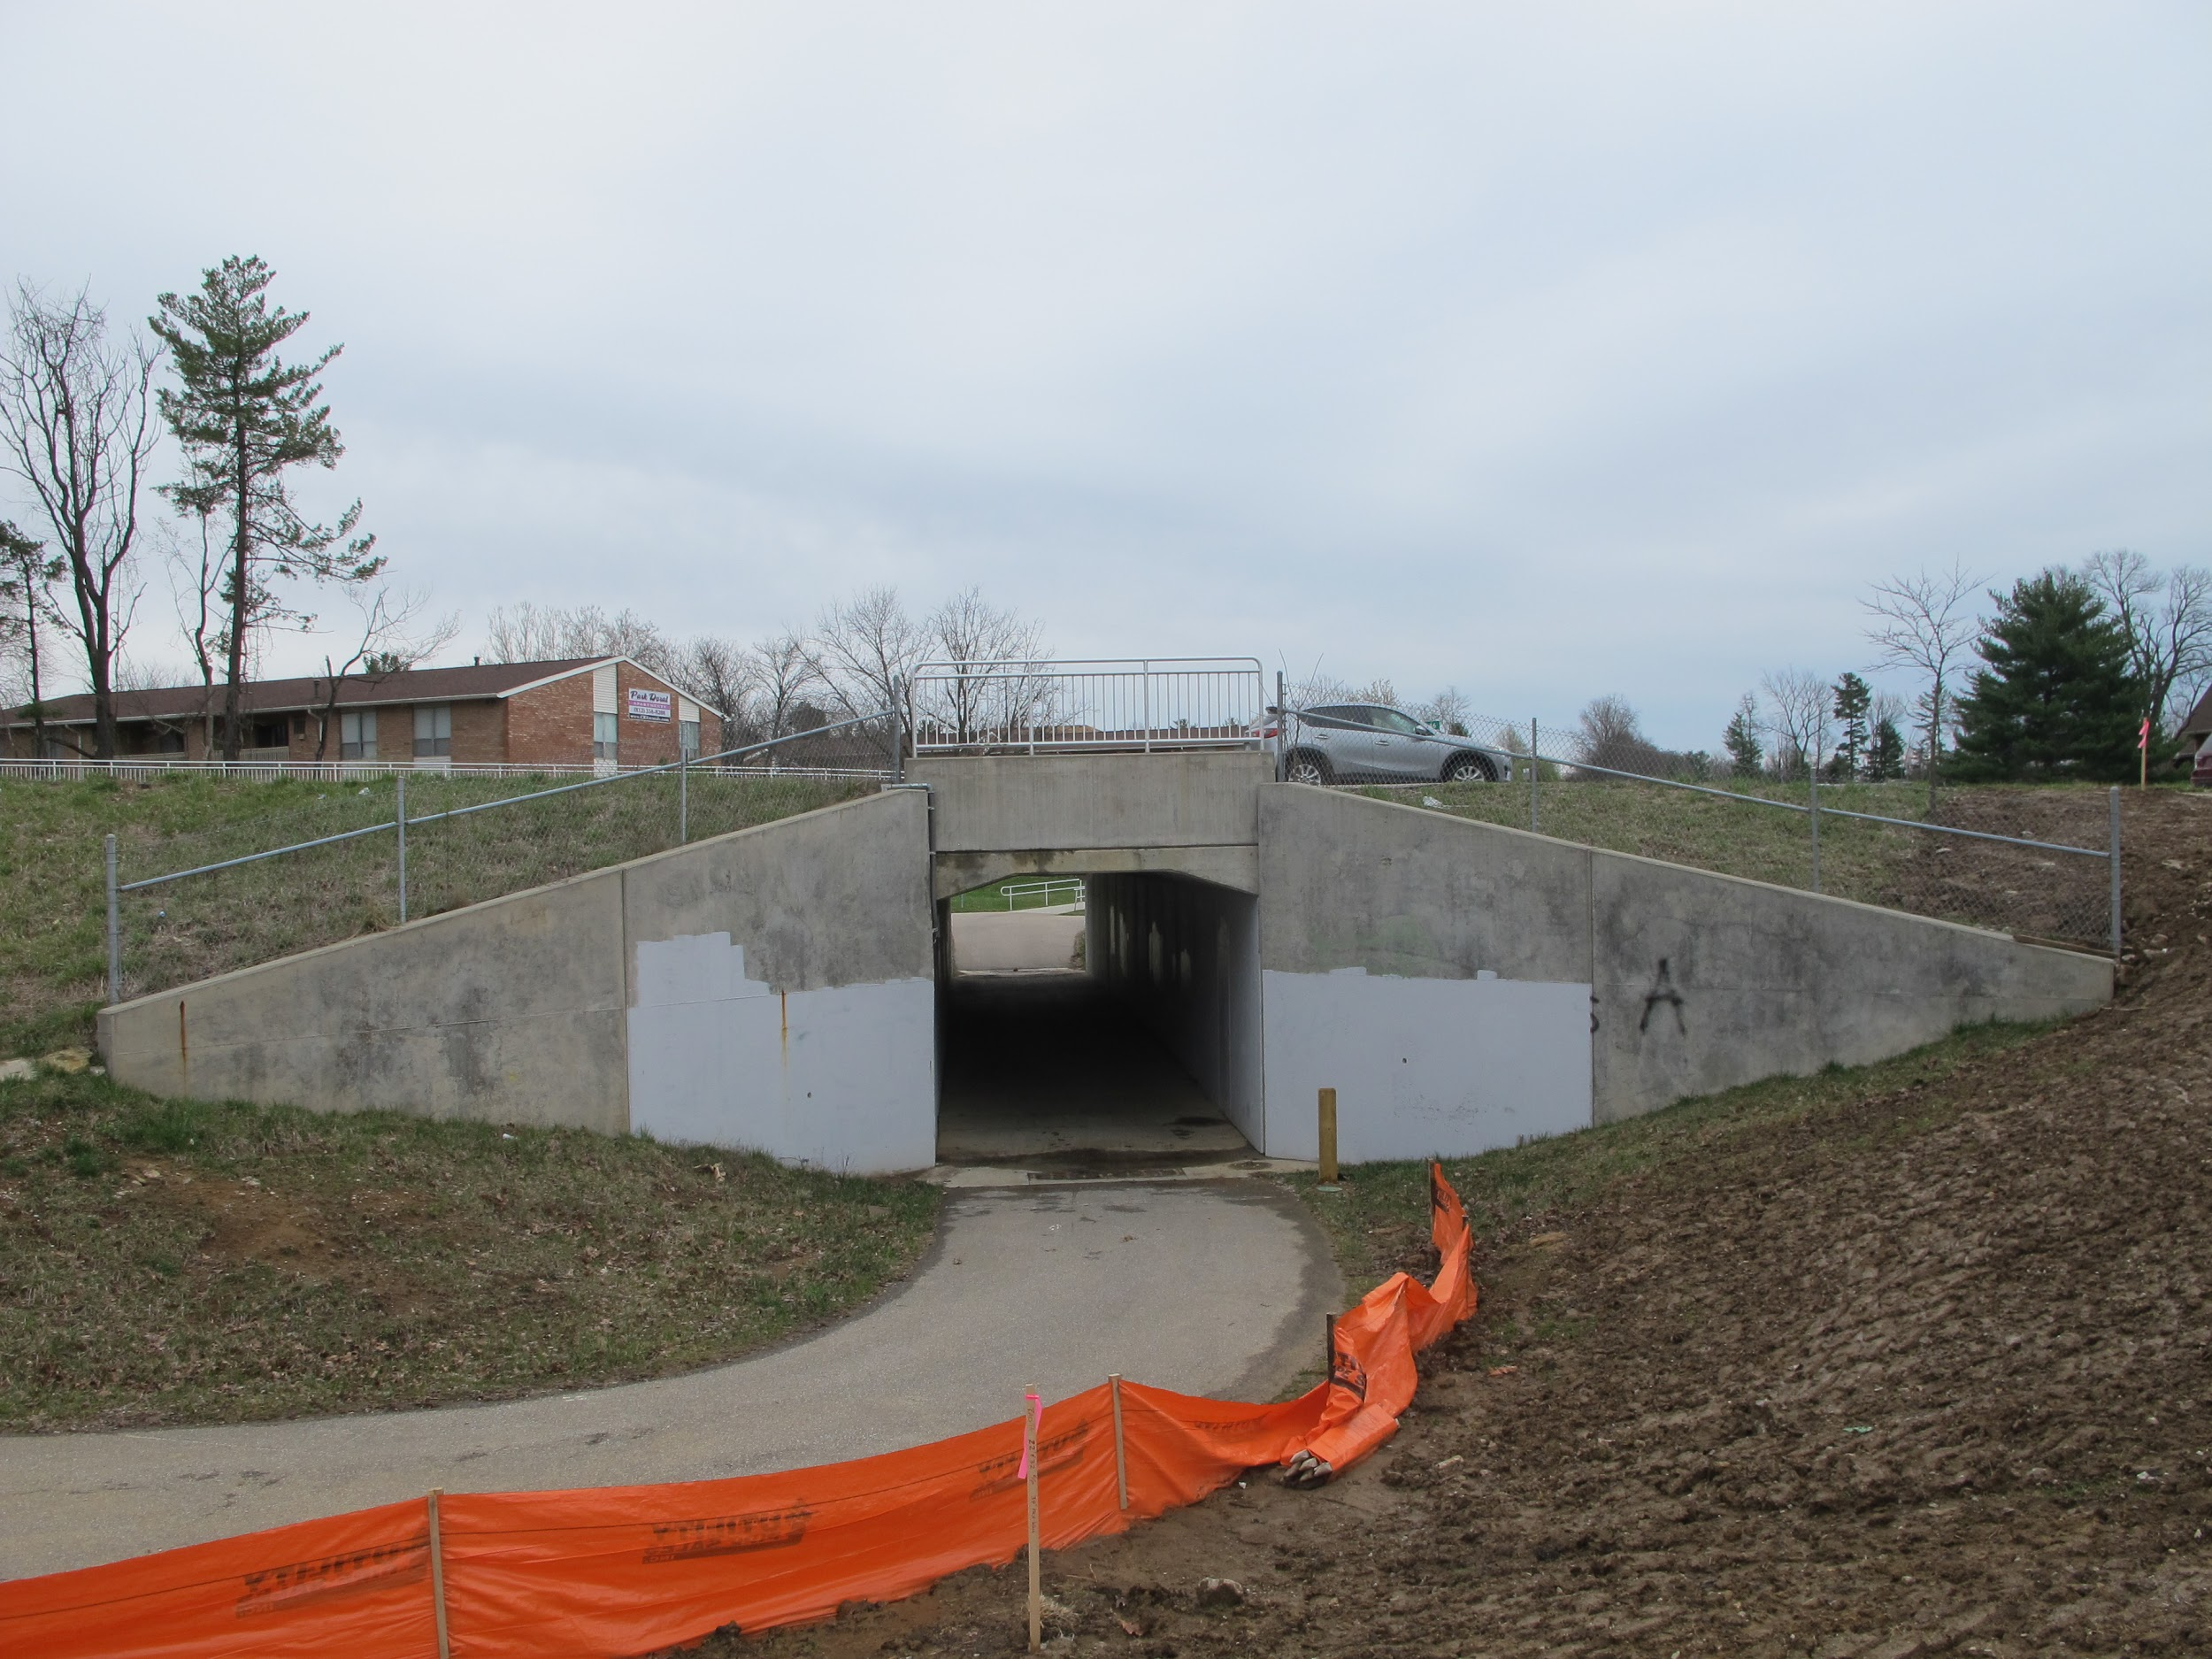
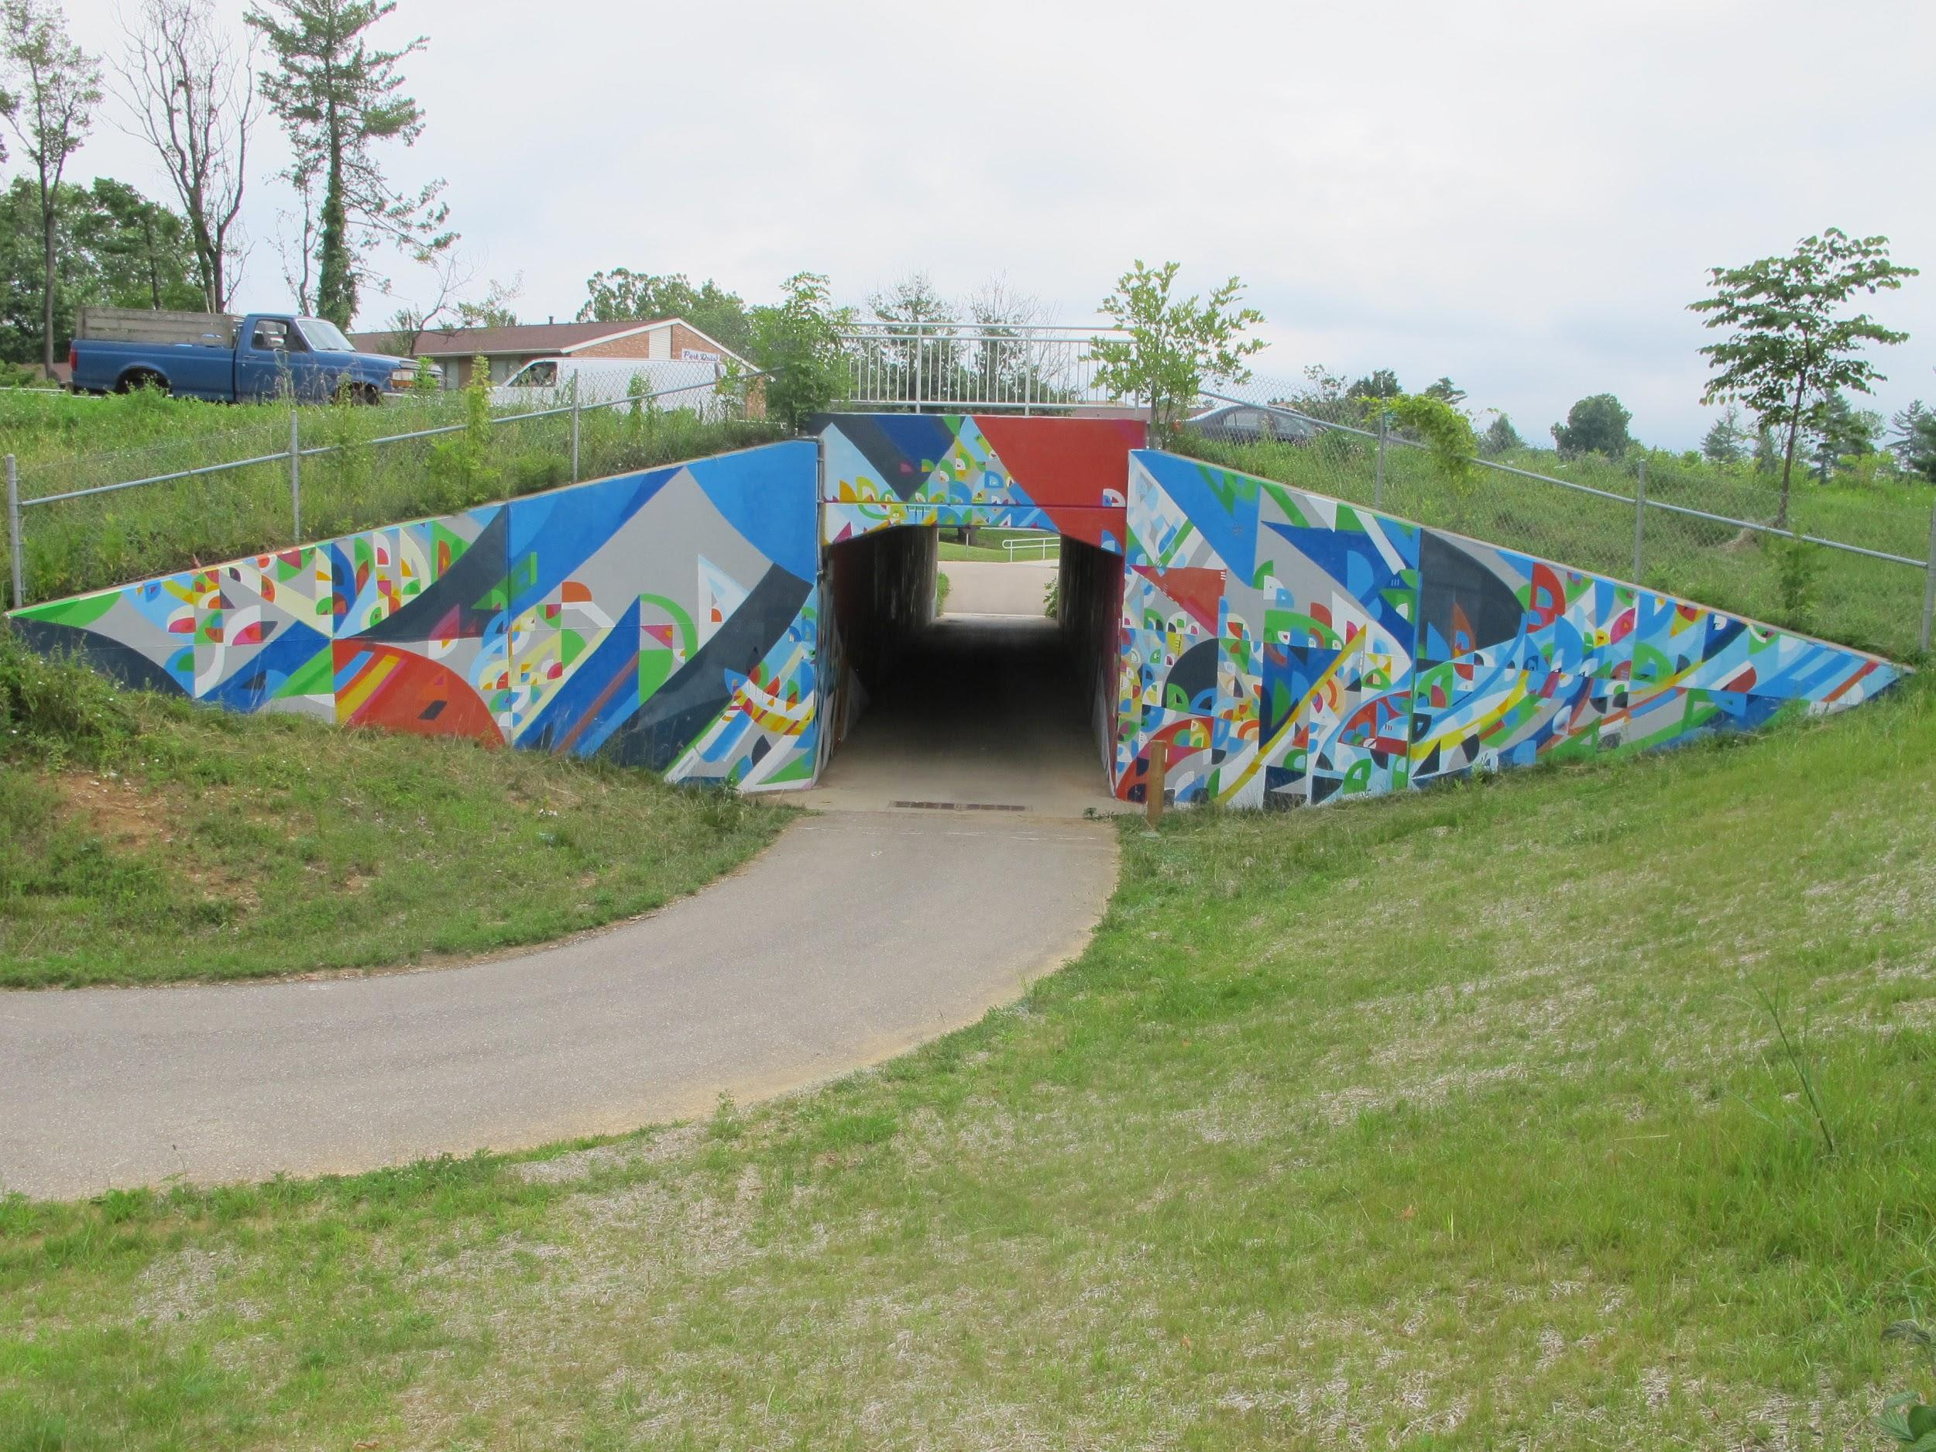
Notes:
Averages 6,000 users in peak seasons.

Slide 21
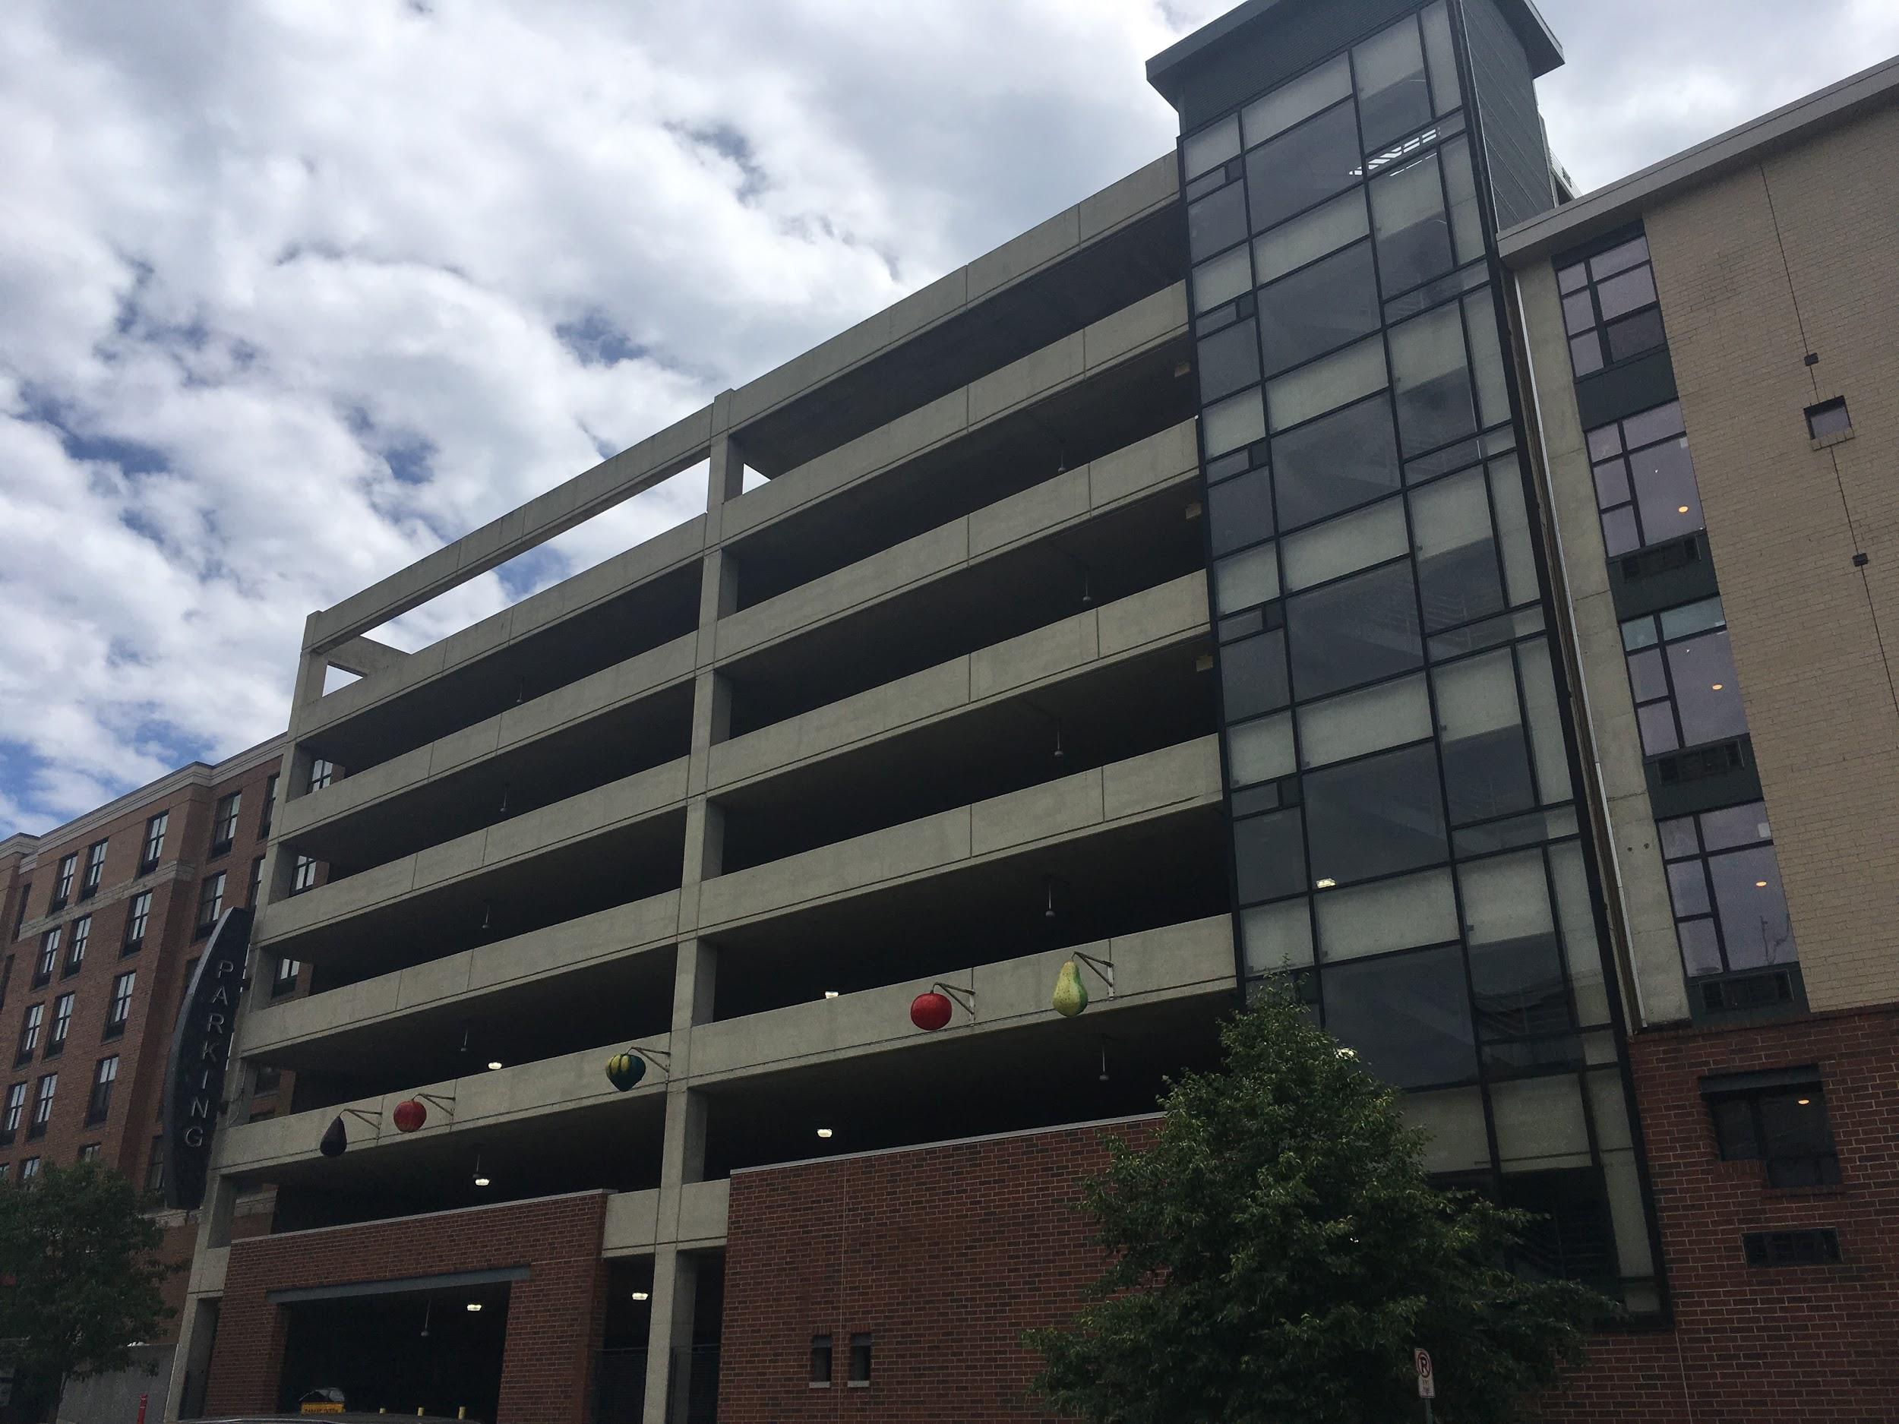
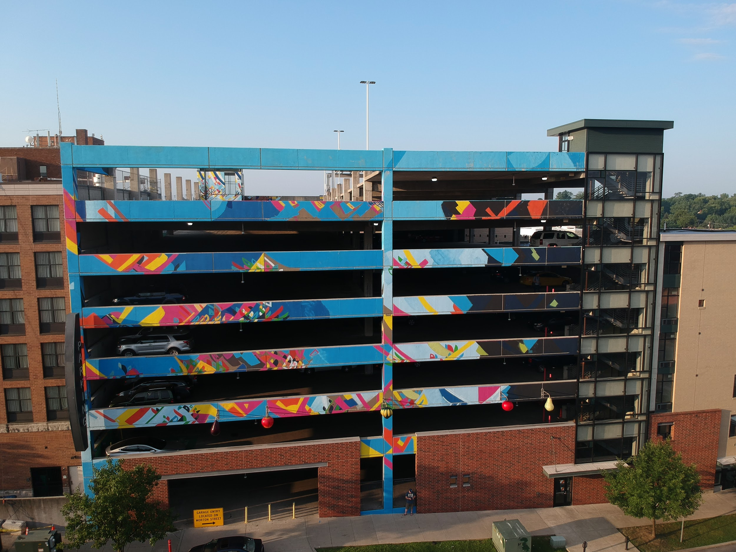

Slide 22
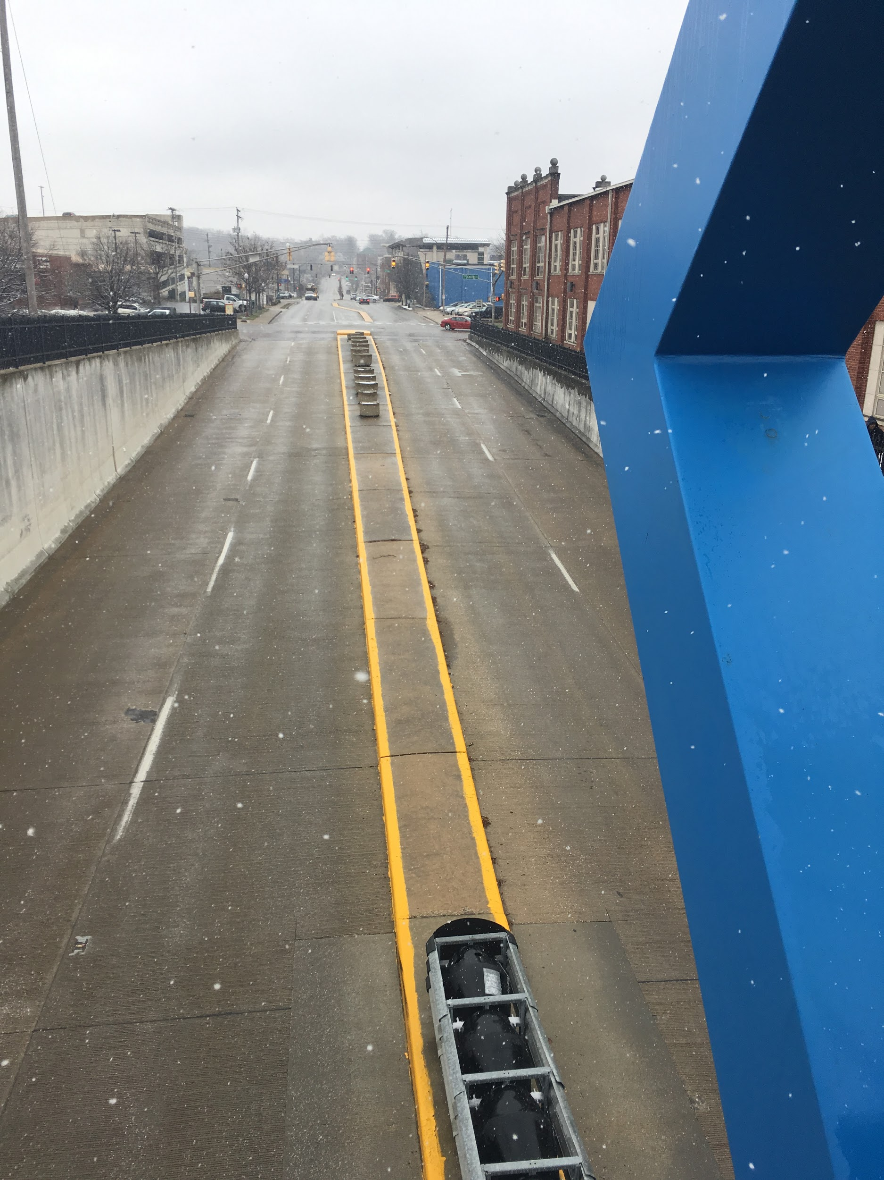
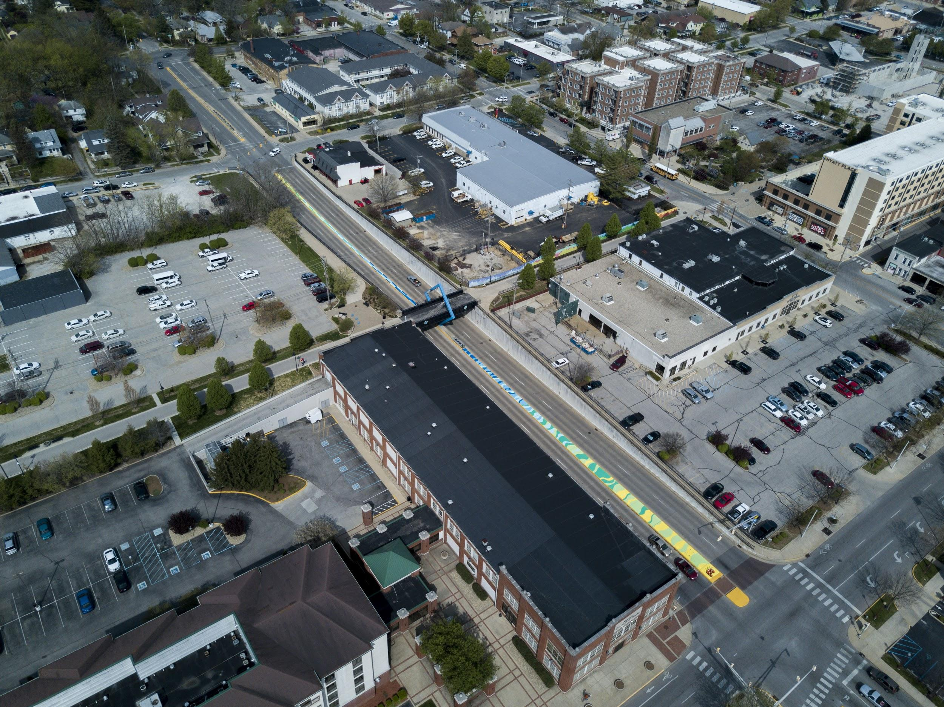
Notes:
Resulting in over 30,000 sq ft of new murals in the community.
All of these projects have come out of RFQ process

Slide 23
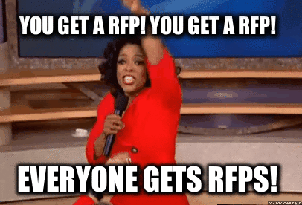
From RFPs to RFQs:
Since 2016, we have released 10 public RFQ’s for various arts/culture projects receiving over 120 submissions.
Over 60% of the artist submissions are new to the public art landscape.
50% of the artists selected are women.
Notes:
We need to have more strategic efforts to encourage artist of color.

Slide 24
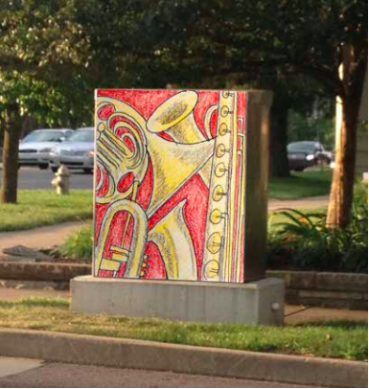
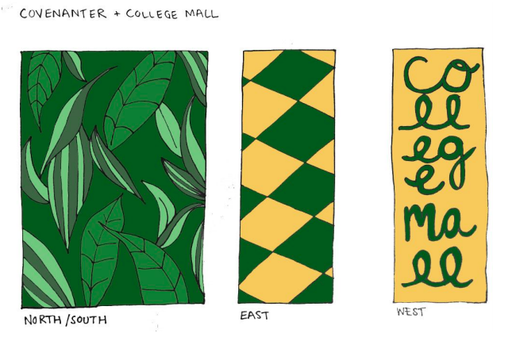
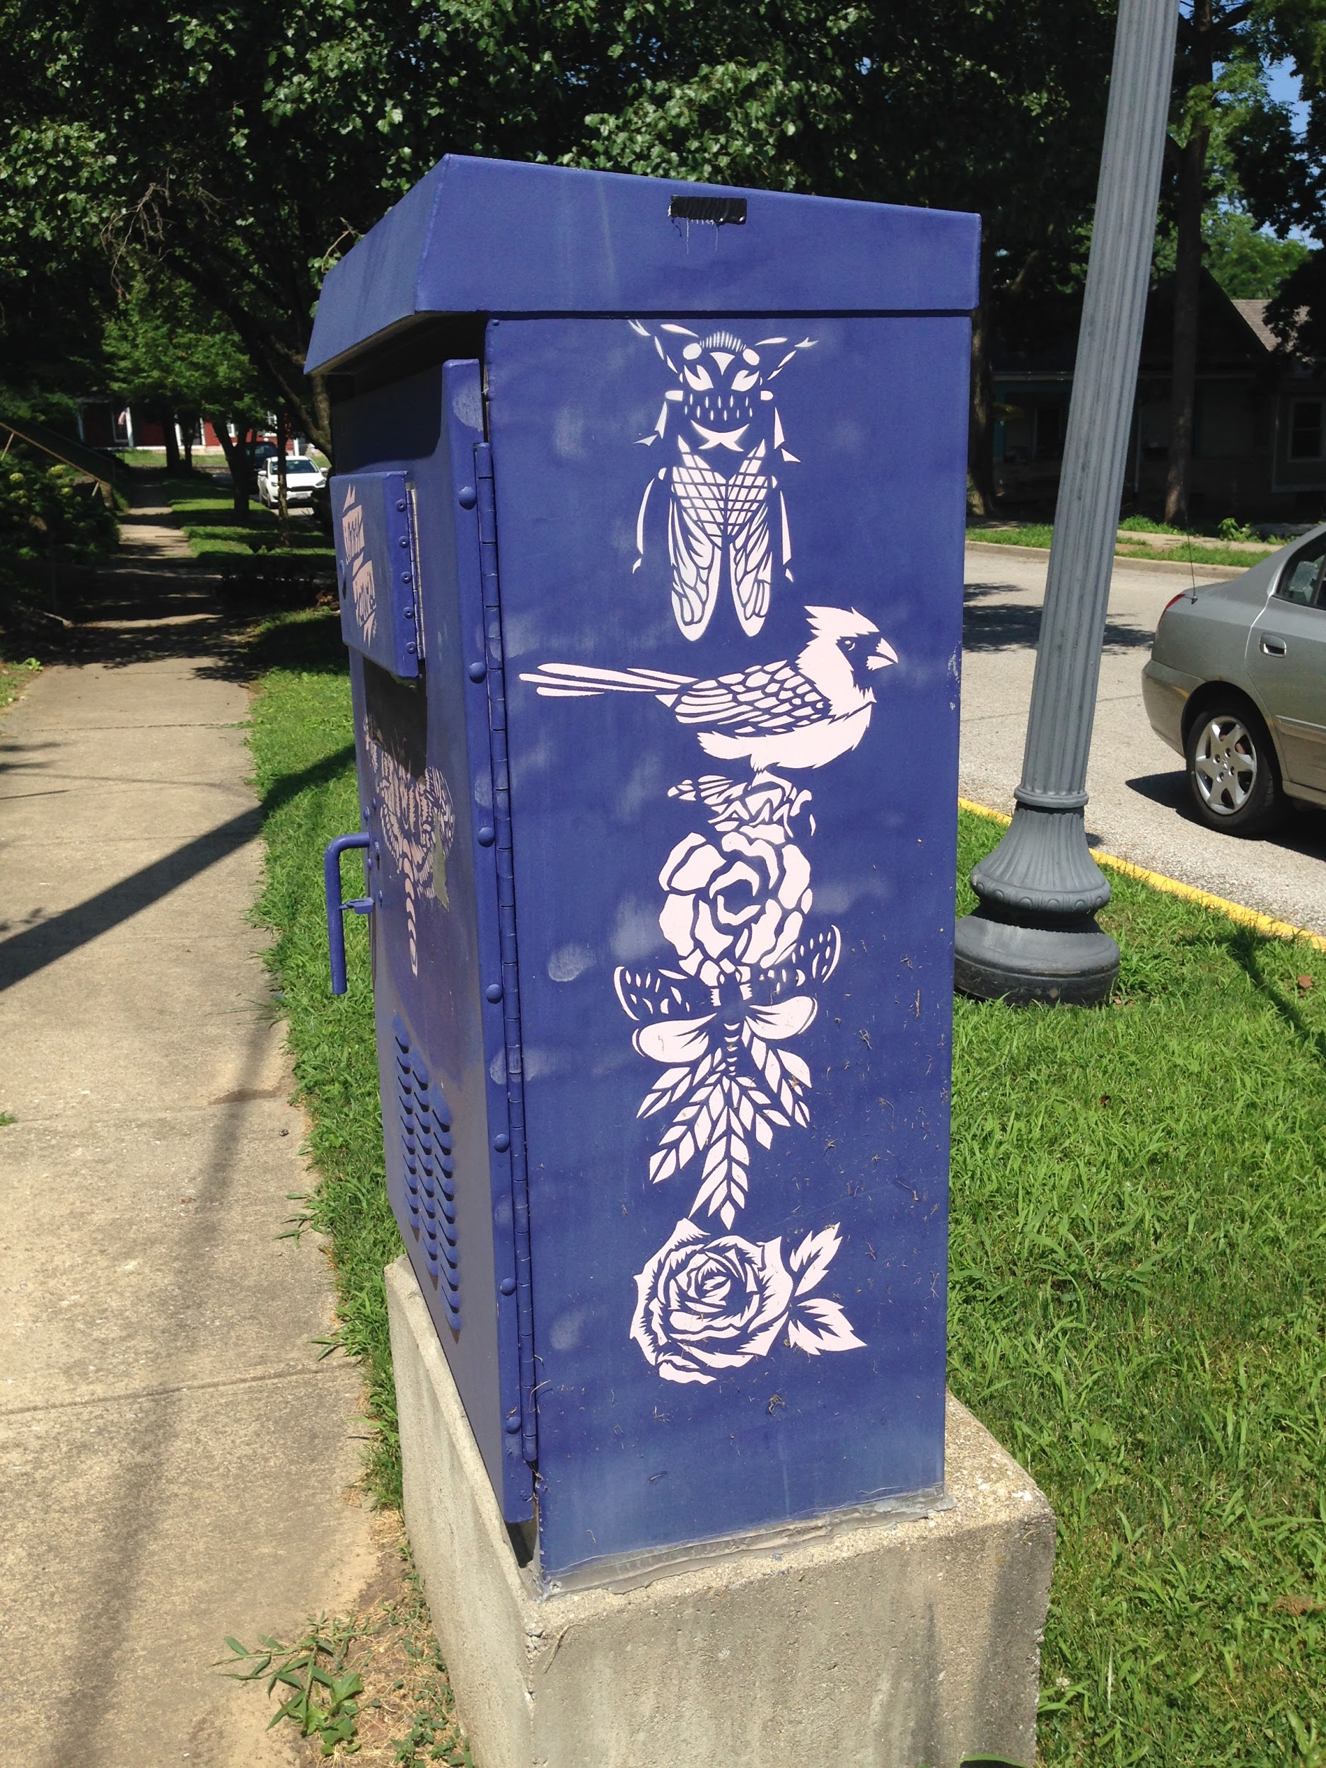
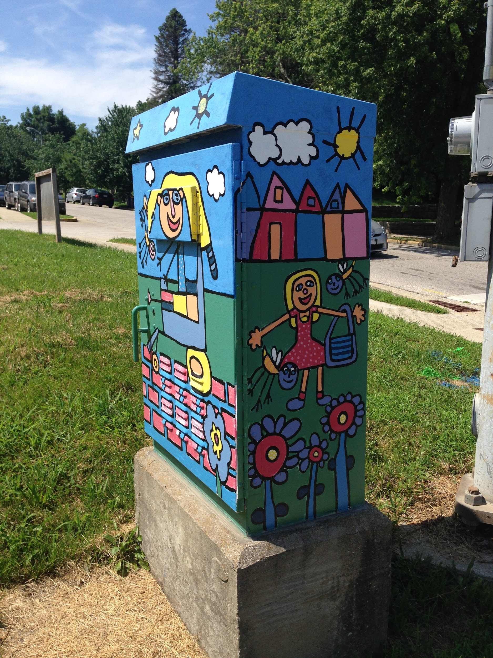
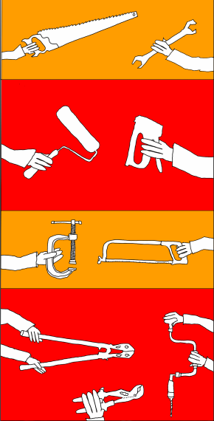
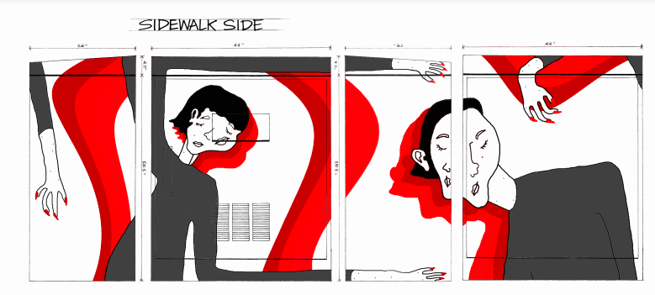
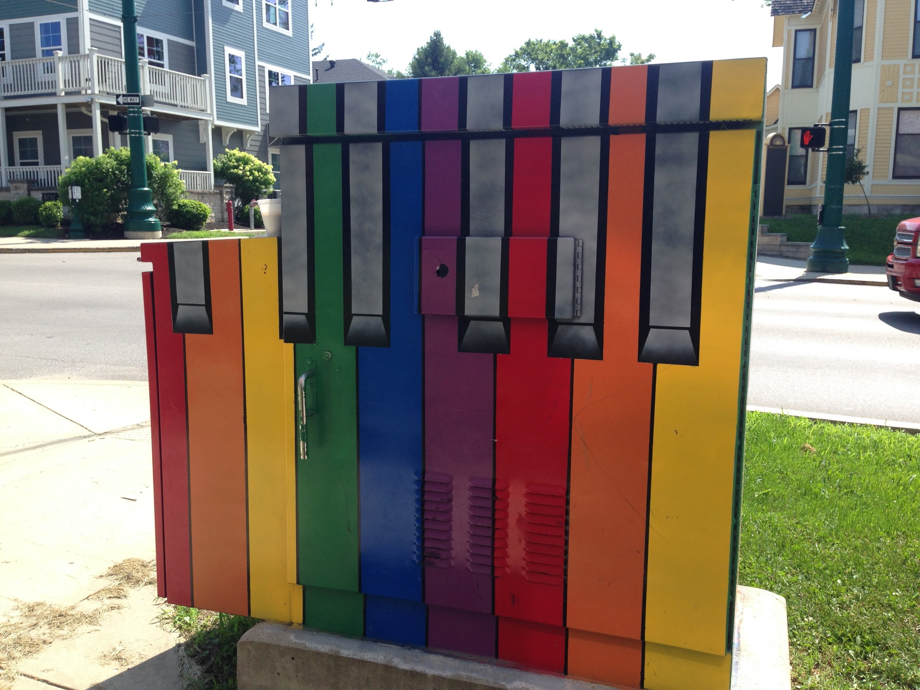

Notes:
Now pays up to $300.
Combining both material and artist fee into one payment.

Slide 25
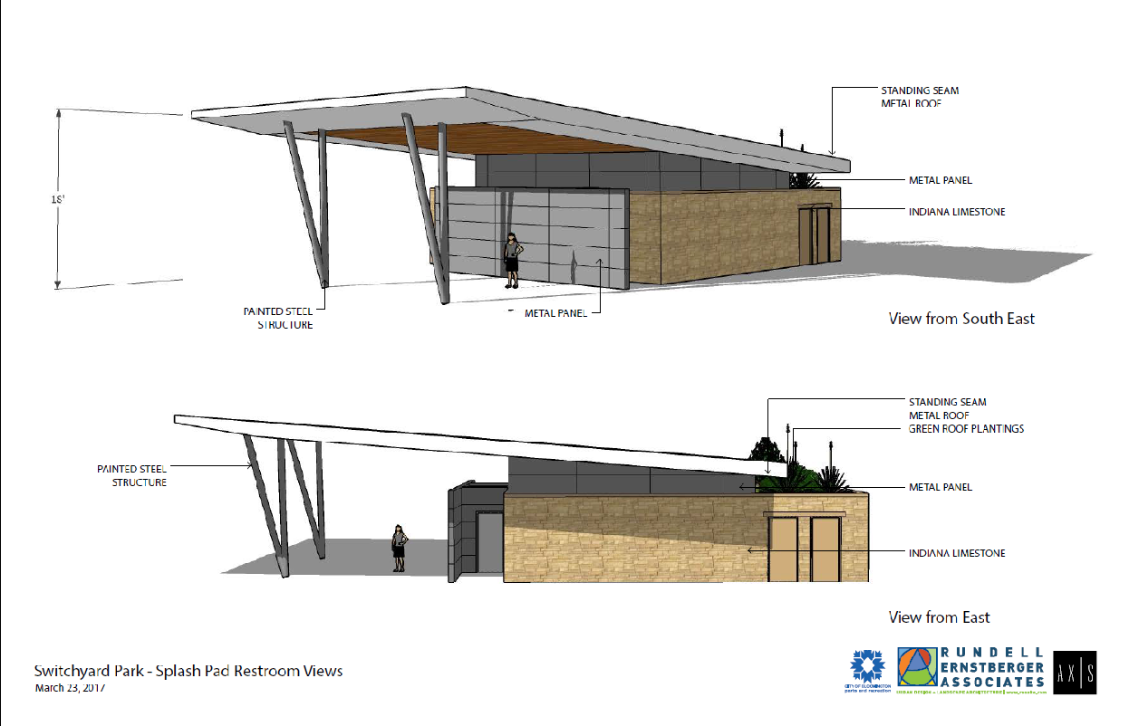
One Percent for Arts: Switchyard Park, Trades District

Slide 26
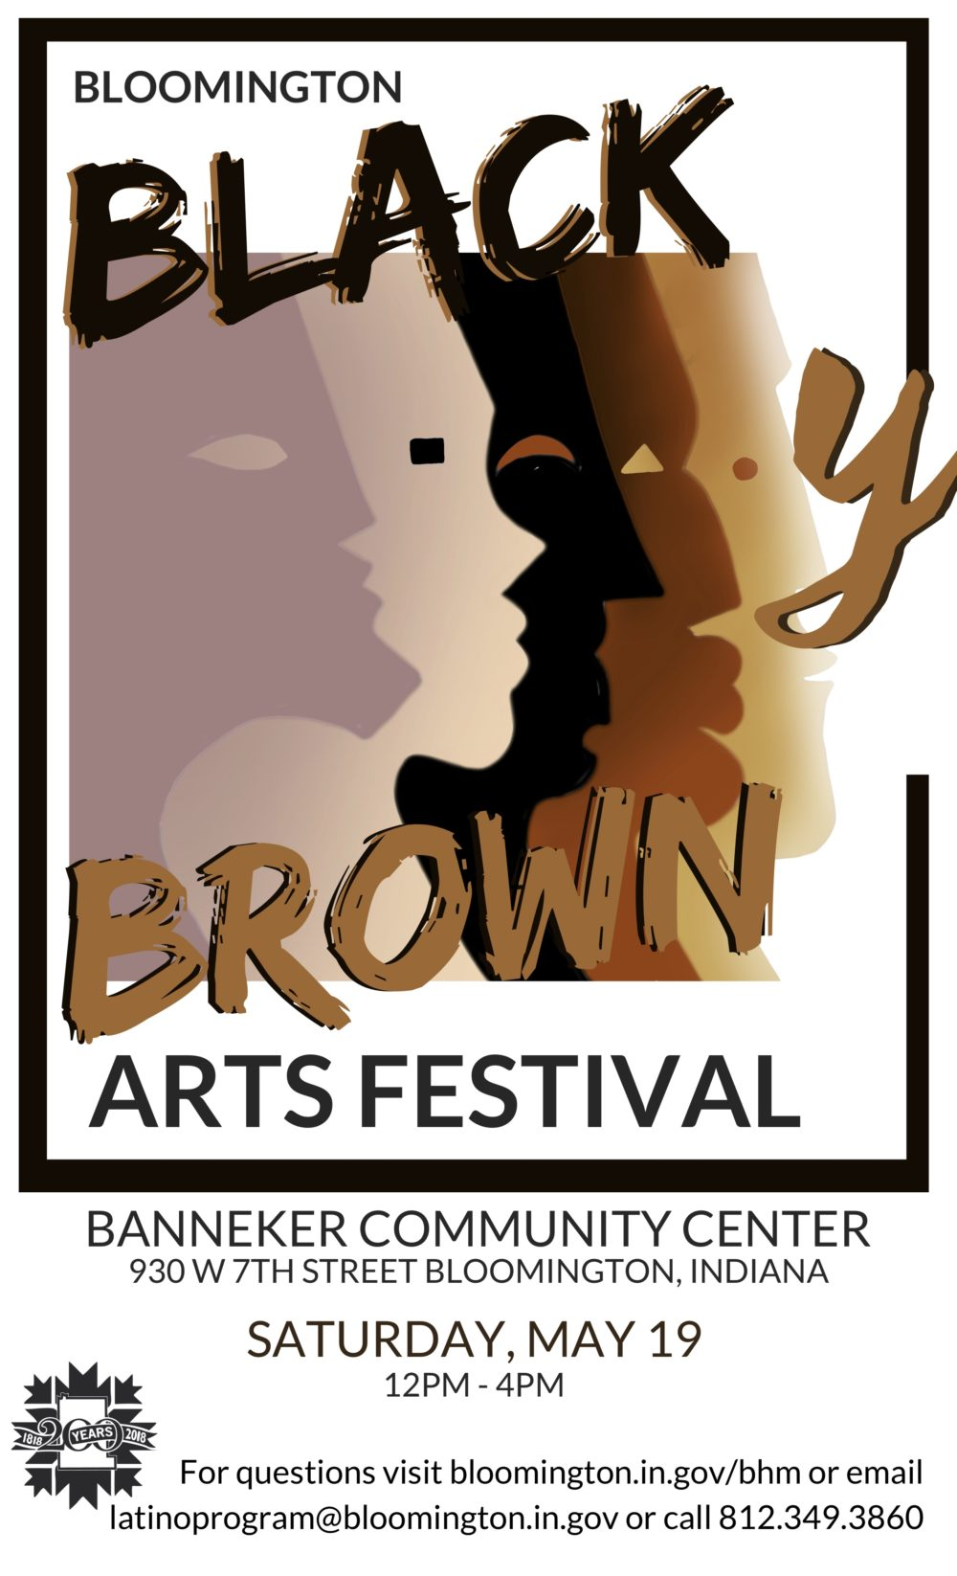
Notes:
Marisa Au la ping

Slide 27
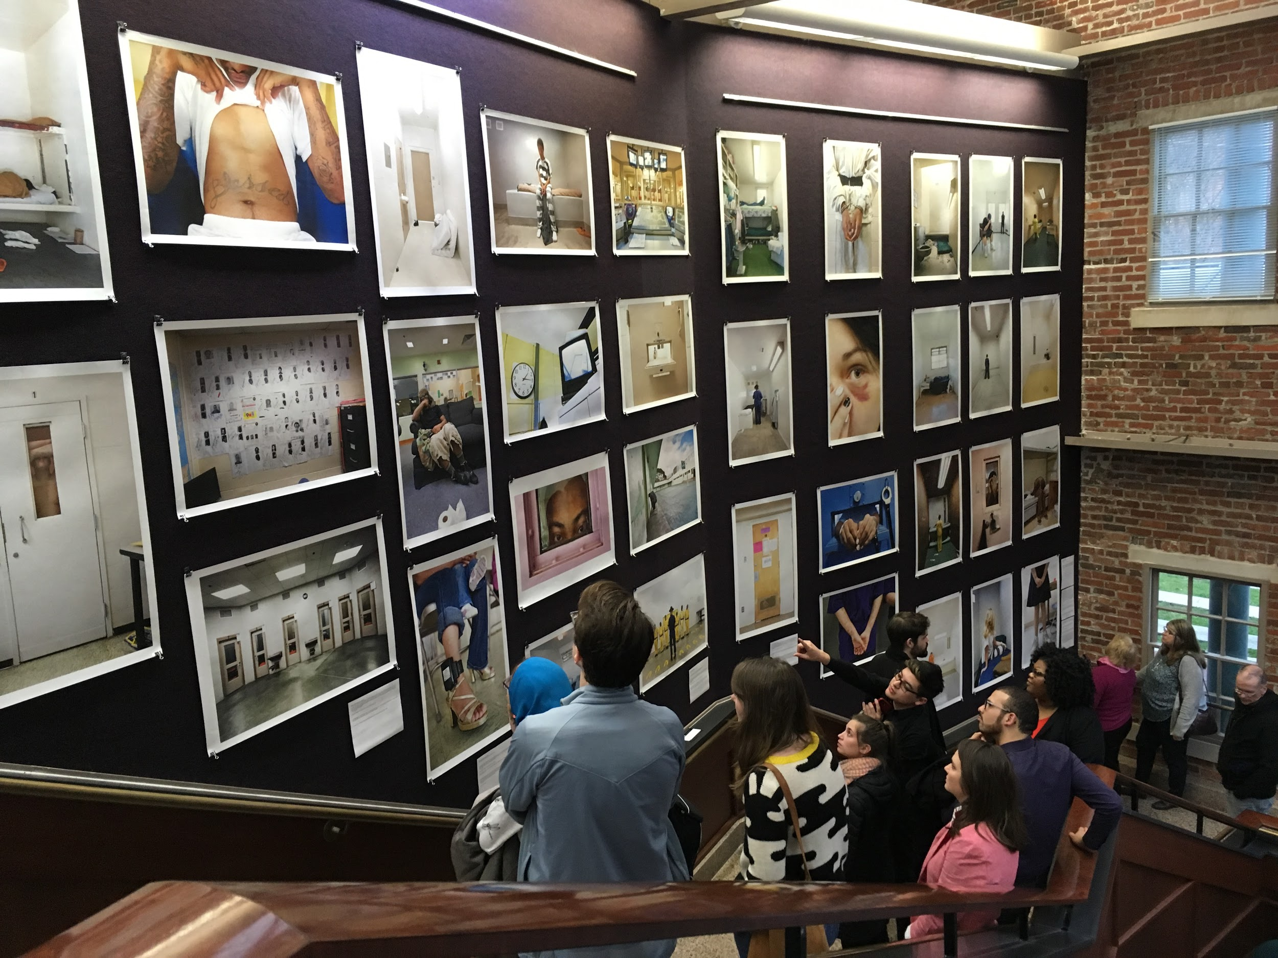

Slide 28
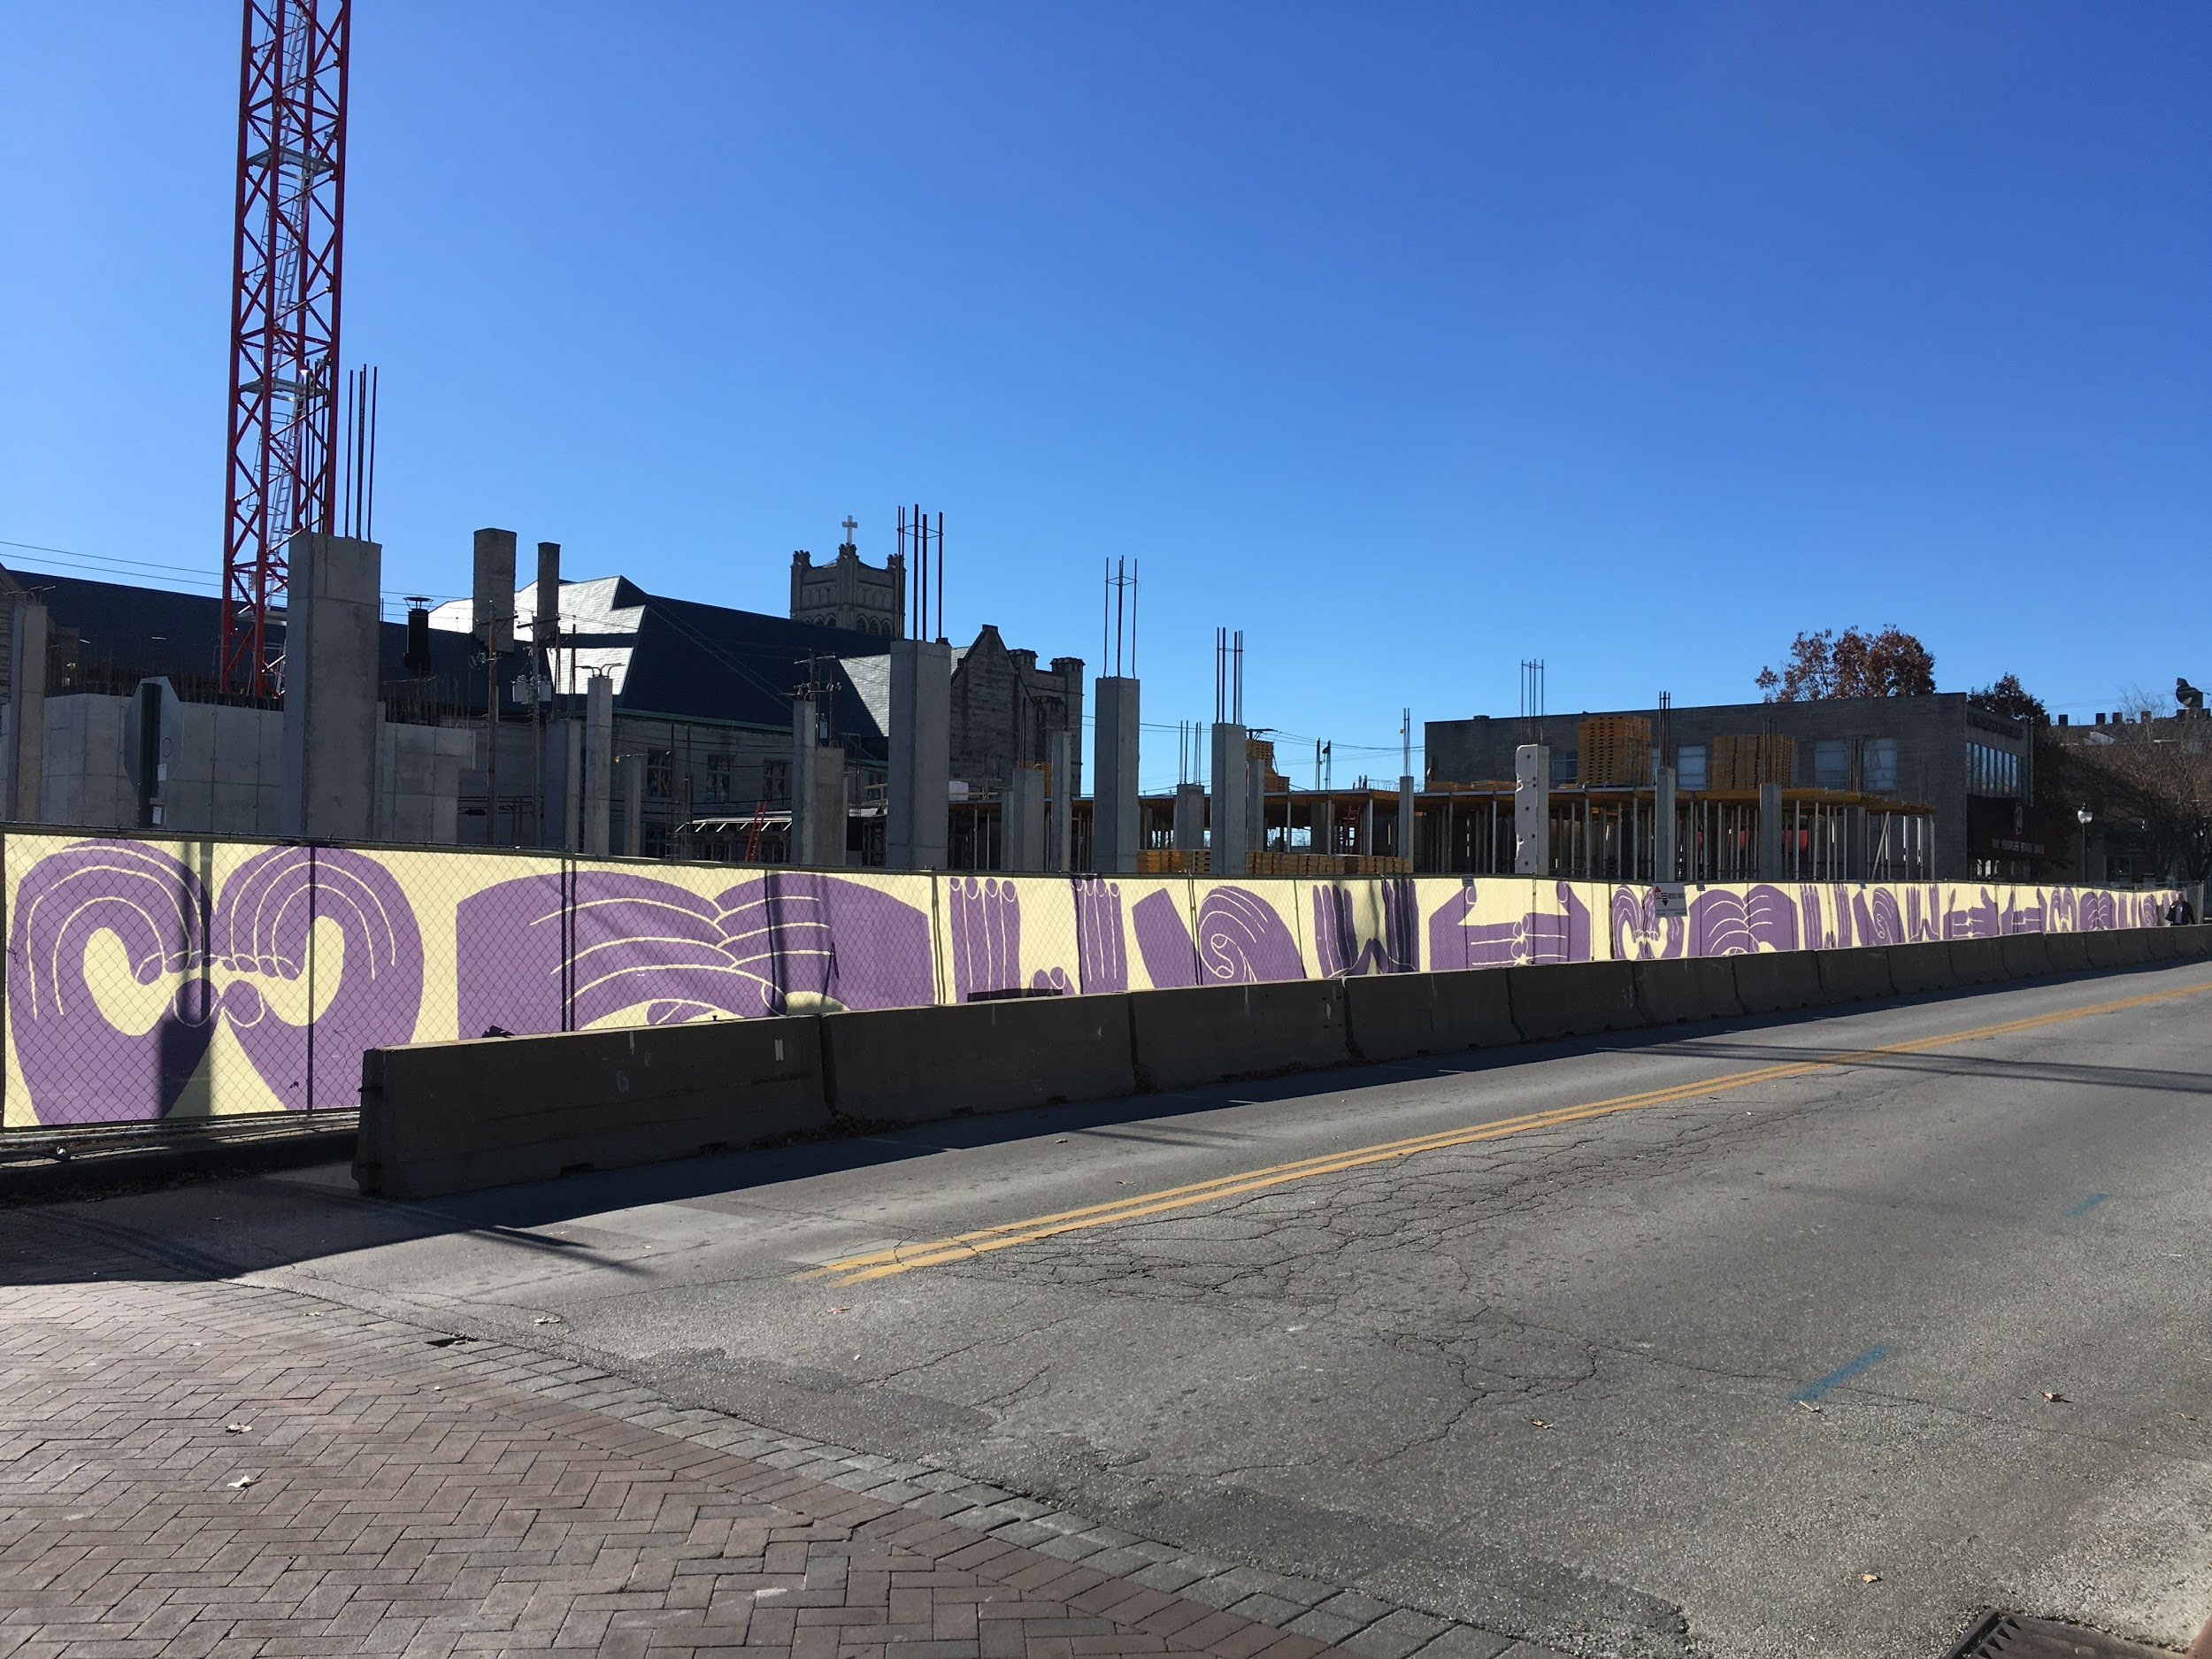
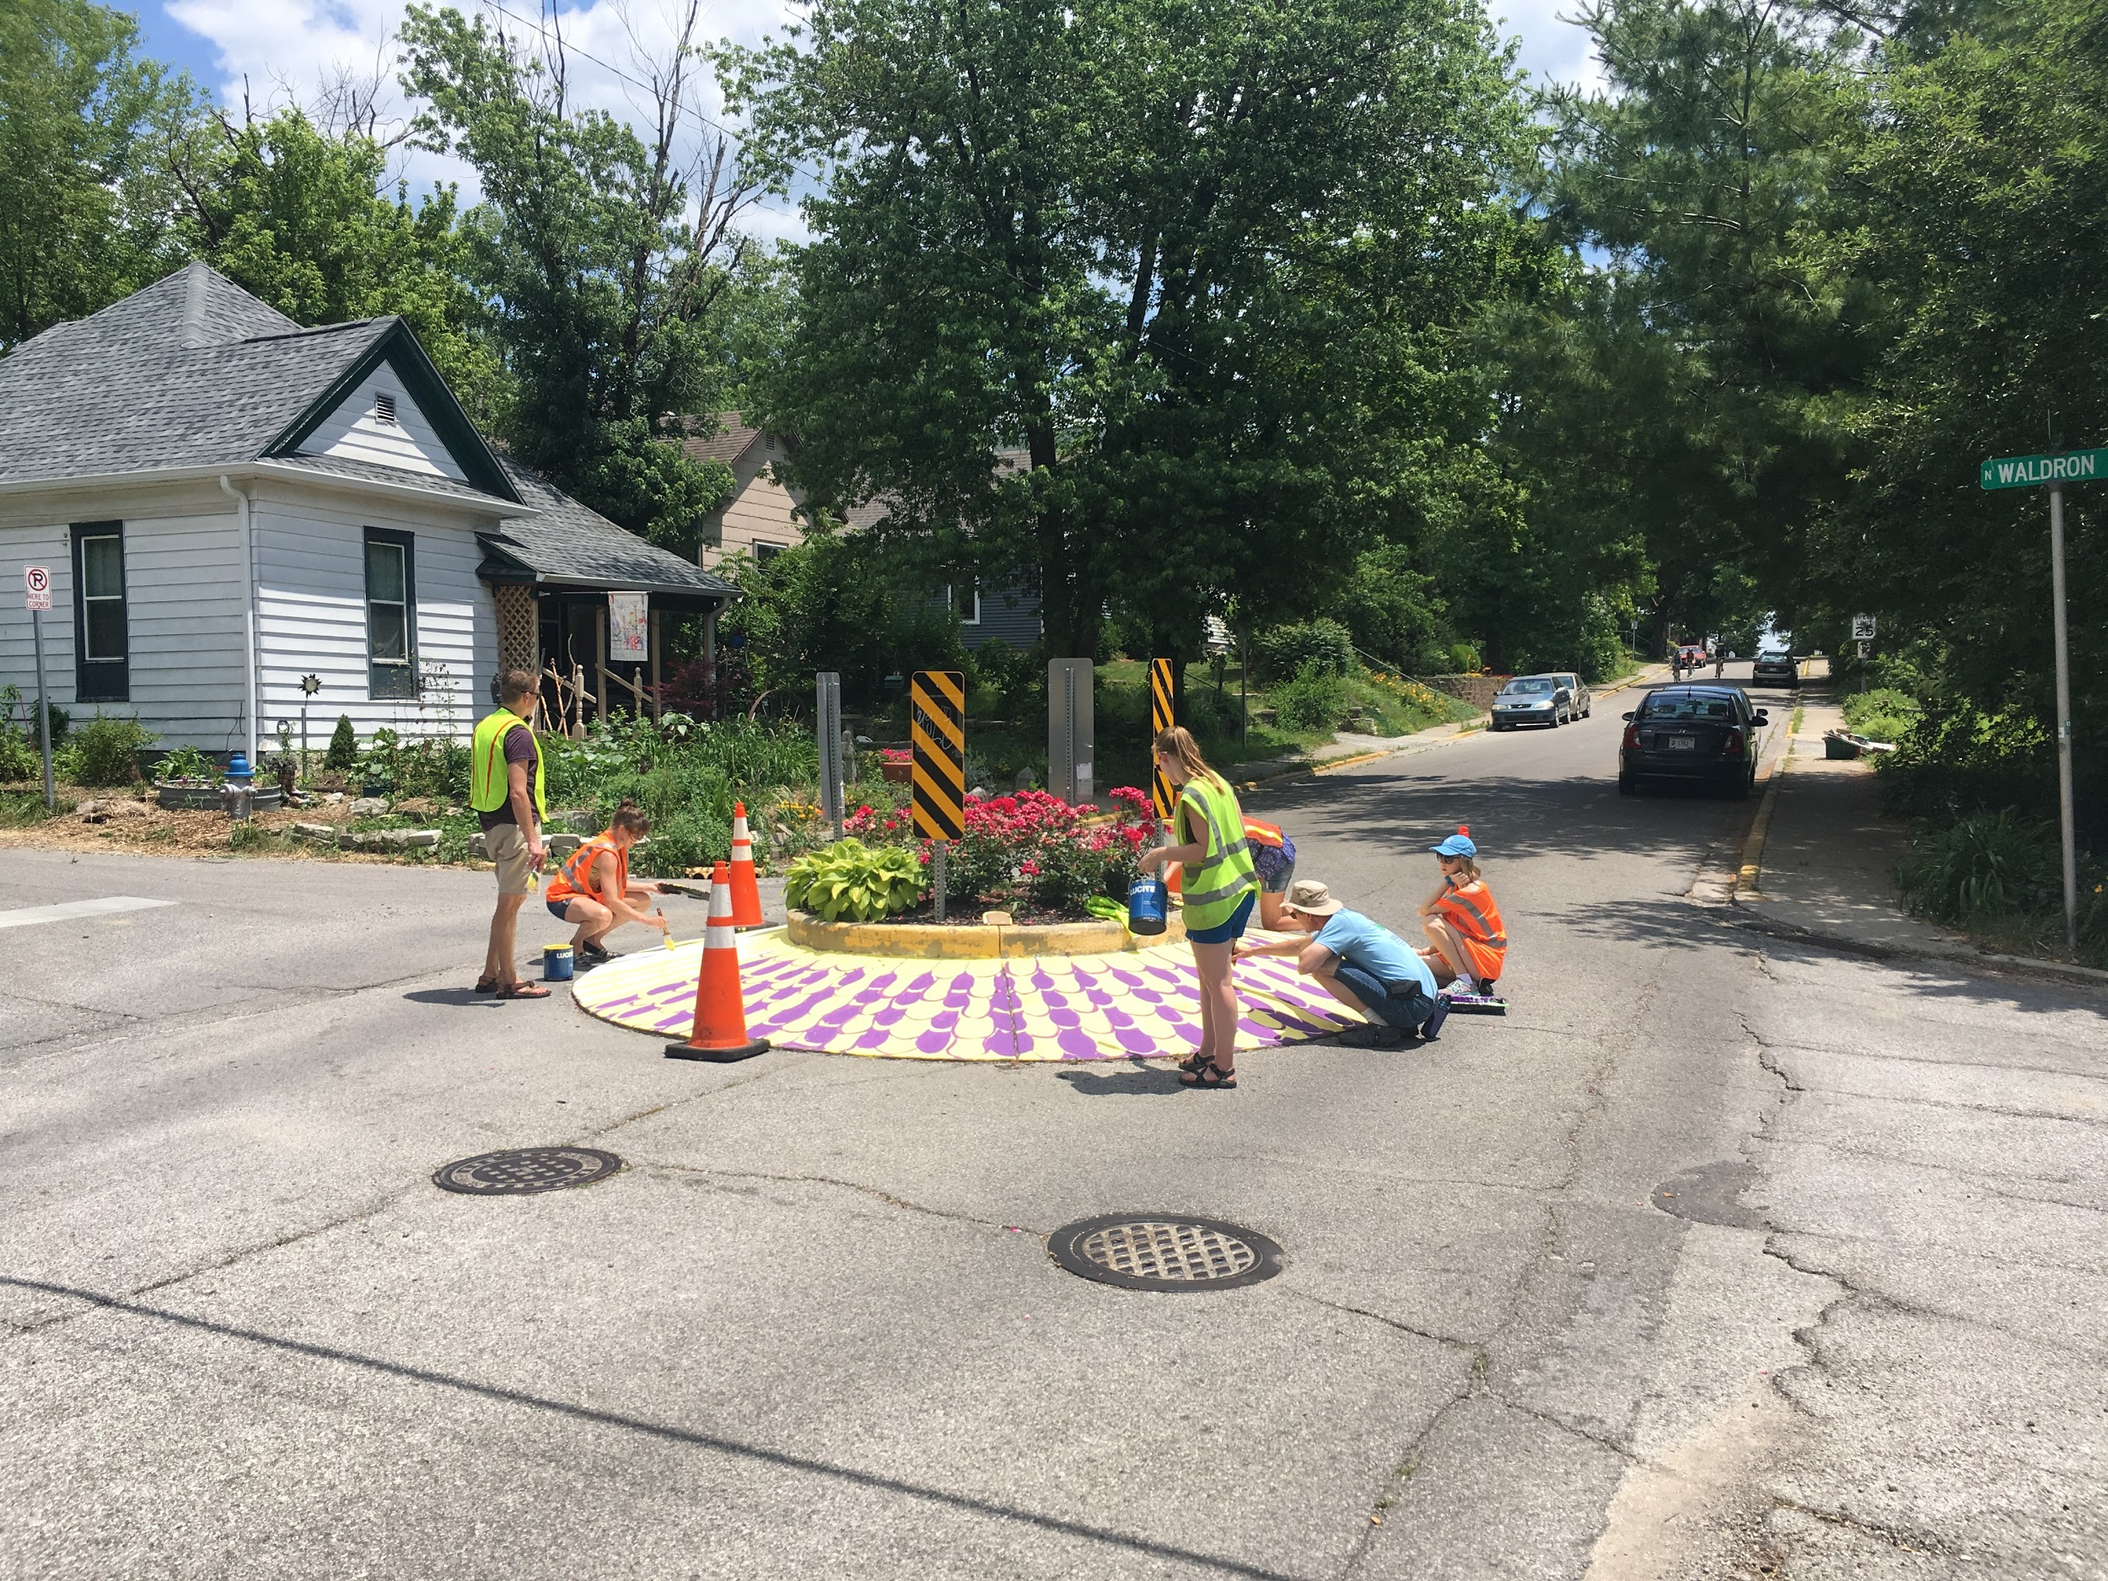

Slide 29
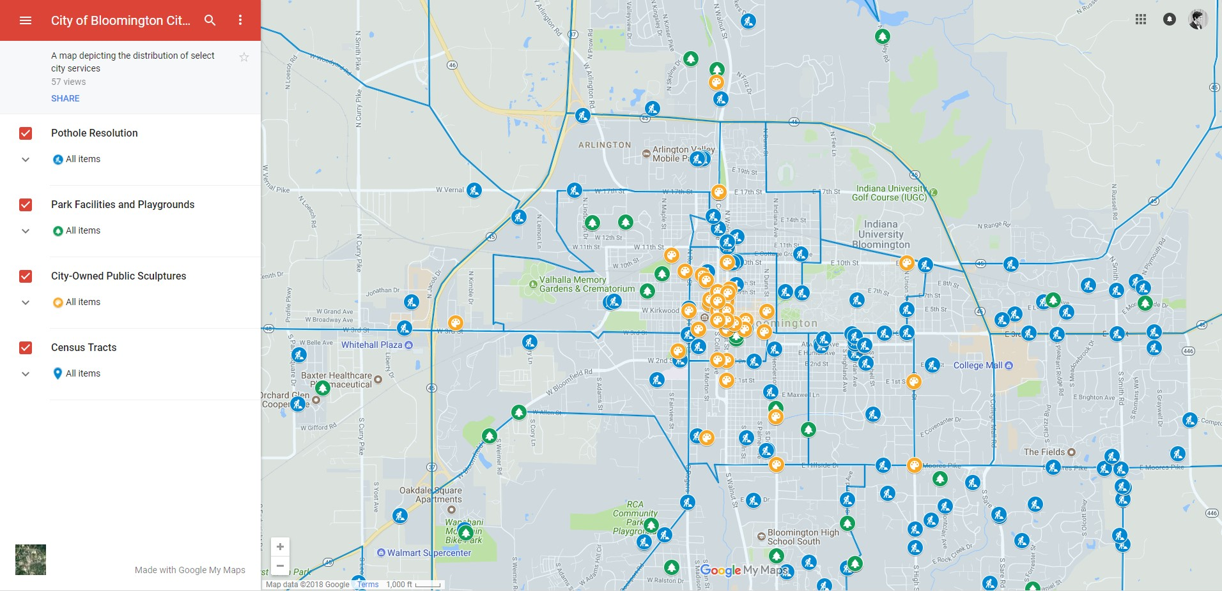

Slide 30
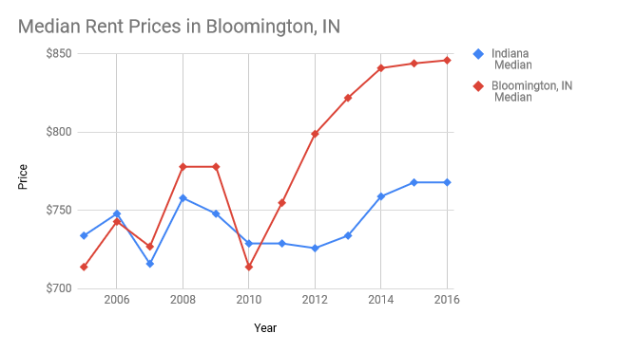

Slide 31
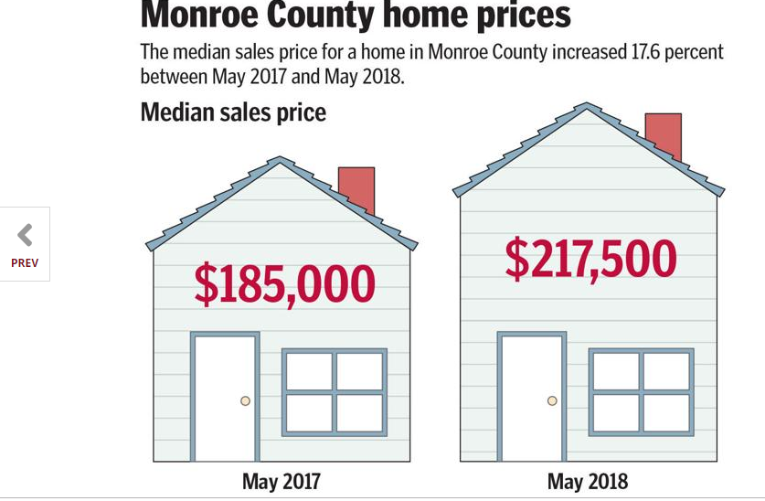

Slide 32
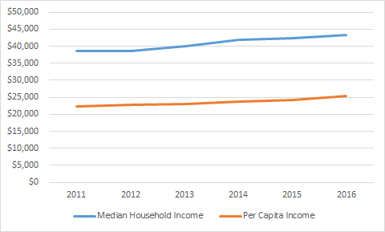

Slide 33
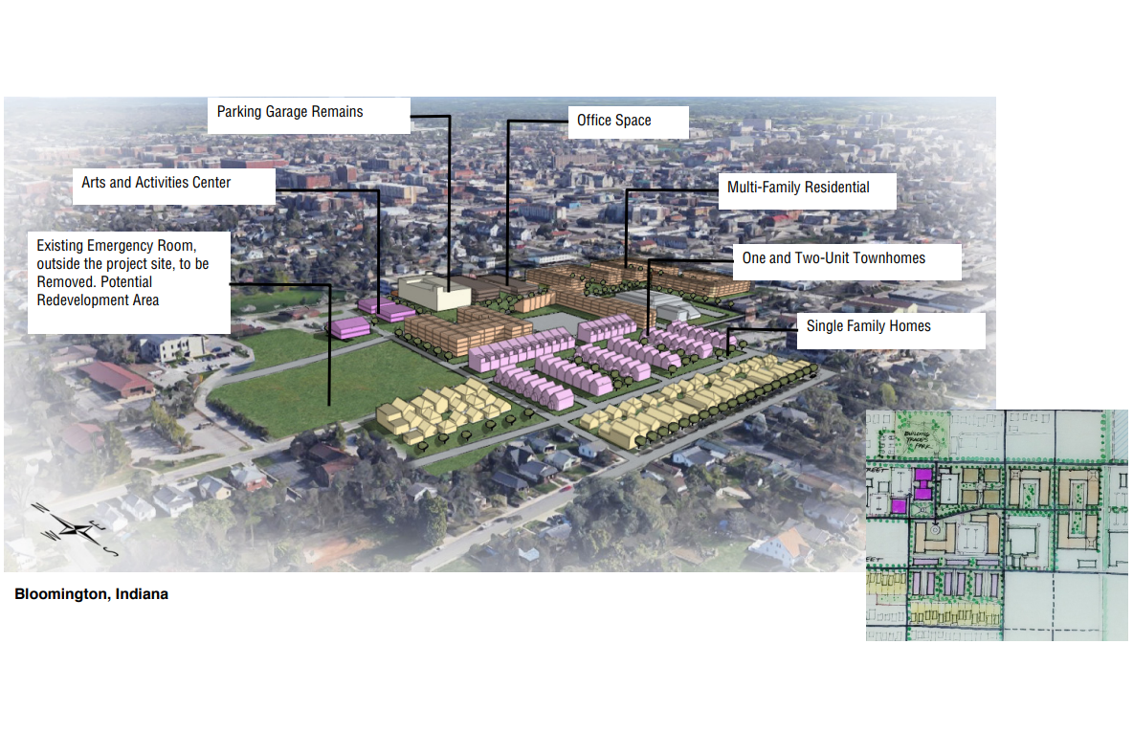

Slide 34
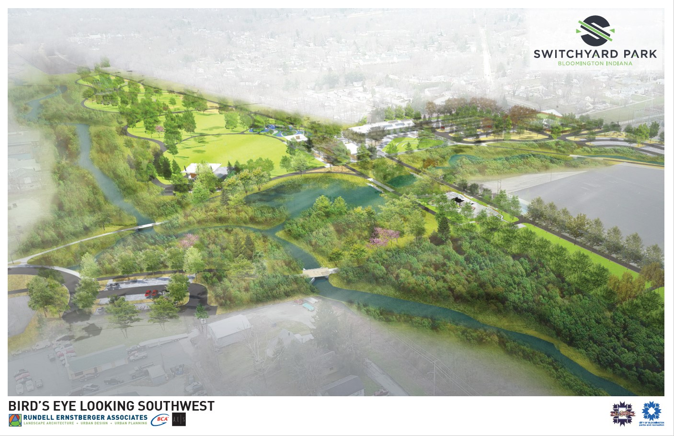

Slide 35
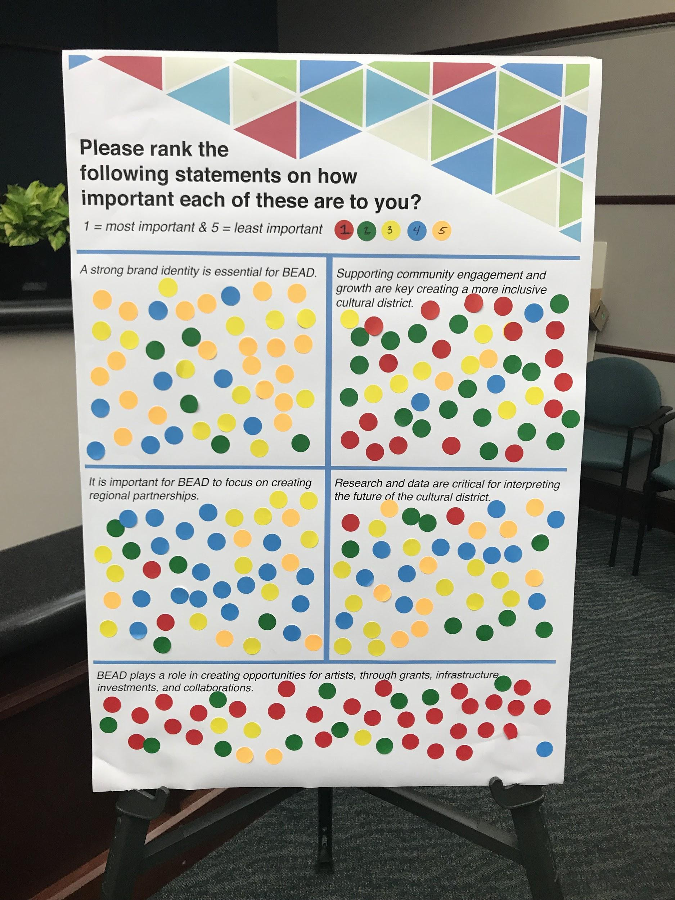
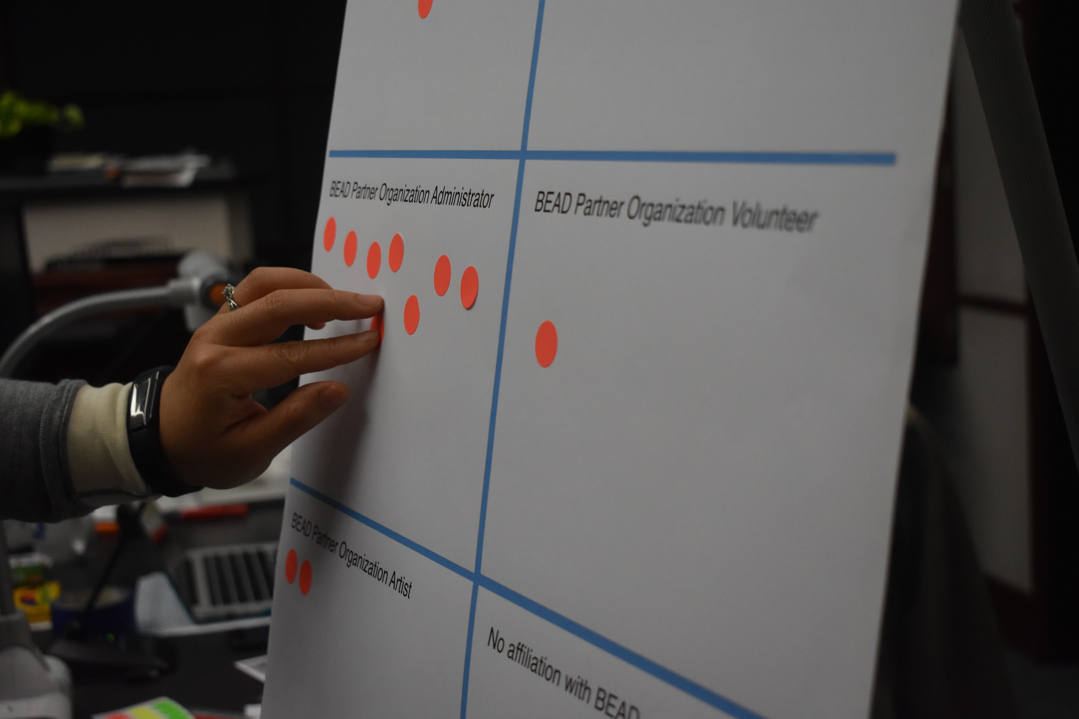

Slide 36
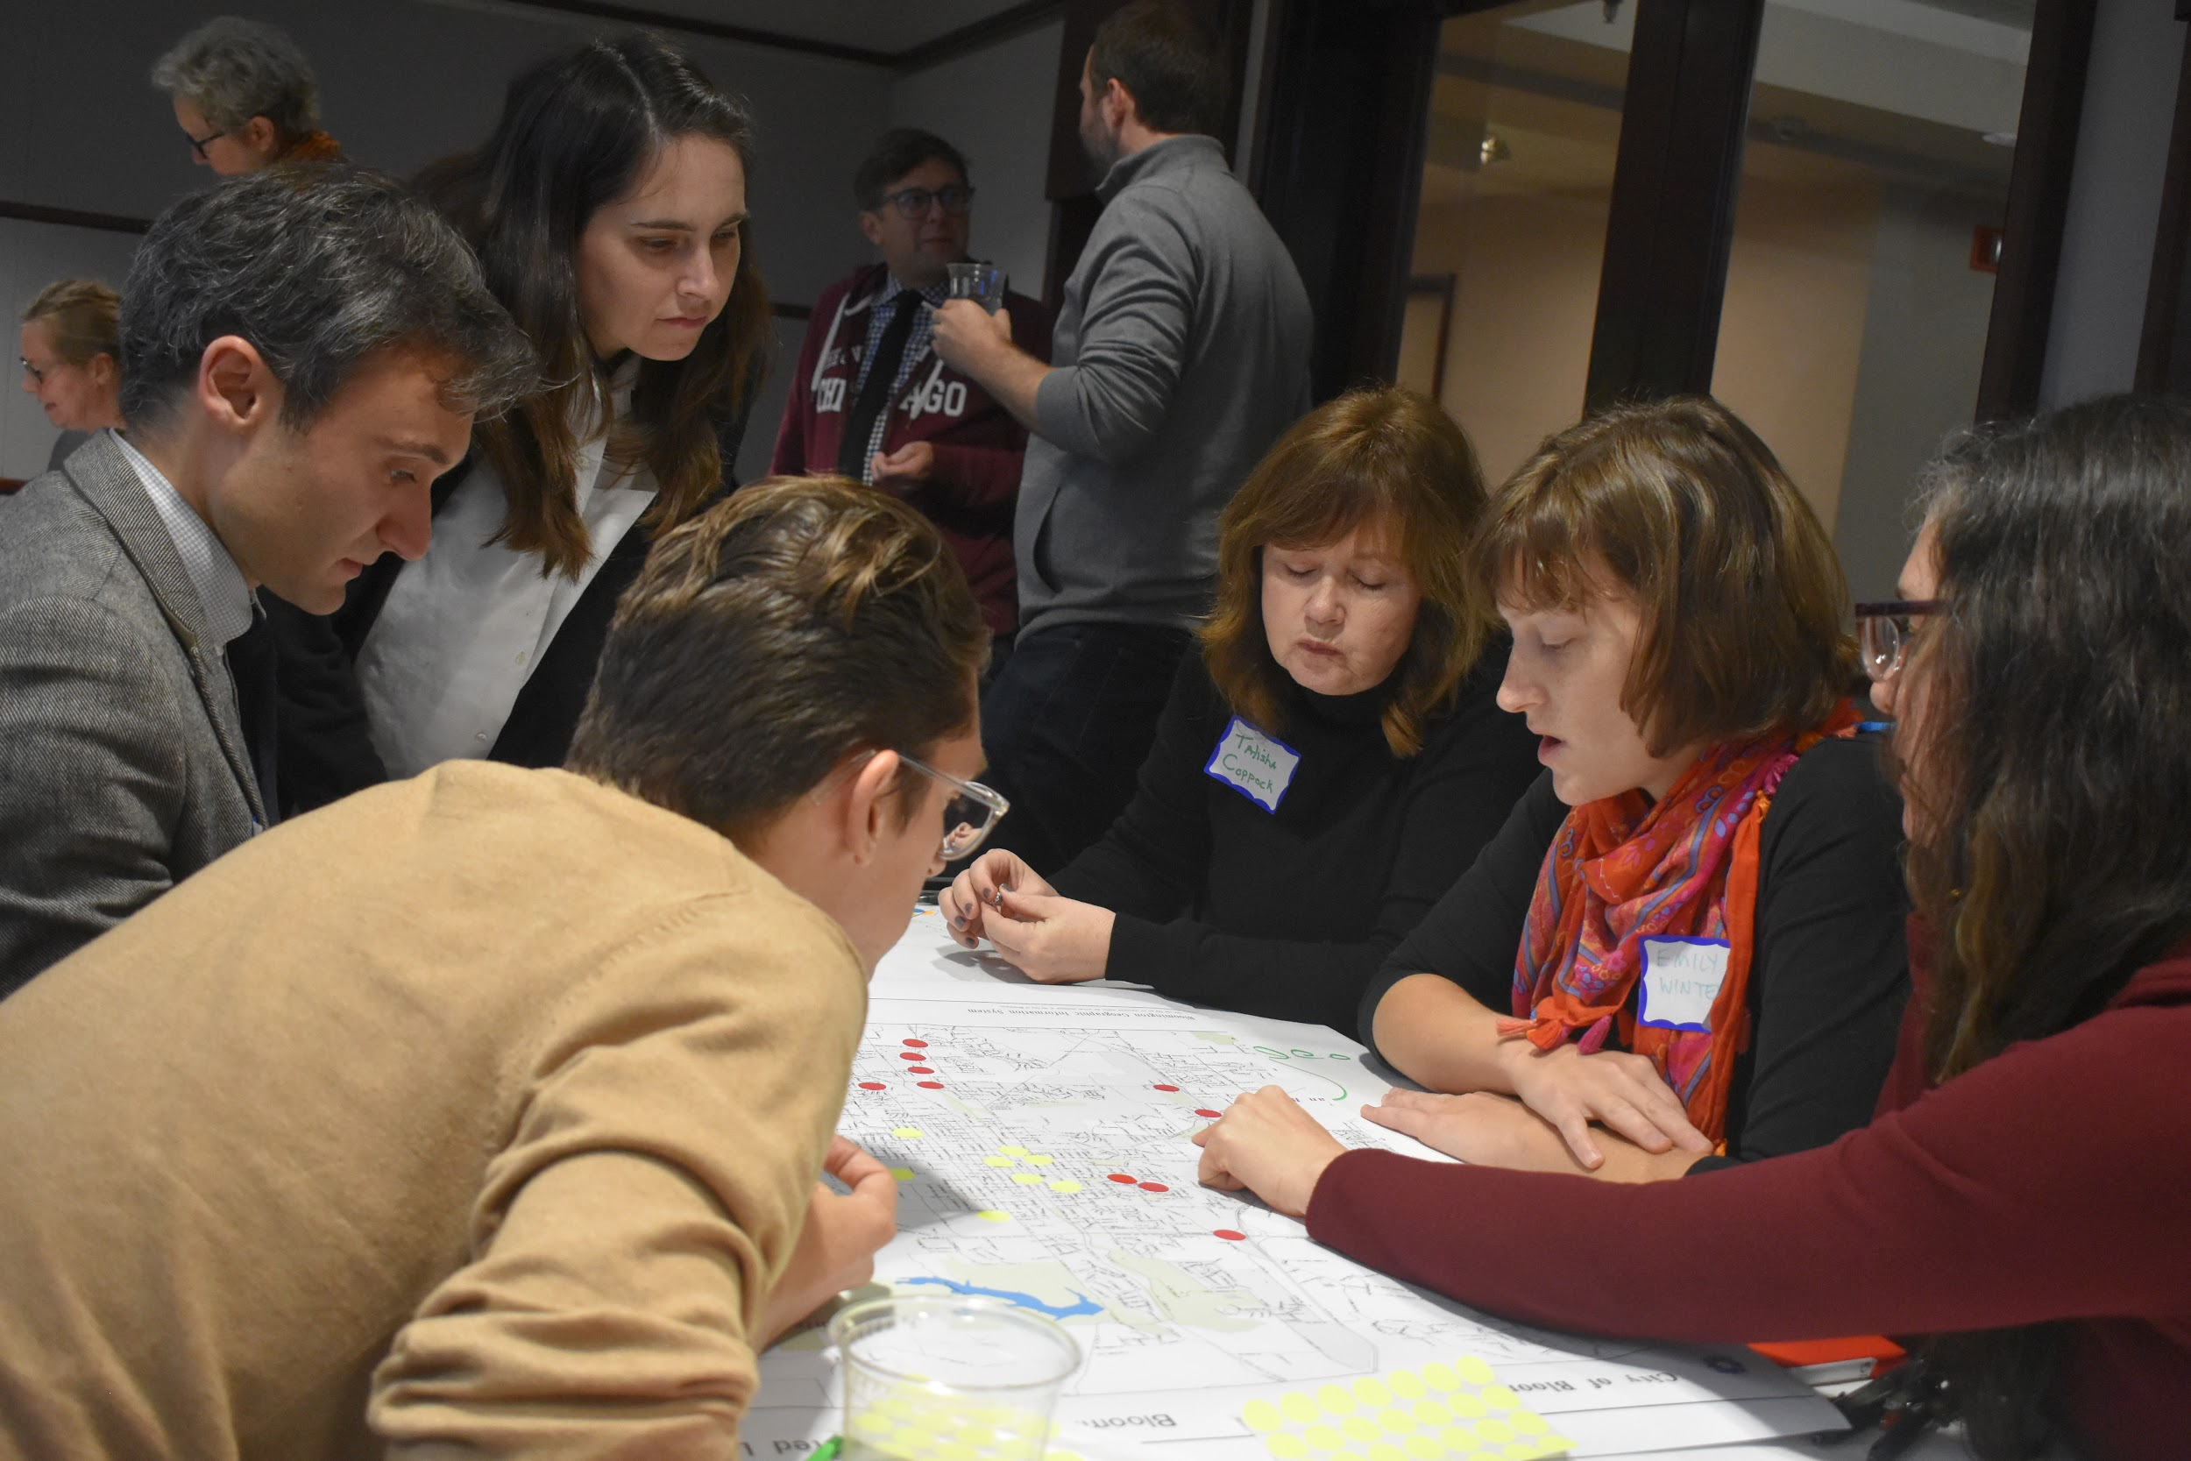

Slide 37
Challenges in the Establishment of Cultural Districts
Gentrification = Displacement: Social, Cultural and Economic
Staffing and administration
Financing and securing funding
Relevance to local residents
Relevance to local arts community
Long-term planning
Cultural districts find it challenging to bring tangible benefits and making those benefits accessible and equitable.
Source: National Assembly of State Arts Agencies: State Cultural Districts

Slide 38
2019-2021 Strategic Plan for the Bloomington Entertainment and Arts District
Mission: The Bloomington Entertainment and Arts District seeks to bring the business and creative sectors together to advance commerce and culture, build community, spur sustainable economic development and to foster excellent quality of place.
GOAL NO. 1: Promote and support district-wide cultural planning and identity efforts. The BEAD is committed to planning and implementing diverse policies and programs that enhance and promote an equitable, culture-enriched community.
GOAL NO. 2: Amplify and support the development of sustainable services, processes, and collaborations that increase community engagement and promote growth in and around the BEAD.
GOAL NO. 3: Coordinate research and advocacy initiatives about the BEAD to provide data and analysis to arts and culture organizations, partners, patrons, constituents, and supporters.

Slide 39
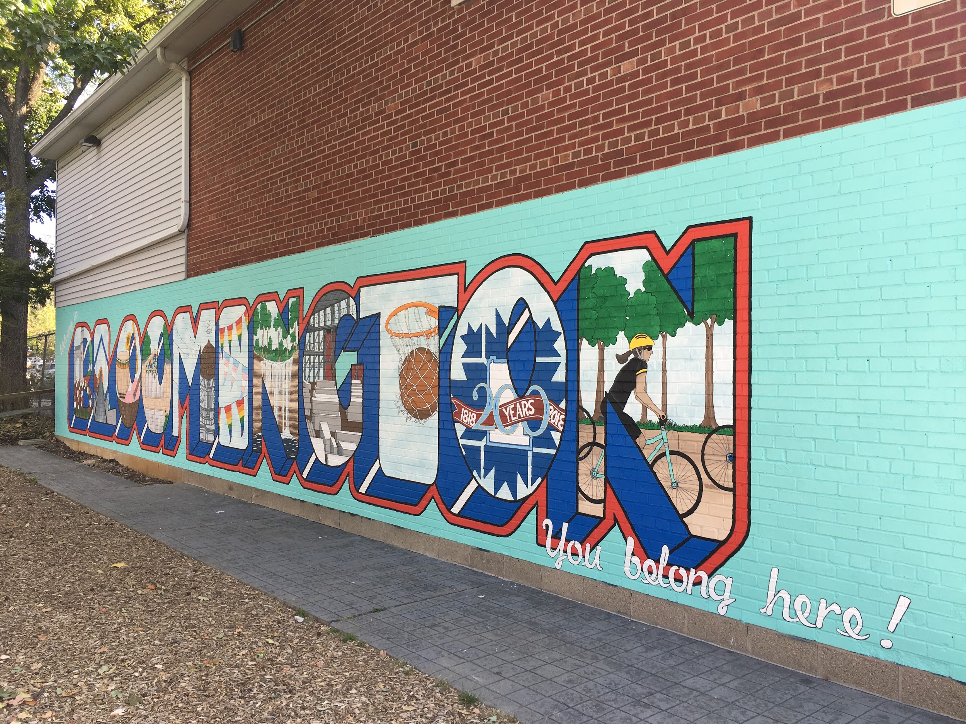

Slide 40
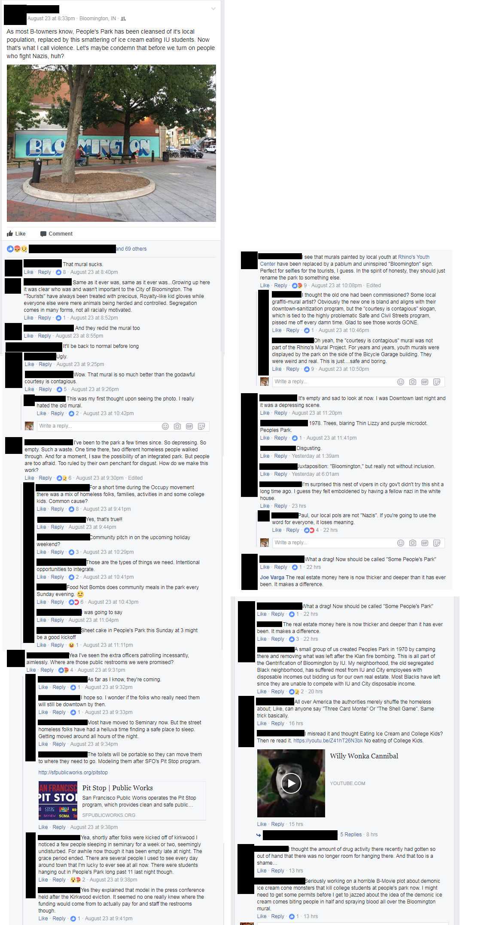


Slide 41



“WHY A WEEKEND IN BLOOMINGTON, INDIANA SHOULD BE BUMPED UP YOUR LIST”
Camels & Chocolate

Slide 42
Politics of/around public space and community identity are challenging...
Who Pays...
Who Benefits...
Who Decides…

Slide 43
Questions?
Sean M. Starowitz
Starowis@bloomington.in.gov
812-349-3534

