Slide 1
Creating a Vibrant Community Through the Arts
Indiana Arts Commission 100 N Senate Ave., N505
Indianapolis, IN 46204
(317) 232-1269
arts.IN.gov
@INArtsComm instagram
@Indiana Arts Commission facebook

Slide 2
Welcome! A little bit about us...
Paige Sharp, Deputy Director of Programs, Indiana Arts Commission
Brian Sheehan, Director of Special Projects, City of Rushville
Sean Starowitz, Assistant Director for Economic Development for the Arts, City of Bloomington
Tetia Lee, Executive Director, Tippecanoe Arts Federation

Slide 3
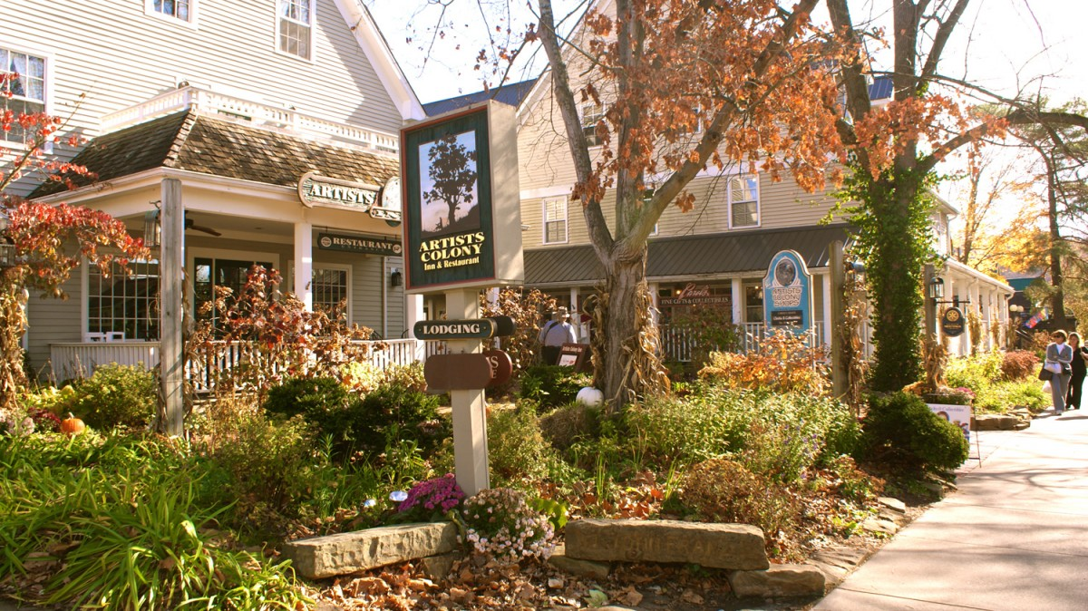
Today, you will learn about...
What a cultural district is including benefits and best practices.
How to identify, cultivate, and collaborate with the cultural sector for short and long term goals
As well as strategies for working with the creative community.

Slide 4
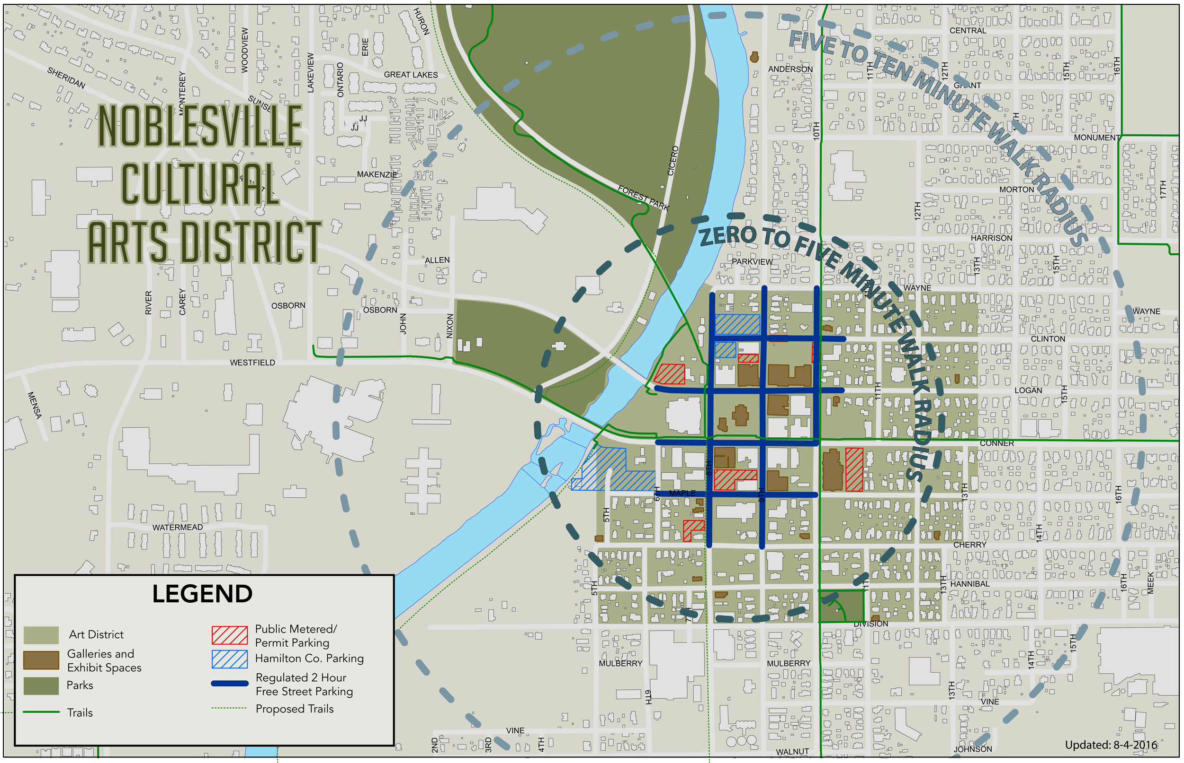
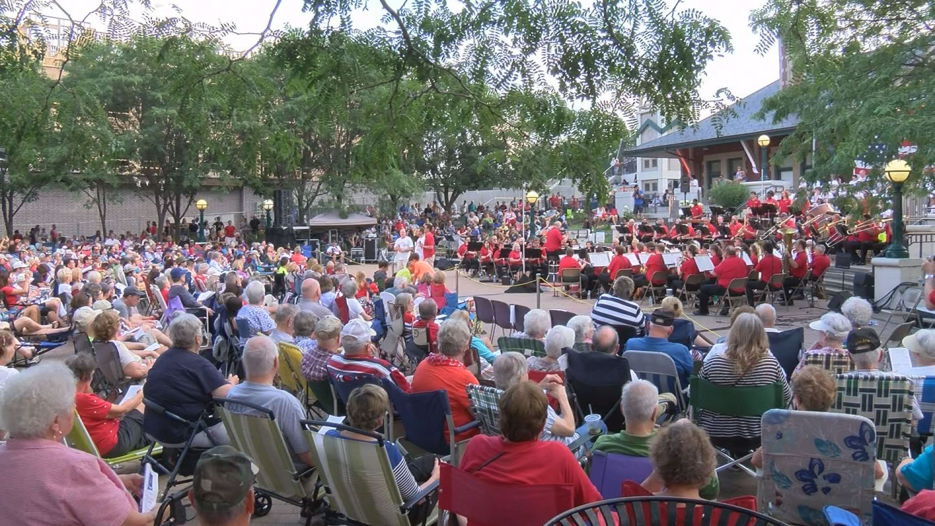
What’s a Cultural District?
Cultural districts are defined as well-recognized, labeled areas of a city in which a high concentration of cultural assets and programs serve as the anchor. They help strengthen local economies, create an enhanced sense of place, and deepen local cultural capacity. Cultural districts develop through cultural, community, and/or economic development planning efforts and can move a naturally occurring cultural cluster into a burgeoning cultural epicenter.

