Slide 2
Neighborhood Organizing
A basic introduction to the tools using in neighborhood organizing, as outlined through INRC’s Organizer’s Workbook.
Notes:
The trouble with organizing a thing is that pretty soon folks get to paying more attention to the organization than to what they're organized for. Laura Ingalls Wilder

Slide 3
Tools from the Organizer’s Workbook
ABCD
Steps to Direct Action Organizing
Develop a work plan
Servant Leadership
Engagement
Collaboration
Communication
Measuring Success

Slide 4
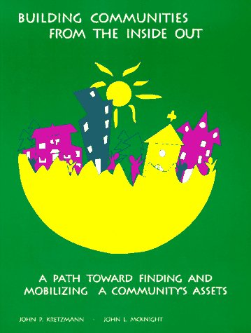
John P. Kretzmann and John L. McKnight
Notes:
John P. Kretzmann and John L. McKnight co-authored a book in 1993 called Building Communities from the Inside Out: A Path Toward Finding and Mobilizing a Community’s Assets. The book provided the first outline for an asset-based approach to community development.
The ABCD approach was developed by John L. McKnight and John P. Kretzmann at the Institute for Policy Research at Northwestern University in Evanston, Illinois. The Community Development Program at Northwestern University’s Institute for Policy Research established the Asset-Based Community Development Institute based on the research and community work of Kretzmann and McKnight.
Currently, Kretzmann and McKnight co-direct the Asset-Based Community Development Institute at DePaul University in Chicago, IL.

Slide 5
AB
Asset-Based
Notes:
What does “Asset-Based” mean to you?
Asset-Based means focusing on the good part of any situation. An Asset-Based mindset changes our natural inclination to view life and situations as problems that need to be solved and replaces those thoughts with a focus on supporting and promoting the things that are working.
There are assets in our city, on every side of town, in our communities, our neighbors, and ourselves.

Slide 6
Notes:
Close your eyes.
Think about one thing you dislike about yourself. Imagine that people only identified you by that feature. *Click* Think about how that makes you feel. Could we share a few words?
Now think about your best quality. How would you feel if people mentioned and praised this part of you? *Click* It feels good right? A few words?

Slide 7
CD
Community Development
Notes:
What is community development?
How do you feel when you hear the term? Negative? Positive?
Are there times when community development can be harmful?
How do we make community development a positive experience?
When we incorporate the skills, abilities, gifts, passions, and opinions of community members, we create an opportunity for community development to be an experience that brings people together. It is not a dictatorship. A “bandaid” to a problem. It is neighbors and residents discovering and creating opportunities where other people saw obstacles. It is focusing on strengths instead of surrendering to weaknesses.

Slide 8
Exchange
Land
Institutions
Associations
People

Slide 9
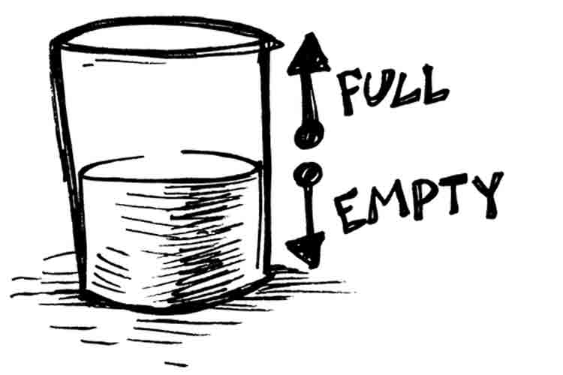
Notes:
ABCD is not simply seeing the glass as half-empty or half-full. It is recognizing the glass of water as an asset.
Reference the Hand out (need map and asset map)

Slide 10
6 Steps to Direct Action Organizing
People identify something to improve
Organization turns the problem into an issue
Develop a strategy
Bring many people to meet with the decision maker
The decision maker reacts to you.
Win, regroup, and go on to the next campaign

Slide 11
6 Steps to Direct Action Organizing
People identify something to improve
Notes:
After you identify your assets, you can start working on making improvements. What might be a problem that your neighborhood would address?
If none, use walkability – people can’t get around very easily

Slide 12
6 Steps to Direct Action Organizing
Organization turns the problem into an issue
Notes:
Solve one aspect of the problem.
Walkability – You might want broken sidewalks repaired, or better ADA ramps,or better signs at intersection.

Slide 13
6 Steps to Direct Action Organizing
Develop a strategy
Notes:
Define your goals – Who cares? Who can help you (ABCD list)? Who has the power make a decision? What tactics will you use?
Sidewalks – ADA – people in your neighborhood who are elderly or live with disabilities – City’s office of disability coordinator – Health by Design – DPW staff, maybe CCC, Meetings with decision makers

Slide 14
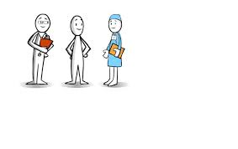
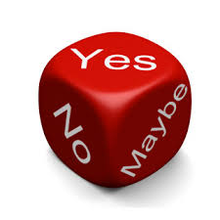
6 Steps to Direct Action Organizing
Bring people to meet with the decision maker
The decision maker reacts to you.
Notes:
May need more than one meeting. May need to compromise “maybe”. Remember that the decision maker is getting pushed from more than one side – your’s is not the only issue they are facing

Slide 15
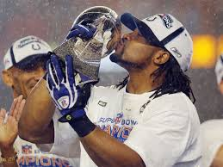
6 Steps to Direct Action Organizing
Win, regroup, and go on to the next campaign
Notes:
Even if you don’t win this one, you might win next time. You’ll never win, if you quit playing.

Slide 16
Work Plan
Description of Task | Goal/Outcome | Resources | Timeframe/Deadline | Result upon completion | Partners: Committed/Potential
Notes:
Description of the Task
Goal/Outcome
Resources
Timeframe/Deadline
Result upon completion
Partners – Committed/Potential

Slide 17
Notes:
Exercise: Plan Annual meeting together

Slide 18
Servant Leadership
Notes:
Servant Leadership – Seek not to be served, but to serve, see big picture, work for common good, create trust, seek consensus, encourage collaboration, don’t seek power, listen, model appropriate behavior

Slide 19
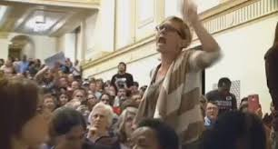
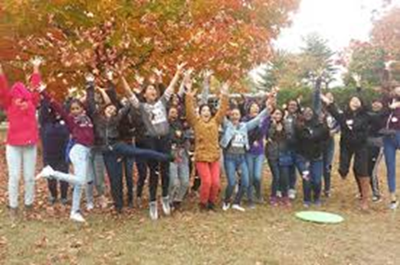
Stages of Group Development
Gathering
Chaos
Unity
Performance
Notes:
Gathering – Get to know each other, acknowledge new and old members, outline expectations, invite questions, level playing field, give all chance to be heard
Chaos – Build common ground, active listening, encourage personal stories and perspectives, clarify purpose and goals, accept/manage conflict, communicate often
Unity – Buy-in for a plan, buy-in for evaluation of success, focus on tasks, teach value and conflict mgmt., celebrate diversity, celebrate consensus, share progress
Performance – Coach and validate, pass on wisdom to others, celebrate future challenge

Slide 20
Appreciative Inquiry/Engagement
What is possible?
What is best?
What should we strive for?
Notes:
Not too much on Engagement with this course, because many of you attended the course on 2/6
Another way to look at AI – Possible, best, and strive for ---
Use positive and unconditional questions – Negative question might be: Why do you think we can’t get people to help our neighborhood?
Minimize questions that direct toward an answer – Example: Do you think having food at our meetings would improve attendance?
Use open-ended questions that promote thoughts and ideas. Ask for examples of close-ended and open-ended questions.
(Do you think we should build more sidewalks? vs. do you have any ideas to promote more walking in the neighborhood?

Slide 21
Collaboration
Notes:
No notes

Slide 22
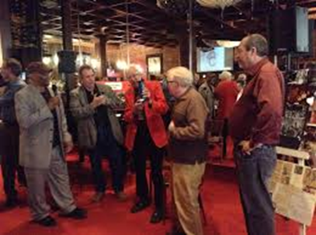
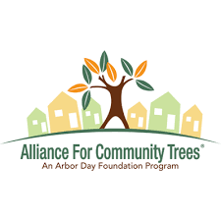
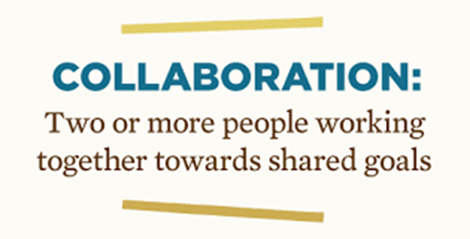
Collaboration
Networking
Cooperation or Alliance
Coordination or Partnership
Coalition
Collaboration
Notes:
Networking – build relationships
Cooperation/Alliance – Match needs, limit duplication, short term (KIBI/Tree planting)
Coordination/Partnership – Share resources, merge resource base to create something new, some formal links, with roles defined (Grant application)
Coalition – Share ideas and resources – longer-term commitment, usually around a task or issue, formal links and defined roles (Serving homeless)
Collaboration – shared vision and measure impacts, build interdependent system

Slide 23
Communication
Marketing Tools | Collaborations/ Partnerships | Target Populations | Strategies
Notes:
Newsletters, fliers, website, facebook, twitter (and other technology), Nextdoor, media coverage
All this is to market your neighborhood --- To whom? Your neighbors, those you might work with, new residents, the community at large, decision-makers, like CCC

Slide 24
Notes:
Each take few minutes to think about the communication mapping, and we’ll share out.

Slide 25
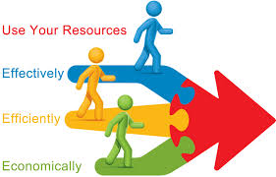
Meeting methodologies
Relationships
Resources
Results
Notes:
The three Rs……………………..
Relationships – How will participants relate to you, each other and the result?
Resources – What do people have and can bring to help get the result?
Results – What do you want to accomplish? What will you see when the project is complete?
Many types of meeting formats in Organizer’s Workbook

Slide 26
Measuring Results
Notes:
Identify Goals, and then objectives (Outcome and Process)
Time-frame may be important – Quality may be important – Numbers (total) may be important – Triangle, but not equilateral
Find out by: collecting data (need baseline data to show change), talking with participants, etc., surveys

Slide 27
Results
Outcomes At the end of this project, what results will you have achieved? | Experience Once this outcome has been accomplished, what will the participants have experienced? | Story What is going on currently to let you know that your participants would benefit from this outcome? | Strategies What sorts of things can we do that will work to change our outcome? | Measurable How do you plan to measure the success of this outcome? | Partners Who can assist you with this outcome? | Actions What works/actions or next steps do you need to take in order to accomplish your outcome?
Notes:
Worksheet to help you plan for and measure results -- Outcomes – what will you achieve?
Experience – What will participants have experienced?
Story – Why would you and your neighbors be interested in the project (or whatever you are doing)?
Strategies – What will you do (in a general sense)?
Measureables – How will you know if you’re successful?
Partners – Who can assist you with this outcome?
Actions – What tasks and steps must be completed in order to be successful?

Slide 28
Notes:
Exercise: 1. Tree planting
Neighborhood Clean-up
Block Party

Slide 29
Notes:
Now you know about some community organizing tools – It is up to you to decide what you’re going to build with them. It’s probably not a Little House on the Prairie, but it could easily become you’re next success story.

Slide 30
Maury Plambeck
mplambeck@inrc.org
317-920-0330 x305
Ashlee Weaver
aweaver@inrc.org
317-920-0330 x309

